Slide 1
Readme!
Feel free to edit this template by adding / editing and removing slides. I’ve tried to cover most of what you might want to include but there are many ways of providing evidence so don’t be afraid to delete slides that you don’t need.
Slides with a green background should be used to show planning evidence of the individual components and the testing procedures you made during the development process. Orange slides can be used to show evidence of the refinements and final testing of the completed program.

Slide 2
Program name goes here
Link to github Repository:
Links to trello board / project management tools:
Link to a short (2-3 mins) program testing video:
Name of the final completed program:
You MUST provide evidence showing how the problem has been decomposed, how the components have been developed and trialled, and of how they have been assembled and tested to create a final, working outcome.

Slide 3

Authenticity!!
Using generative AI to 'help' is not allowed. NZQA is interested in your knowledge and skills. If you use external resources (like Stack OverFlow, W3C please cite / acknowledge the source).
By submitting this assessment, you declare that the work is your own. This means that you have generated the content yourself and have not looked at any other student's work. If you have used external sources, those have been clearly cited.

Slide 4
Relevant Implication
Explain a relevant implication and how you addressed it. Please watch this video to learn how to do this. A relevant implication and how I addressed it in my program is Functionality, what Functionality involves is ensuring that the program works as expected. The program should work for the expected, boundary testing, and the unexpected. How my program addressed Functionality was with the asking how many pizzas the user wants. The program works for the sensible answers such as ‘2’, ‘3’, and ‘4’, it also accepts a low value of 1 and a high value of 5. The program should not crash if users put a decimal, text, or 0. Functionality is key to developing a successful program as if the program crashes everytime a missinput is made the user will become frustrated with the program, incorrect programs can damage the developers reputation if it does not function correctly
Notes:
Explain the relevant implications here. Then as you work, develop your program, discuss how the implications are being met.

Slide 5
Relevant Implication
Explain a relevant implication and how you addressed it.
A relevant implication and how I addressed it is Usability. Usability is about how the user can complete tasks. It deals with issues like making instructions and error messages clear and easy for the user to understand.
The implication of Usability matters for programs because without clear instructions, and error messages explaining to the user what they did wrong, the user could get frustrated. This could again hurt the reputation of the developer. I addressed Usability in my through clear instructions on how to use the program and developing safeguards for when the user makes an error a message will inform them on how to avoid it. An example is the program asks if he user would like to order extras, the program only accepts yes or no answers, so if the user said “maybe” an error message would pop up and tell the user to answer with ‘yes’ or ‘no’.
Notes:
Explain the relevant implications here. Then as you work, develop your program, discuss how the implications are being met.

Slide 6
Relevant Implication
Explain a relevant implication and how you addressed it. A relevant implication and how I addressed it is Aesthetics. Aesthetics involves an outcomes appearance. A program should have spaced out instructions, prompts and ‘decoration’ around key information is aesthetically pleasing to the user, instead of a program which has unspaced, plain text. Aesthetics matter because users like an interface which are pleasing, rather than one that is plain and boring. I addressed the relevant implication of Aesthetics, through my use of spacing in the instructions, and key messages to aesthetically please the user and prevent them from losing interest for lack of understanding of the format. My program uses Aesthetics to keep the program more professional and pleasing to the user.
Notes:
Explain the relevant implications here. Then as you work, develop your program, discuss how the implications are being met.

Slide 7
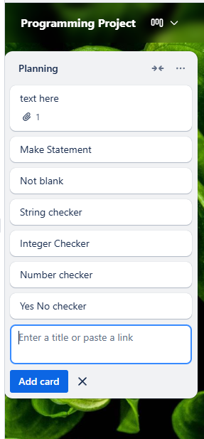
Decomposition
Notes:
Paste screenshots of your initial Trello/Padlet board / task decomposition on this slide. If you have a long list, you might need to break it up into several columns.

Slide 8
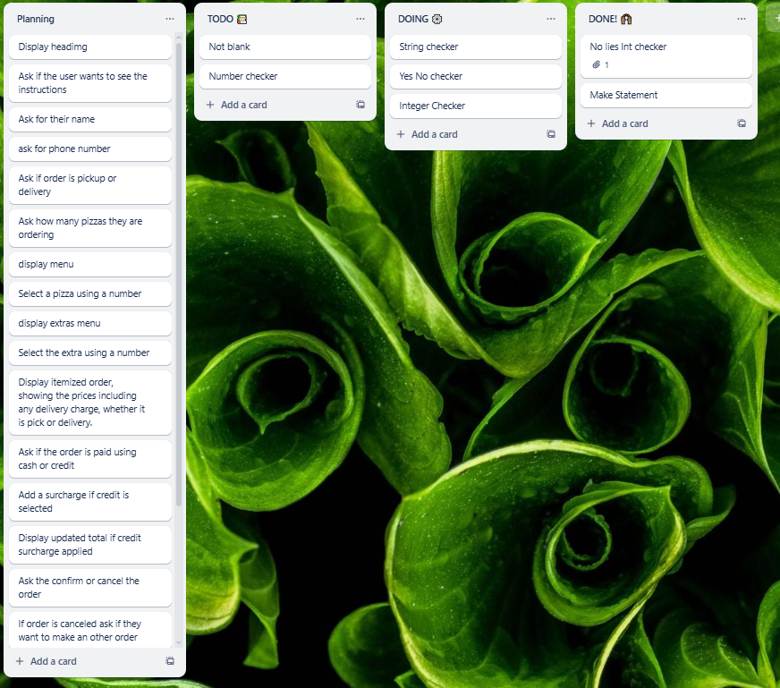
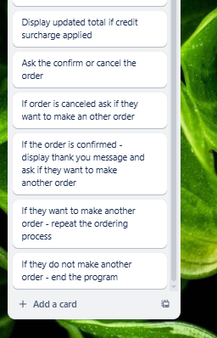
Updated Planning
Notes:
Add screenshots of your Trello/Padlet board showing any updates that have been made from the trialling and/or testing phases

Slide 9



Planning - Component 1
Notes:
Add screenshots of your Trello/Padlet board showing the planning for component 1

Slide 10
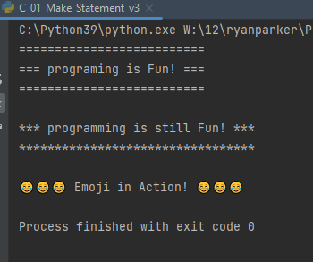
Component 1 - Test Plan (Trello and testing screenshot)
Data Input | Expected Output (What should happen)
Run the program | Program displays 3 different statements
Notes:
Include a screenshot of your testing that shows the output

Slide 11
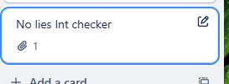
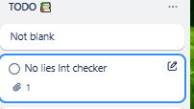

Planning - Component 2
Notes:
Add screenshots of your Trello/Padlet board showing the planning for component 1

Slide 12
Component 2 - Test Plan (Trello and testing screenshot)
Data Input | Expected Output (What should happen)
Enter key | Sorry, this can’t be blank. Please try again.
Bob | Bob
11 | {Name} is too young
121 | {Name} is too old
21 | {name} bought a ticket
Actual Output (What actually happened)
Notes:
Include a screenshot of your testing that shows the output

Slide 13
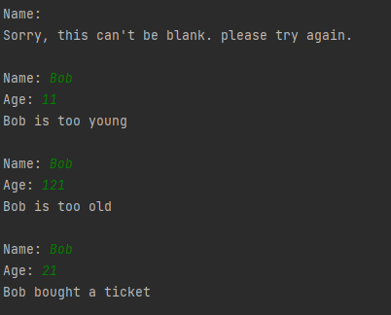
Component 2 - Test Plan (Trello and testing screenshot)
Actual Output (What actually happened)
Notes:
Include a screenshot of your testing that shows the output

Slide 14

Planning - Component 3
Notes:
Add screenshots of your Trello/Padlet board showing the planning for component 2

Slide 15
Component 3 - Test Plan (Trello and testing screenshot)
Data Input | Expected Output (What should happen)
11 | Oops - please enter a number between 1 and 10.
0 | Oops - please enter a number between 1 and 10.
5.5 | Oops - please enter a number between 1 and 10.
8 | You selected (pizza) $12
Actual Output (What actually happened)
Notes:
Include a screenshot of your testing that shows the output

Slide 16
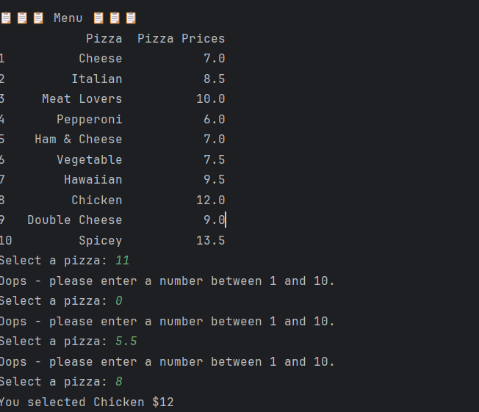
Testing - Component 3
Notes:
Add screenshots of your Trello/Padlet board showing the planning for component 2

Slide 17
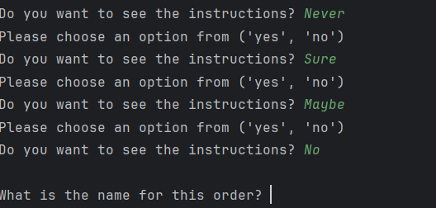

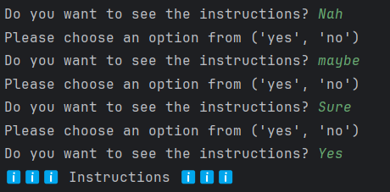

Component Trialing
Trialing my String check function
Notes:
Your trialing evidence should go here. Include screenshots and details about the different things you have trailed e.g. the three different ways that the make statement went through

Slide 18
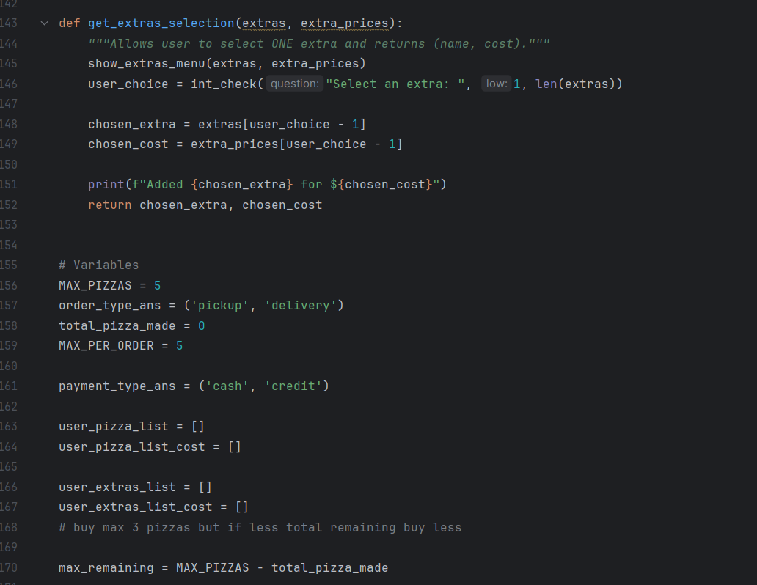
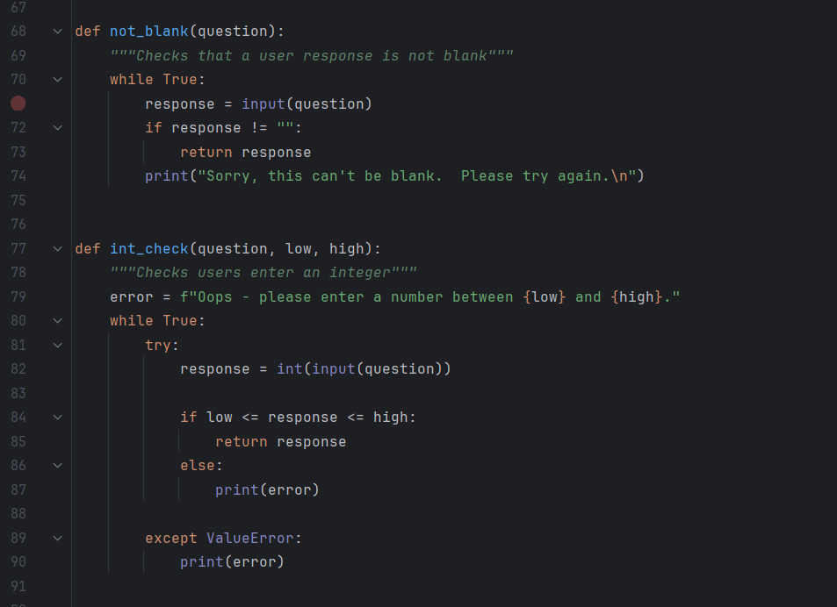
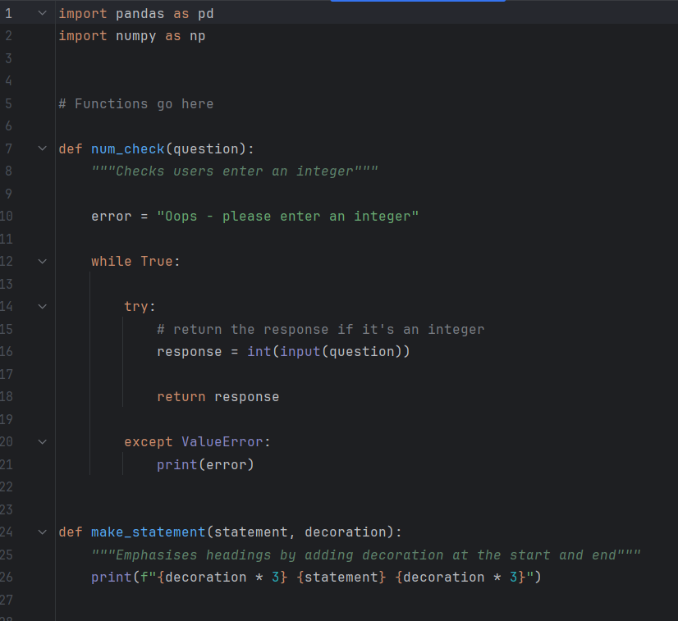
Work Log
I started working at 10:14 and worked on finishing extras: the ordering , the menu and the final list
Notes:
Each session you should note what you did and what you plan to do next. This is a useful habit that makes it easy to keep on track. Your log at the end of each session can match the comment you make when you commit your code to github :) e.g.
05/02 - finished number checking function. Starting the not blank function, uploaded file to GitHub
06/02 - finished the not blank function. Started adding the number checking and not blank functions to a main program file, uploaded file to GitHub

Slide 19




Component Trialing
Trialing my function for the user to pick ‘pickup’ or ‘delivery’
Notes:
Your trialing evidence should go here. Include screenshots and details about the different things you have trailed e.g. the three different ways that the make statement went through

Slide 20
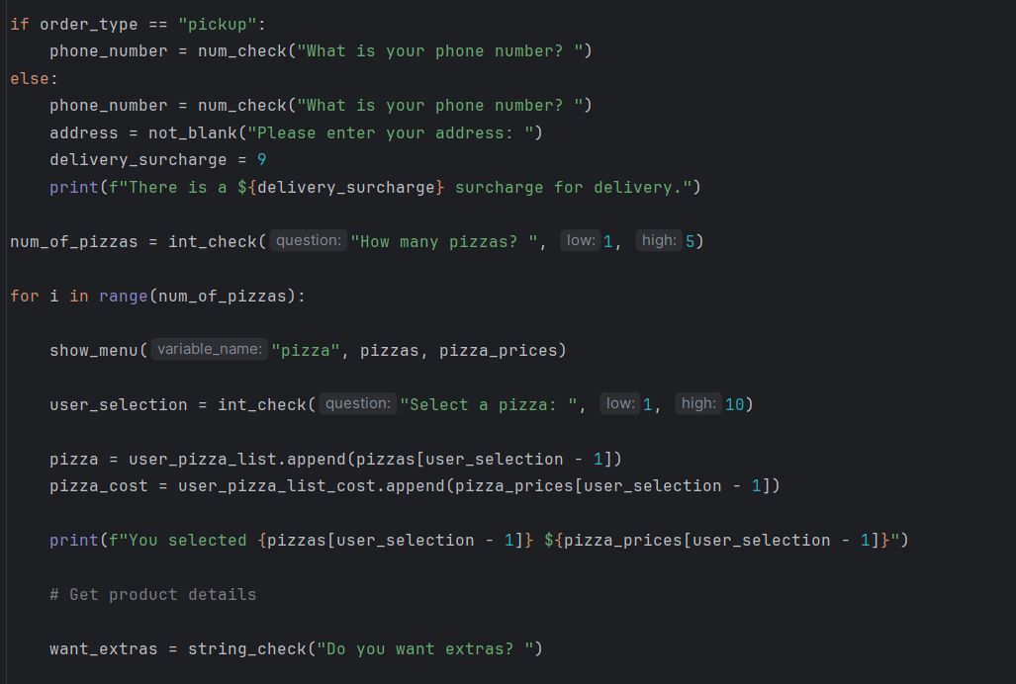
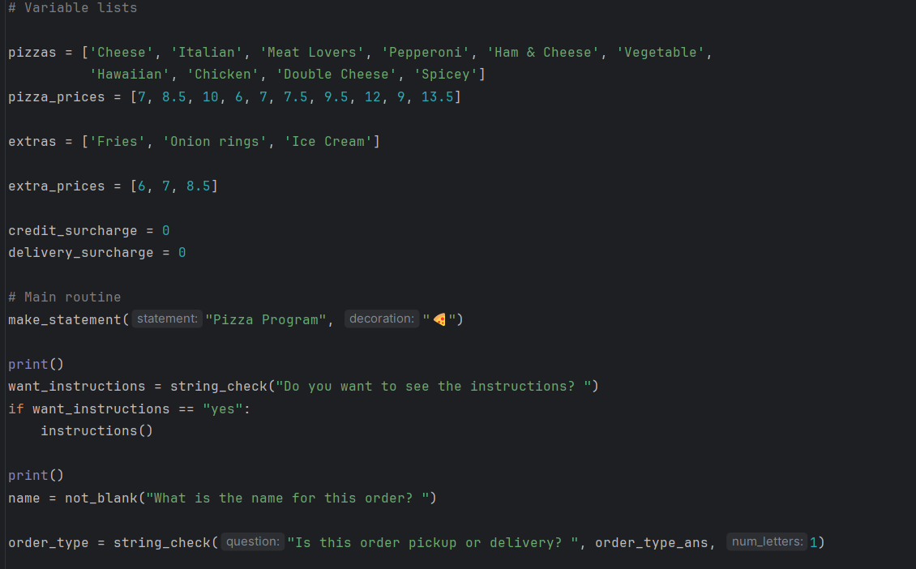
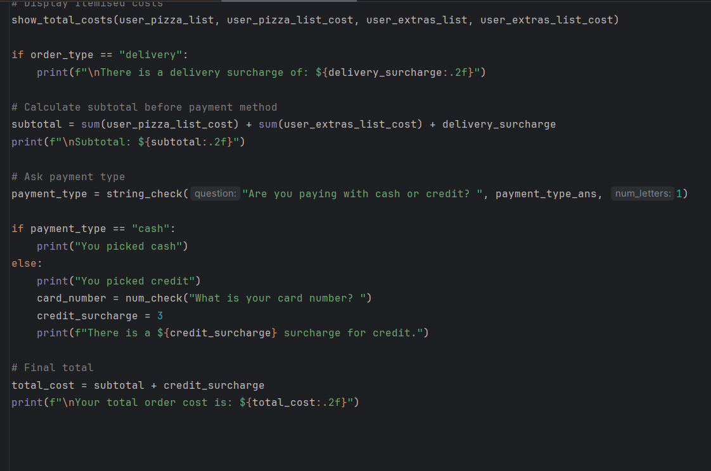
Work Log
I also did some tweaks with ordering extras
Today I started at 10:00 and worked on developing the payment function and implementing credit surcharges
Notes:
Each session you should note what you did and what you plan to do next. This is a useful habit that makes it easy to keep on track. Your log at the end of each session can match the comment you make when you commit your code to github :) e.g.
05/02 - finished number checking function. Starting the not blank function, uploaded file to GitHub
06/02 - finished the not blank function. Started adding the number checking and not blank functions to a main program file, uploaded file to GitHub

Slide 21
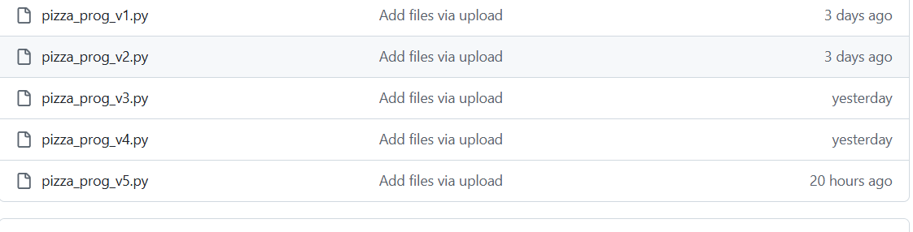
Version Control
I implemented version control by whenever I made a significant change I’d create a new version to have a backup in case the code broke, it also serves as a reference when I need to fix any previous code.
Notes:
Your version control evidence should go here. This could be in the form of annotated screenshots which show you you managed this process or you could make a brief screencast explaining how you implemented version control. GitHub screenshots or screenshots showing the different versions of the main program

Slide 22
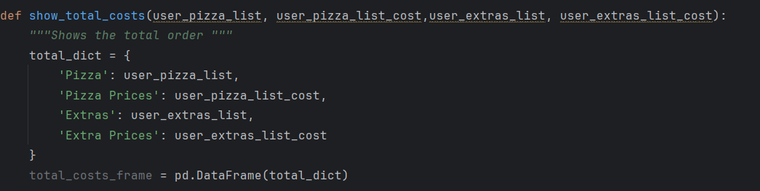
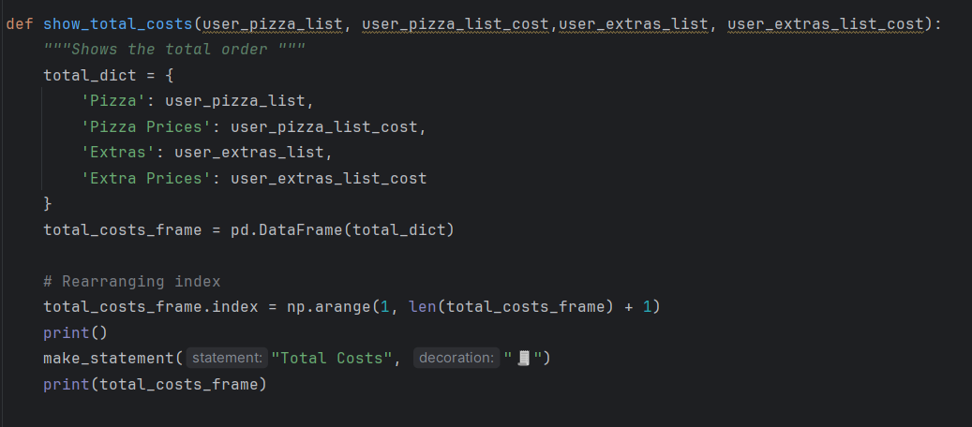
Improvements & Refinements
Refinement: Improved …. Show total cost function
Before | After
This improved the indexing in the dataframe in my original version the dataframe had the index starting at 0 instead of 1. In the improved version it starts at 1 making it more readable for users. Also the print() adds an extra line to prevent the Total Costs title from being right under the last displayed message. In the improved version, the code to display the users receipt is included, so users actually see the summary table of pizzas, extras, and costs.
Notes:
Add evidence of the improvements & refinements you have made through your testing and end user feedback. Add information about why you made the improvements

Slide 23
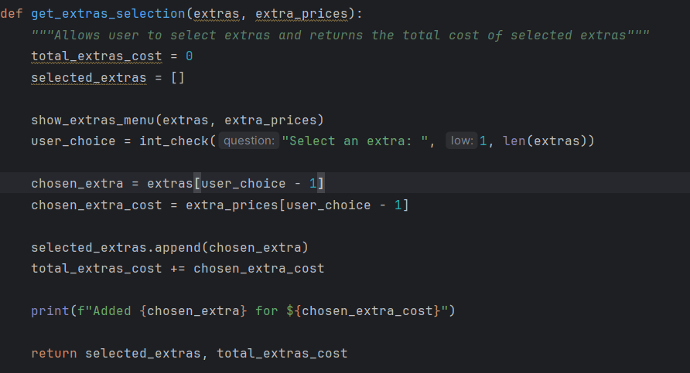
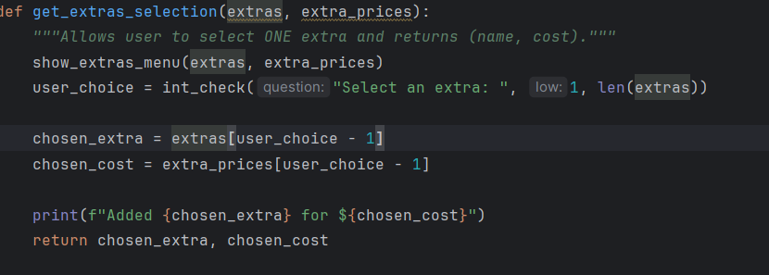
Improvements & Refinements
Refinement: Improved ….
Before | After
The refined version of this function is cleaner, more accurate, and easier to use. Instead of returning a list and a running total for just one item, it now directly returns a single extra and its cost as a tuple, which better reflects the actual function behavior. I also updated the docstring to clearly state that only one extra is selected, avoiding confusion (that caused a lot of frustration). I removed unnecessary variables and simplifying the return values, the improved code is shorter, more readable, and easier to maintain while still giving the user clear feedback about their choice.
Notes:
Add evidence of the improvements & refinements you have made through your testing and end user feedback. Add information about why you made the improvements

Slide 24
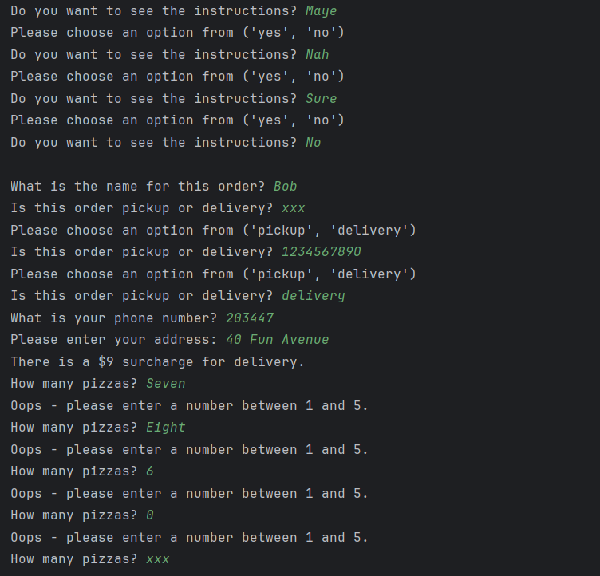
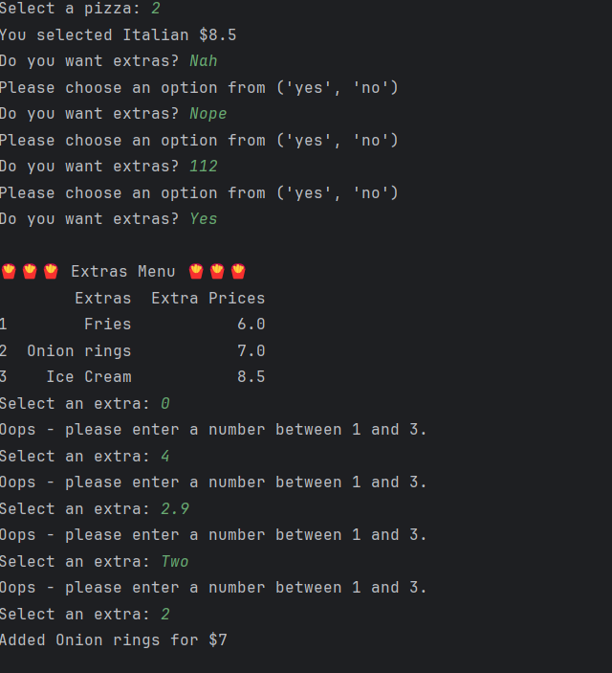
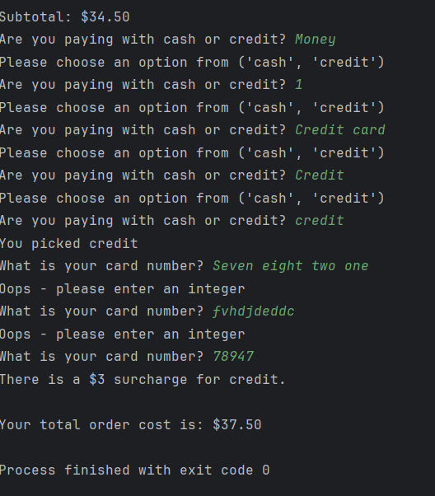
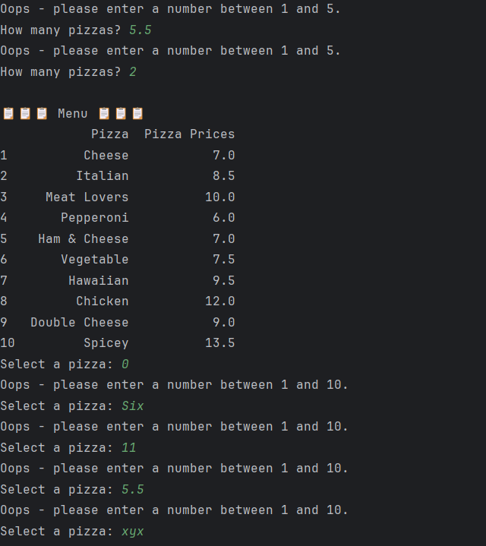
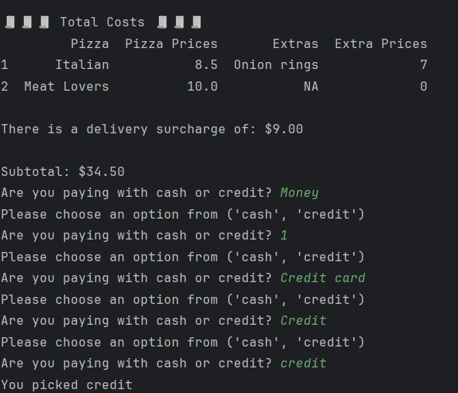
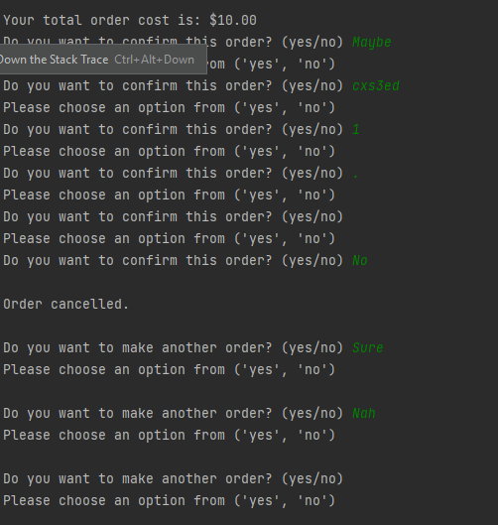
Comprehensive Testing Evidence - Final Program Version
Notes:
Add screenshots or a short video showing boundary testing (if the number range is 5 - 15, test for 4,5,15, 16 and xyz), invalid and unexpected input.

Slide 25
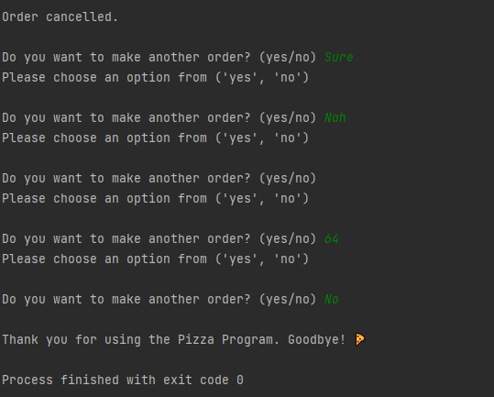
Comprehensive Testing Evidence - Final Program Version
Notes:
Add screenshots or a short video showing boundary testing (if the number range is 5 - 15, test for 4,5,15, 16 and xyz), invalid and unexpected input.

Slide 26
Discussion
Two significant things that helped me code this program was planning, testing and trialing. I used trello for my entire plan as it was an easy to use and had very simple features to understand and use. My planning contained a four step process which followed the stages of Planning, To Do, Doing, and Done. All the features I was going to add was put in the planning, A couple examples from the planning section include “Display heading”, “Ask for their name”, “yes no”, and “integer checker”. The next step was moving the ones that I was going to do into the to do phase. The next step was to move the ones I was currently coding into the doing phase to have it their while I coded to keep track of what feature I was on. The final step was to move them into the Done phase which was done once I completed a feature and integrated it into the code successfully. This planning allowed me to stay on top of my coding and keep track of my progress.
Notes:
Discusses how the information from planning, testing and trialling of components assisted in the development of a high-quality outcome

Slide 27
Discussion
The second significant thing that helped me code this program was testing and trialing. An example of this being done in my program was my total_costs function which I constantly had to make improvements to keep it working in the final program, testing brought forward errors and allowed me to go back and fix what needed to be fixed, the trialling let me work on the function to perfect it. What I did to test it was order pizzas and extras in different way and different wording to see what would break it and what wouldn’t. An example of what broke it before I fixed it was ordering fries, instead of fries you would get Ice cream, in the final list so I looked at my code and found that a variable had the wrong value. This constant testing and trialling allowed me to identify problems early and stopped me from having to fix it all at the end.
Notes:
Discusses how the information from planning, testing and trialling of components assisted in the development of a high-quality outcome

