Slide 1
91906 & 91907 Complex Programming
Trello board / Project Management: https://trello.com/invite/b/67e30bbf8234412ebe7e0454/ATTI511f2eba1976d9d5b5e2dbcc86d2bf5f579893F3/numberguesser
The project on Github: https://github.com/amaya26/number_guesser
Final Project Filename: number_guesser_v4
Final Testing Video: Artist Guesser Testing.webm
Notes:
Please add links to your work on this slide

Slide 2
Project Management
I am using Trello to manage my project because it allows me to sort my tasks into separate components and break them down. I can also check off tasks that have been completed to keep track of what I need to do. This aids with time management and ensures I complete everything in a logical sequence, without forgetting any steps or components.
Using this tool helped me to follow the Agile project management methodology. Trello allowed me to break the program into small components, which then enabled me to iteratively develop, test, and improve each component separately. Breaking it into smaller tasks also allowed me to easily plan my sprints (short cycles of developing and testing) to ensure that each component was completed within the time frame. Without this approach to project management, I would have struggled to know how to begin the project and likely would have run out of time to build a fully functional program.
I used the following sprint tracking slides as another project management tool to ensure I met my target dates for completion, and always knew what the next steps were.
Notes:
Brief description of the project management methodology

Slide 3
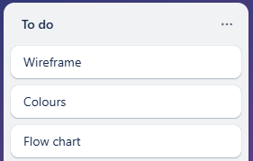
Project Management - Sprint Tracking
Task | Sprint Number | Start Date | End Date
Wireframe and flowchart | 1 | 26/3 | 2/4
What are you working on? | What did you achieve? | What are the next steps?
Planning and setting up to start coding. | I made a simple wireframe using my colour scheme and broke down my project into a flowchart. | Begin coding each component, starting with get rounds.
Evaluation - what worked well & what did not?
Making the flowchart was difficult with the initial program I used. Switching to draw.io was more effective.
Notes:
Add information about how your project is progressing - Sprint tracking

Slide 4
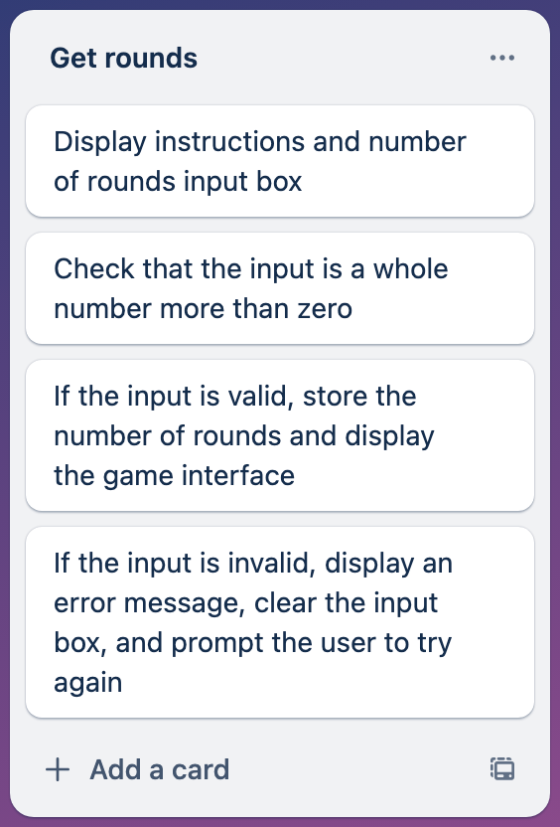
Project Management - Sprint Tracking
Task | Sprint Number | Start Date | End Date
Get rounds | 2 | 3/4 | 10/4
What are you working on? | What did you achieve? | What are the next steps?
Planning, coding, and testing the get rounds component | I created the component and tested it, then made a second, improved version. | Create the user interface
Evaluation - what worked well & what did not?
The component worked well, but after testing, I decided to put a limit on the number of rounds. This meant coding and testing a 2nd version.
Notes:
Add information about how your project is progressing - Sprint tracking

Slide 5
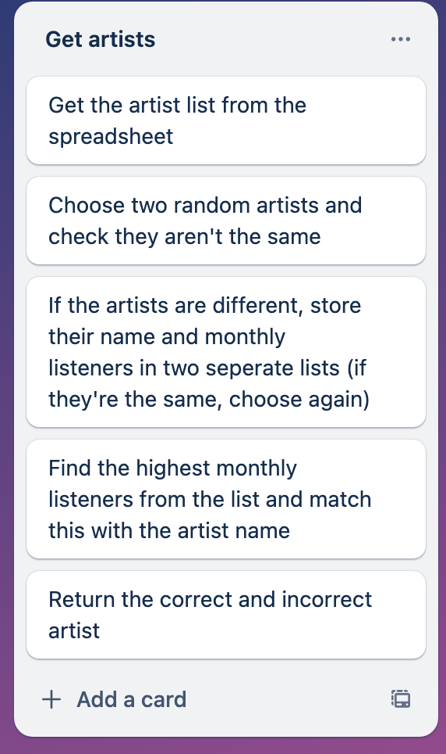
Project Management - Sprint Tracking
Task | Sprint Number | Start Date | End Date
Get artists and check answer | 3 | 11/4 | 27/4
What are you working on? | What did you achieve? | What are the next steps?
Retrieving the artists from the csv file and finding the correct one | I created the get artists component, and then built upon that to get the correct answer | Creating a usable game interface and incorporating these components into it.
Evaluation - what worked well & what did not?
This component took a long time as there were multiple issues. The csv had unreadable characters and the program was choosing the wrong answer. Once the component was working, I found the csv file was really useful in being able to edit as needed.
Notes:
Add information about how your project is progressing - Sprint tracking

Slide 6
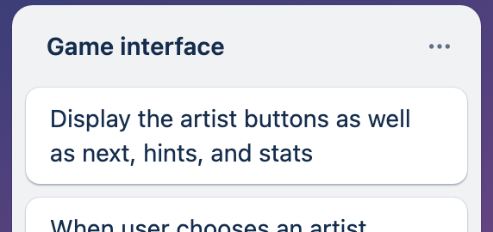
Project Management - Sprint Tracking
Task | Sprint Number | Start Date | End Date
Game interface | 4 | 28/4 | 1/5
What are you working on? | What did you achieve? | What are the next steps?
Creating the game interface component based on my wireframe. | I created buttons and added them to the GUI in the correct colours/positioning to match my wireframe. The buttons aren’t yet functioning. | Making the buttons function by adding in the components I’ve already created (and the hints and stats components).
Evaluation - what worked well & what did not?
It was easy to change the colour, font, and positioning of my buttons until they matched my wireframe.
Notes:
Add information about how your project is progressing - Sprint tracking

Slide 7
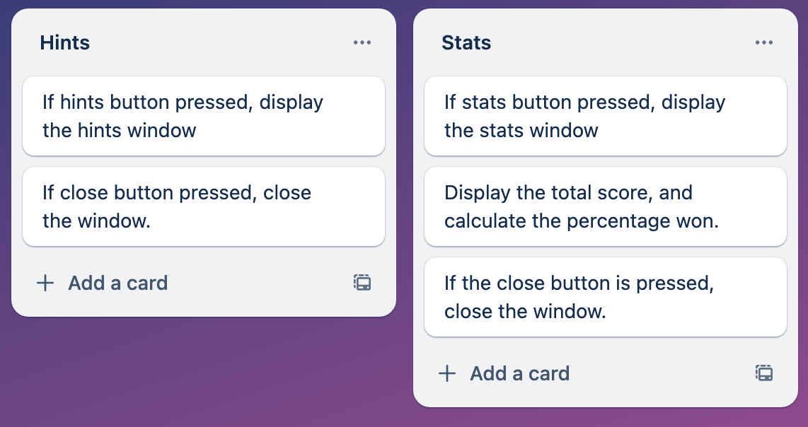
Project Management - Sprint Tracking
Task | Sprint Number | Start Date | End Date
Hints and stats | 5 | 1/5 | 7/5
What are you working on? | What did you achieve? | What are the next steps?
Creating both the hints and stats components. | I created a clickable hints button and wrote the help text. I also created a clickable stats button with the logic to calculate the user’s score. | Integrate these into the base component.
Evaluation - what worked well & what did not?
Hints and stats both function similarly so I was able to create the hints component first, and then copy it with some small changes to create the stats component.
Notes:
Add information about how your project is progressing - Sprint tracking

Slide 8
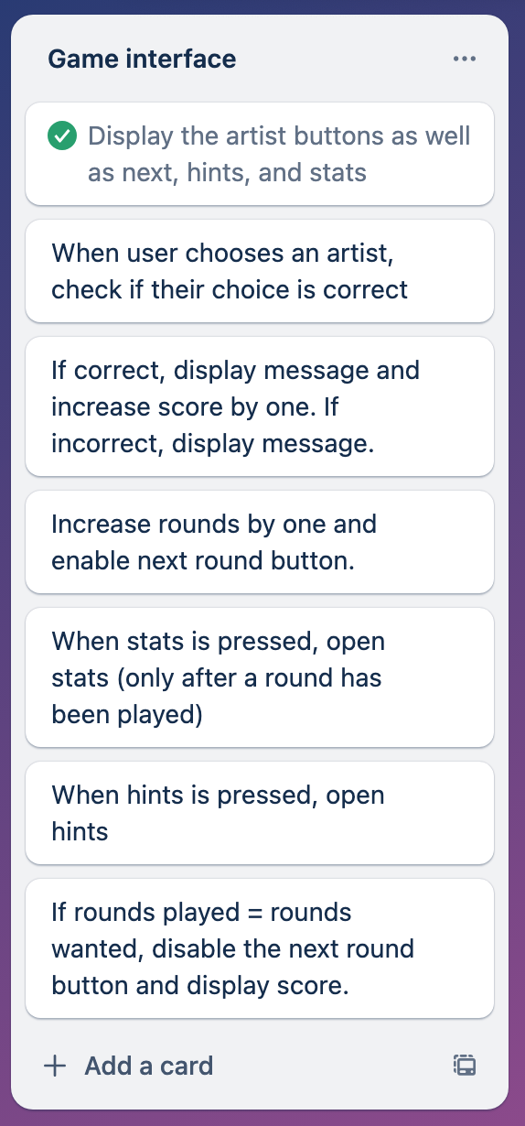
Project Management - Sprint Tracking
Task | Sprint Number | Start Date | End Date
Integrating all components | 6 | 8/5 | 14/5
What are you working on? | What did you achieve? | What are the next steps?
Integrating my components into the final outcome and testing as I go | I implemented get artists first so that the program displayed two artists and checked for the correct answer. Once that was functioning, I ensured my other buttons were functioning, using the hints and stats component. | User testing and refining.
Evaluation - what worked well & what did not?
Bringing in the components I’d already created was efficient as I didn’t have to write too much extra code to get the entire program working. Breaking it down into small components had made it more manageable.
Notes:
Add information about how your project is progressing - Sprint tracking

Slide 9
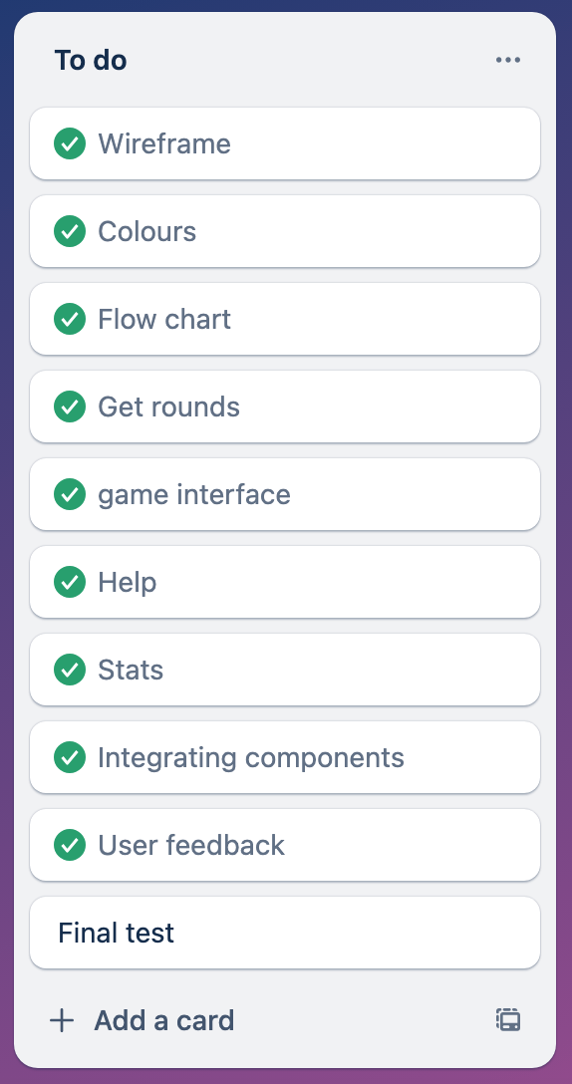
Project Management - Sprint Tracking
Task | Sprint Number | Start Date | End Date
Refining and testing | 6 | 15/5 | 19/5
What are you working on? | What did you achieve? | What are the next steps?
Making changes based on user testing | I got feedback from me peers who suggested that I add an end game button. I implemented this then got feedback from my parents who said that the hints window was difficult to read. | Implement feedback and do final testing.
Evaluation - what worked well & what did not?
The feedback was helpful for improving my project to suit all users.
Notes:
Add information about how your project is progressing - Sprint tracking

Slide 10
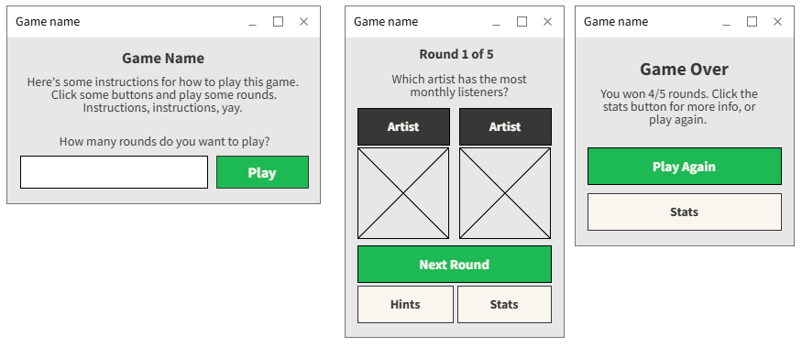
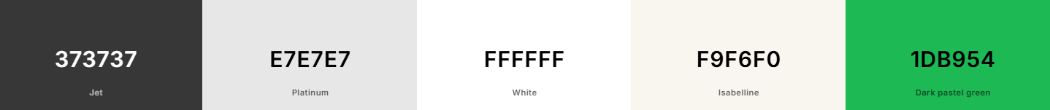
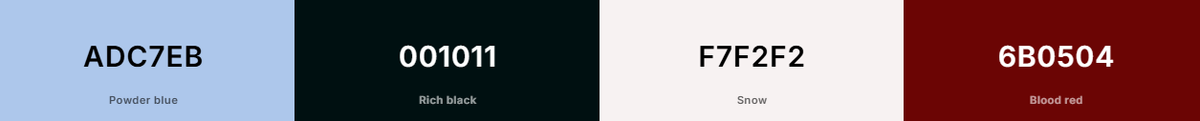
Graphical User Interface Design...
I considered the colour palettes below as I wanted a soft, modern look. Eventually I went with the green one as it’s similar to the colours used by Spotify, making the connection clear to the user, without infringing copyright.
Notes:
Create wireframes for your program’s GUI. Please place them on this slide.

Slide 11
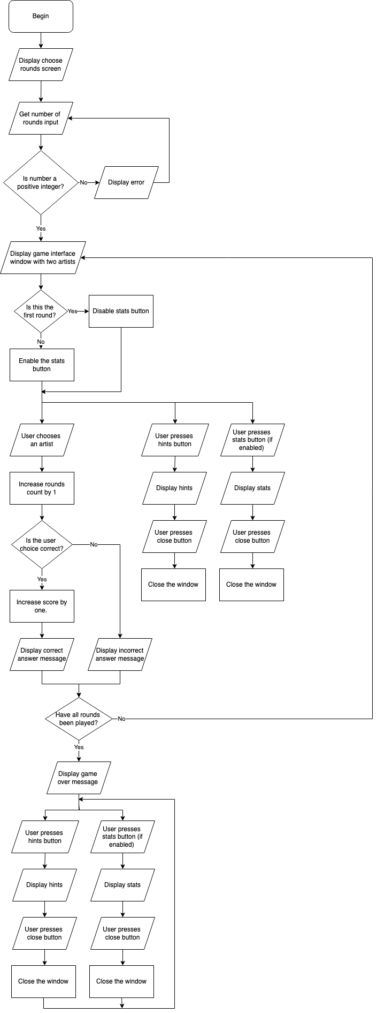

Program Structure
After user feedback, I added one more button to this structure. If the user clicks the end button (available next to stats and hints), the game interface closes and the start screen appears, prompting the user to enter a number of rounds.
Notes:
Create a diagram showing your program’s structure and outline the classes and functions that you plan on developing. You are welcome to edit this slide once you start developing the outcome BUT when you do that, you should show what has changed and explain why those changes were needed.

Slide 12
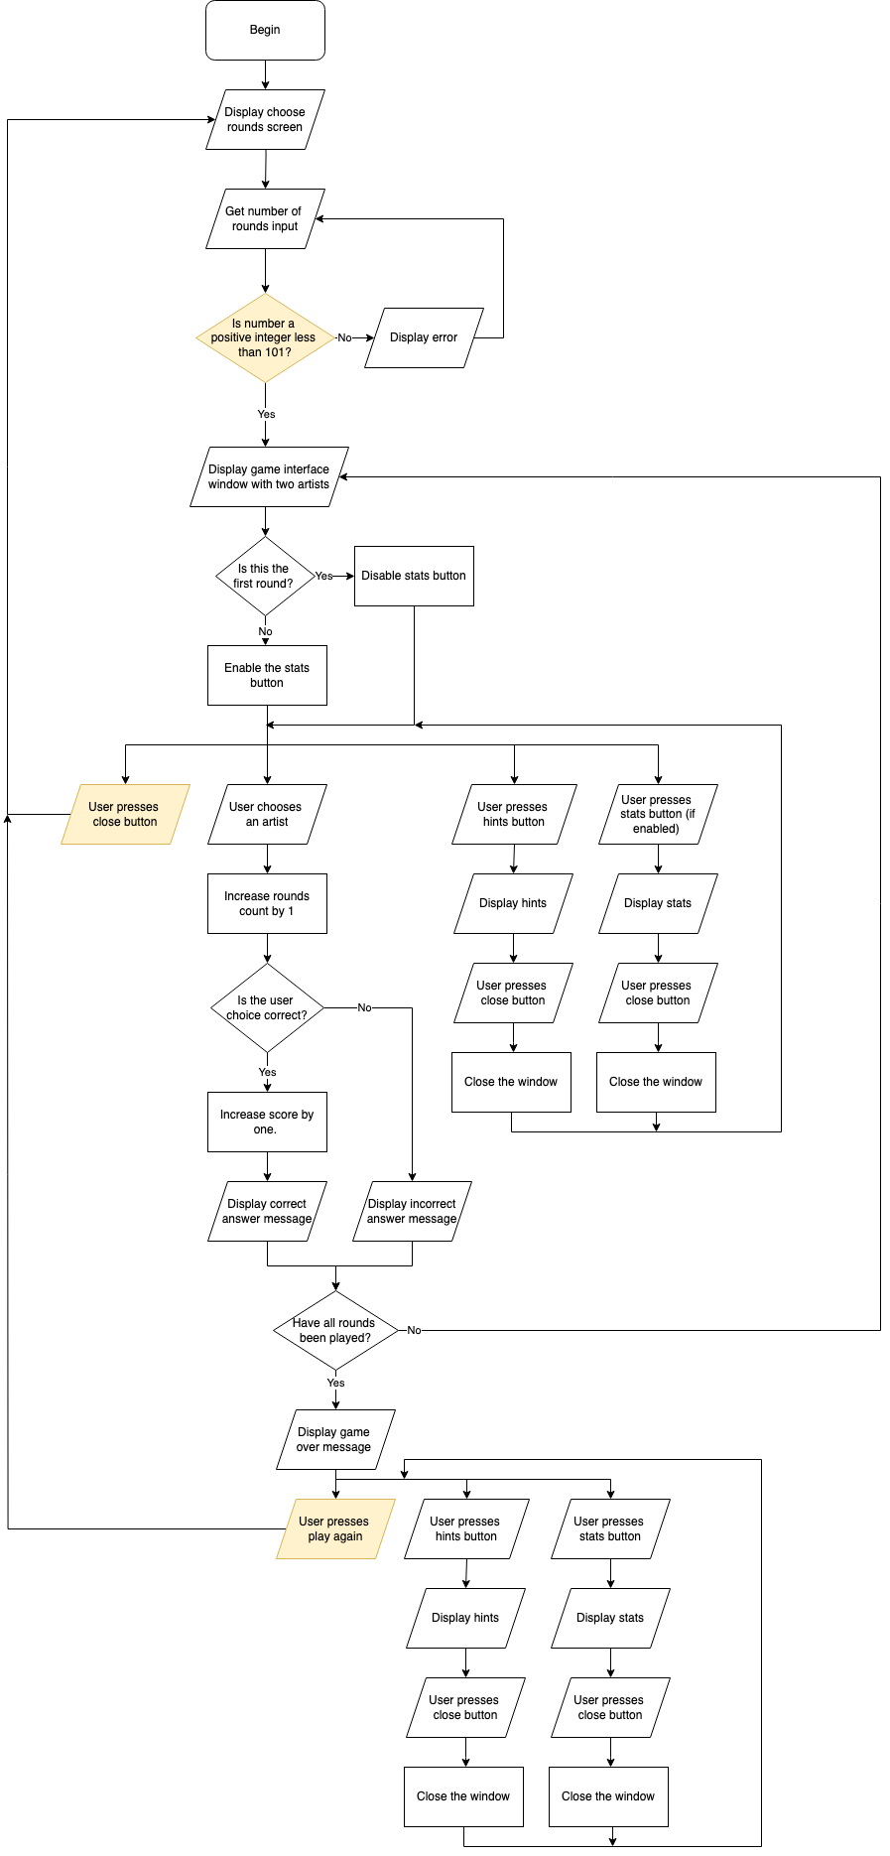
Program Structure
Here is the final program structure after changes (highlighted in yellow)
Notes:
Create a diagram showing your program’s structure and outline the classes and functions that you plan on developing. You are welcome to edit this slide once you start developing the outcome BUT when you do that, you should show what has changed and explain why those changes were needed.

Slide 13
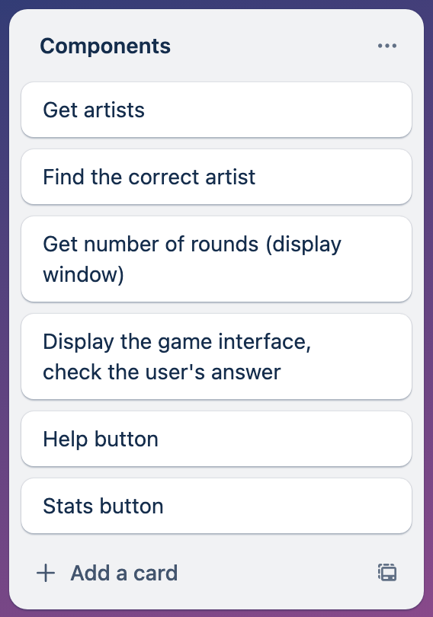
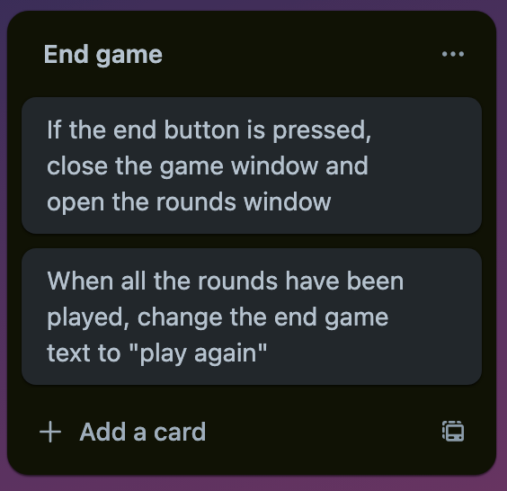
Problem Decomposition
My original components are listed here. After user testing, I added a component that ends the game.
Notes:
Provide evidence showing that you have decomposed the task. This can be in the form of a trello screenshot or a list of components. If necessary, you may revisit this slide and add to it / edit it as you create your outcome. When you make changes to this slide, please do so in a different colour, date the changes and explain why they were made (this can help provide evidence for M / E grades).
Hint: Use the structure you developed earlier to work out what components you need. For each function, you should have at least one component.

Slide 14
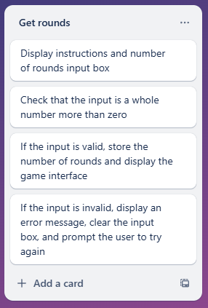
Component 1 - Get rounds
I made two versions of this component. Version 2 has a limit to the number of rounds the user can enter. This was to avoid overloading the program and to address the ethical implication of users spending too long on the game, which could negatively impact mental health.
Notes:
Duplicate this slide and use it to show your planning for the current component. This could be in the form of a trello screenshot.

Slide 15
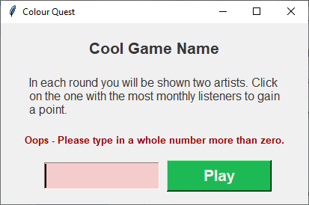
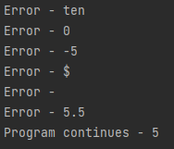
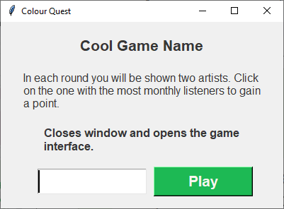
Get Rounds Test Plan - version 1
Data input | Expected output
ten | Error - ten (GUI displays error message)
0 | Error - 0 (GUI displays error message)
-5 | Error - -5 (GUI displays error message)
$ | Error - $ (GUI displays error message)
(blank) | Error - (GUI displays error message)
5.5 | Error - 5.5 (GUI displays error message)
5 | Program continues - 5 (GUI displays message)
For testing purposes, the program printed the user input, and how the system would respond.
“Error” corresponds to the message displayed in the GUI.
“Program continues” is a placeholder which will lead to the game interface window opening once incorporated into the final outcome.
Notes:
Create a test plan for this component BEFORE you start coding. Your plan should allow you to test all logical pathways for this component. It should also include test cases for relevant boundary and unexpected values.

Slide 16
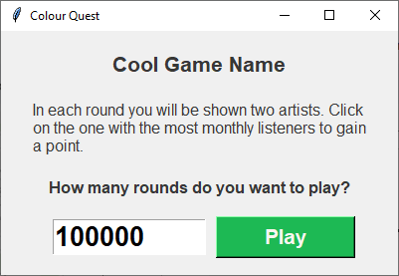
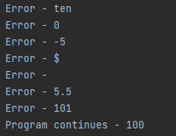
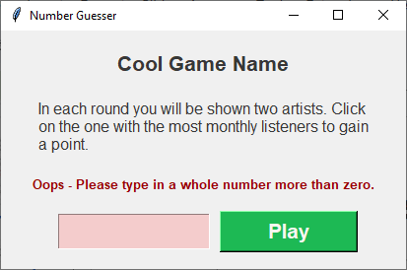
Get Rounds Test Plan - version 2
Data input | Expected output
ten | Error - ten (GUI displays error message)
0 | Error - 0 (GUI displays error message)
-5 | Error - -5 (GUI displays error message)
$ | Error - $ (GUI displays error message)
(blank) | Error - (GUI displays error message)
5.5 | Error - 5.5 (GUI displays error message)
5 | Program continues - 5 (GUI displays message)
101 | Error - 101 (GUI displays error message)
100 | Program continues - 100 (GUI displays message)
I added a limit of 100 rounds. Previously, the user could play unlimited rounds, which could lead to overloading the program.
The program now displays an error message when the user enters a number higher than 100.
Notes:
Create a test plan for this component BEFORE you start coding. Your plan should allow you to test all logical pathways for this component. It should also include test cases for relevant boundary and unexpected values.

Slide 17
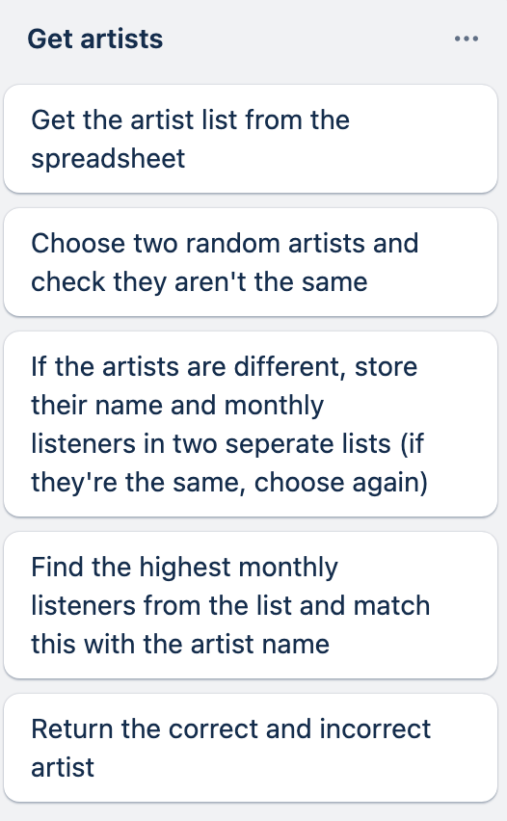
Component 2 - Get artists
This component stores all the data from the csv in a list, then chooses two artists to display to the user. I was initially planning on having this component and the get answers component combined, but I found breaking them down further was more effective in being able to test and improve them.
This means the last two cards on my trello board are handled in the next component.
Notes:
Duplicate this slide and use it to show your planning for the current component. This could be in the form of a trello screenshot.

Slide 18

Get artists testing - version 1
To test this I initially used a CSV file with only three artists.
This was to check that my program could get the artists from the csv file and correctly add them to a list, then choose two random artists from the list.
Since it’s random, the output can’t be predicted, and there’s no user input, to test, I ran the program and checked that the list content was correct.
I discovered that the user could be given two of the same artist to choose between. I fixed this in version 2.
The program got the artists from the csv file correctly.
Notes:
Create a test plan for this component BEFORE you start coding. Your plan should allow you to test all logical pathways for this component. It should also include test cases for relevant boundary and unexpected values.

Slide 19
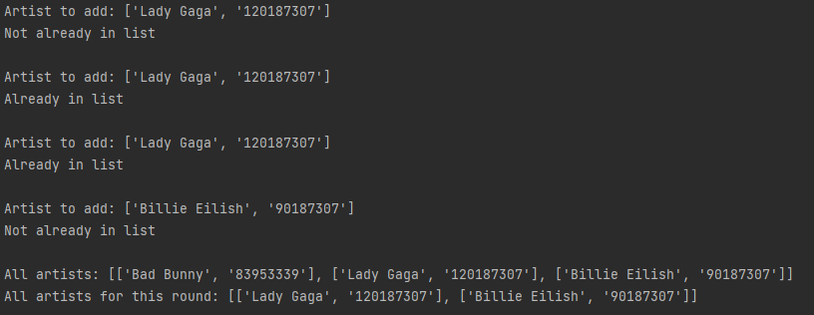
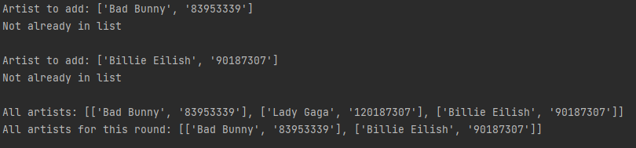
Get artists testing - version 2
In this version I fixed the issue with the same artist printing twice.
This component output is random so instead of a test plan, I made the program print whether the artist was already in the list of artists that round.
Running the program a few times showed that it was correctly checking for the artist.
Notes:
Create a test plan for this component BEFORE you start coding. Your plan should allow you to test all logical pathways for this component. It should also include test cases for relevant boundary and unexpected values.

Slide 20
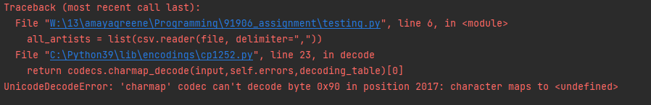
Get artists testing - version 2 (continued)
Once version 2 was working, I switched from my test csv to the actual csv file. When I switched to the actual artists csv file, I encountered an error.
I discovered this was because the characters from my google spreadsheet were changed when the sheet was downloaded to a csv file.
I changed these characters and the error was resolved.
Notes:
Create a test plan for this component BEFORE you start coding. Your plan should allow you to test all logical pathways for this component. It should also include test cases for relevant boundary and unexpected values.

Slide 21
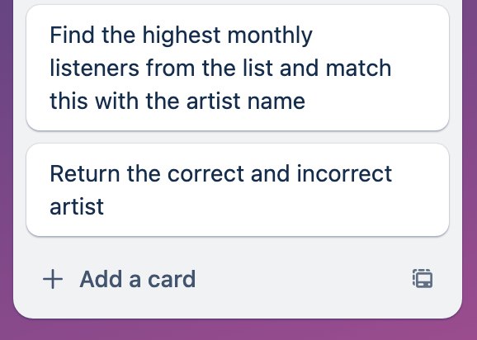
Component 4 - Get answer
This component added on to the preexisting get artists component. It takes the artist list and finds the highest monthly listeners, then uses that to identify the name of the correct artist.
Notes:
Duplicate this slide and use it to show your planning for the current component. This could be in the form of a trello screenshot.

Slide 22


Get answer test plan - version 1
The program compared the monthly listeners incorrectly sometimes, causing it to mix up the correct answer, as seen in the testing below. I discovered that it was treating the monthly listeners as a string instead of an integer, meaning it compared the first digit. Eg. 900 is higher than 1000 as it begins with 9. I fixed this in version 2.
Input (contents of round artists list) | Expected output (correct and incorrect) | Actual output
Lady Gaga, 120187307, Billie Eilish, 90187307 | Correct: Lady Gaga Incorrect: Billie Eilish | Correct: Billie Eilish Incorrect: Lady Gaga
Bad Bunny, 8953339, Billie Eilish, 90187307 | Correct: Billie Eilish Incorrect: Bad Bunny | Correct: Billie Eilish Incorrect: Bad Bunny
(Billie Eilish and Lady Gaga gave the incorrect answer, while Billie Eilish and Bad Bunny worked)
Notes:
Create a test plan for this component BEFORE you start coding. Your plan should allow you to test all logical pathways for this component. It should also include test cases for relevant boundary and unexpected values.

Slide 23

Get answer test plan - version 2
Previously, the program compared the artists monthly listeners incorrectly as shown below…
Converting the listeners value to an integer fixed this issue
I ran the program a few times with the test data, printing the lists each time to check that this fix worked.
To solve this error I researched some solutions and asked our student teacher for help. My discussion covers the process I went through to fix the problem.
Input (contents of round artists list) | Expected output (correct and incorrect) | Actual output
Lady Gaga, 120187307, Billie Eilish, 90187307 | Correct: Lady Gaga Incorrect: Billie Eilish | Correct: Lady Gaga Incorrect: Billie Eilish
Bad Bunny, 8953339, Billie Eilish, 90187307 | Correct: Billie Eilish Incorrect: Bad Bunny | Correct: Billie Eilish Incorrect: Bad Bunny
Notes:
Create a test plan for this component BEFORE you start coding. Your plan should allow you to test all logical pathways for this component. It should also include test cases for relevant boundary and unexpected values.

Slide 24
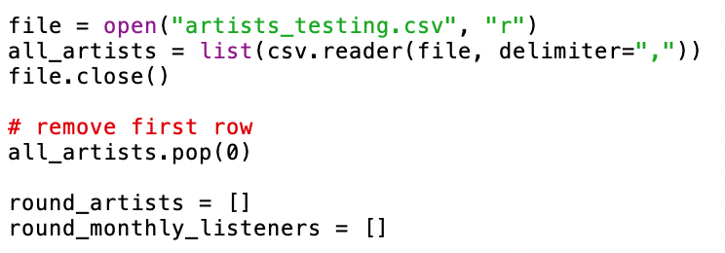
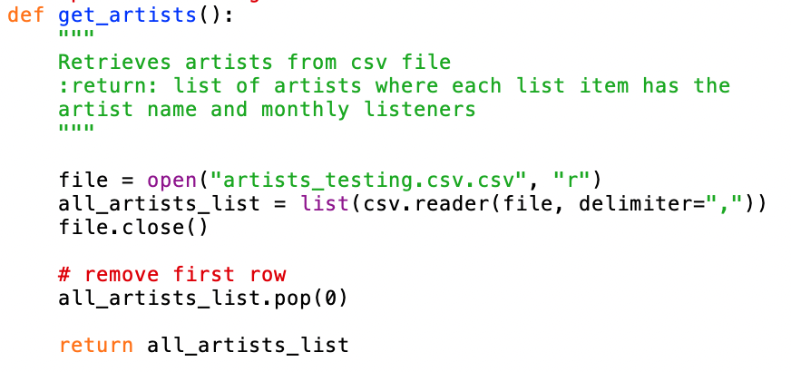
Get answer - version 2 (continued)
Another key change in this version was switching my get artists component into a function. I trialled the component without using a function in the previous version, however I think this will be a more efficient way to structure my program. Now that the csv reading is in a function, I can call that function and use the list of artists at any time without duplicating the code, which will be especially useful once it’s integrated into my final outcome. It also makes the program easier to update. For example, if the csv file changes then I only have to change it once.
Version 1
Version 2
Notes:
Create a test plan for this component BEFORE you start coding. Your plan should allow you to test all logical pathways for this component. It should also include test cases for relevant boundary and unexpected values.

Slide 25
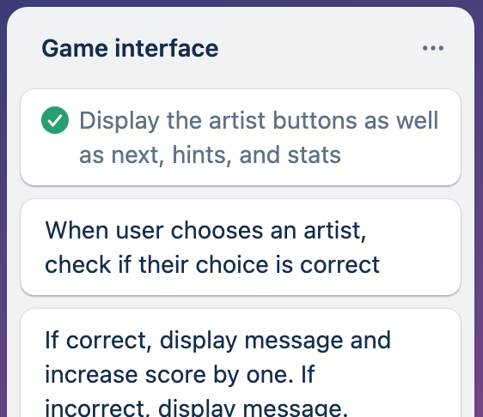
Component 5 - Game interface
The component tested here is the visuals of the final outcome GUI without any of my other components integrated. I created it so that I would have a base component with the necessary buttons. The buttons will become functional once I integrate the other components but for now, I’m just testing that it displays everything correctly.
Notes:
Duplicate this slide and use it to show your planning for the current component. This could be in the form of a trello screenshot.

Slide 26
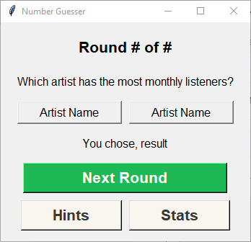
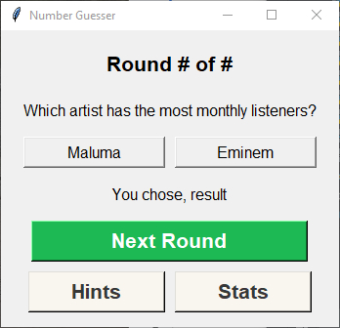
Game interface testing
My game interface:
Wireframe game interface:
In version 2 I integrated the get artists and get answers components so that I had less to integrate into my final outcome.
The key difference between my wireframe and actual interface is the artist images. Based on my sprint tracking, I realised I wouldn’t have time to find an image for each artist and incorporate images into my GUI. I decided to focus on my other components and come back to this if I had time. This decision helped me to manage my time better and focus on the most important tasks for functionality.
Notes:
Create a test plan for this component BEFORE you start coding. Your plan should allow you to test all logical pathways for this component. It should also include test cases for relevant boundary and unexpected values.

Slide 27
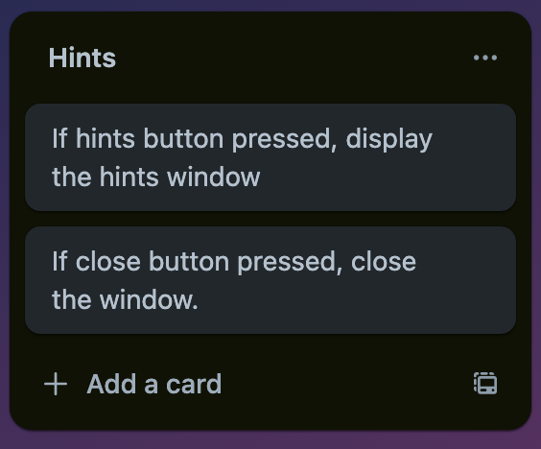
Component 6 - Hints
This component displays hints for the user on how to use the game. It’s similar to the stats component, which helped me to be time efficient as I was able to duplicate and edit the hints component instead of making an entirely new one for stats.
Notes:
Duplicate this slide and use it to show your planning for the current component. This could be in the form of a trello screenshot.

Slide 28
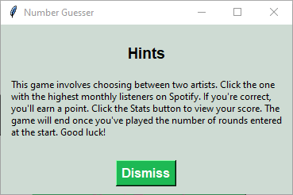
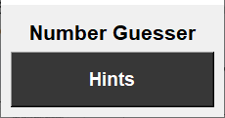

Hints Test Plan
Input | Expected output
Presses the hints button | Open the window (game interface stays open)
Presses the dismiss button | Closes the window
Presses the x button | Closes the window
Both my buttons functioned as expected. If the user presses the x in the top right corner, the window also closes.
For testing purposes I had program print confirmation when each button was pressed.
Notes:
Create a test plan for this component BEFORE you start coding. Your plan should allow you to test all logical pathways for this component. It should also include test cases for relevant boundary and unexpected values.

Slide 29
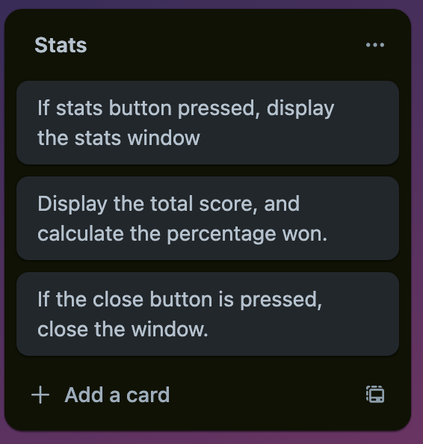
Component 7 - Stats
This component displays a stats window with the score and rounds won as a percentage. When integrated into the final outcome, it will need to be disabled until at least one round has been played. This will be tested in my final outcome testing.
Notes:
Duplicate this slide and use it to show your planning for the current component. This could be in the form of a trello screenshot.

Slide 30
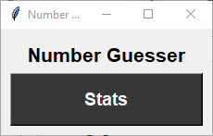
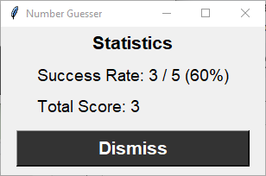

Stats Test Plan
Both my buttons functioned as expected. If the user presses the x in the top right corner, the window also closes.
For testing purposes I had program print confirmation when each button was pressed.
Input | Expected output
Presses the stats button | Open the window (game interface stays open)
Presses the dismiss button | Closes the window
Presses the x button | Closes the window
Notes:
Create a test plan for this component BEFORE you start coding. Your plan should allow you to test all logical pathways for this component. It should also include test cases for relevant boundary and unexpected values.

Slide 31
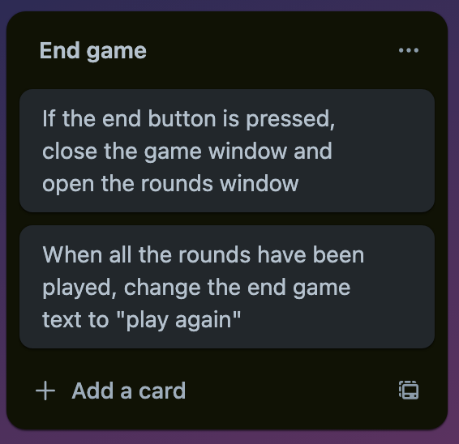
Component 8 - End game
This component was a new addition after my first round of user testing. It’s a button available while the usr is playing the game that takes them back to the choose rounds window. At the end of a game, the button text switches to Play Again.
Notes:
Duplicate this slide and use it to show your planning for the current component. This could be in the form of a trello screenshot.

Slide 32
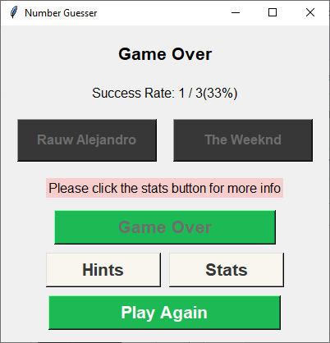
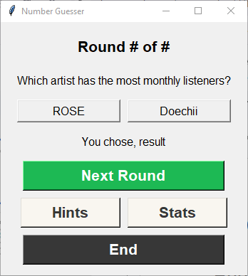

End game Test Plan
When all rounds have been played, the button switches to Play Again. This also functions as expected.
Input | Expected output
Presses the end button | Close the window - open the rounds window
Presses play again | Close the window - open the rounds window
Pressing End closes the window, as confirmed in my testing text
Notes:
Create a test plan for this component BEFORE you start coding. Your plan should allow you to test all logical pathways for this component. It should also include test cases for relevant boundary and unexpected values.

Slide 33
Final outcome versions
I put my final program together in steps. This was to keep track of if everything was integrating properly. I regularly checked that the program worked as expected before integrating another component.
Functions for one round - (Get rounds leading to game interface with get artists and get answers)
Functions for multiple rounds with working buttons - (hints and stats incorporated and button commands work)
Any extra refinements based on user testing
After version 3, I decided another round of testing was needed, so there are four versions of my final outcome.
Notes:
Duplicate this slide and use it to show your planning for the current component. This could be in the form of a trello screenshot.

Slide 34
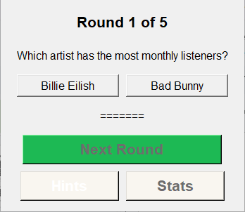
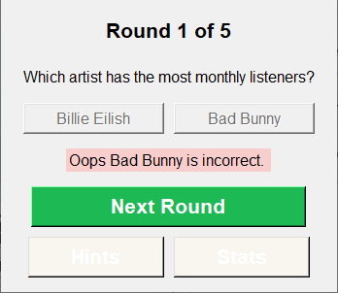
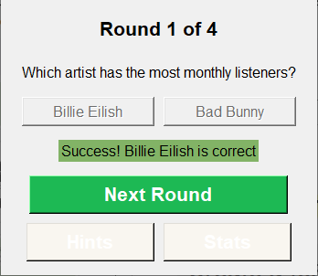
Final outcome testing version 1
Stage 1 of assembling my final outcome. The program functions for one round - (Get rounds leading to game interface with get artists and get answers)
I incorporated the get rounds, get artists, get answer, and game interface functions. The game functions for one round, but none of the buttons are functioning.
Notes:
Create a test plan for this component BEFORE you start coding. Your plan should allow you to test all logical pathways for this component. It should also include test cases for relevant boundary and unexpected values.

Slide 35
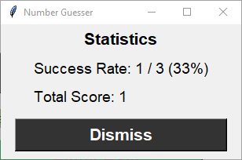
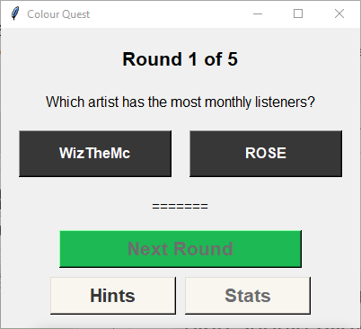
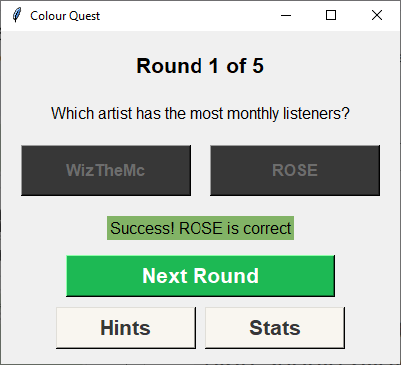
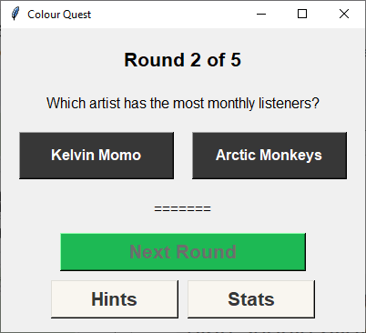
Final outcome testing version 2
The program functions for multiple rounds with working buttons - (hints and stats incorporated and button commands work)
I incorporated the rest of my components and tested. The program functions correctly for multiple rounds. Hints and stats buttons work.
Artists are displayed: Correct/incorrect works: A new round begins:
Notes:
Create a test plan for this component BEFORE you start coding. Your plan should allow you to test all logical pathways for this component. It should also include test cases for relevant boundary and unexpected values.

Slide 36
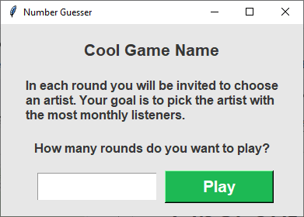
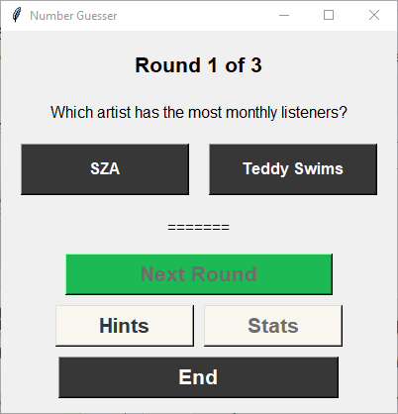
Final outcome testing version 3
I added the End game button and Play Again in version three after user testing with my peers. These buttons function, as shown in the component testing
Notes:
Create a test plan for this component BEFORE you start coding. Your plan should allow you to test all logical pathways for this component. It should also include test cases for relevant boundary and unexpected values.

Slide 37
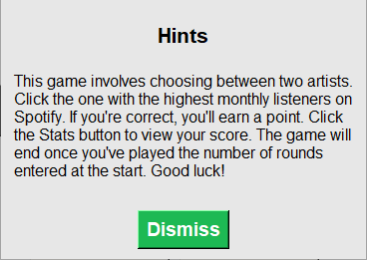

Final outcome testing version 4
In version 4 I used user testing to make some aesthetic and accessibility changes. I made the hints more cohesive colour wise to match the rest of the program. I also made the hints font larger.
Before: After: Before: After:
Background and font changed.
Buttons aligned.

Slide 38


Debugging Evidence
These are my different versions, each one fixing an issue found in testing.
I ran my final outcome through a python validator to ensure there were no syntax errors.
Notes:
Use this slide to provide evidence that you have tested your component in accordance with the test plan you developed earlier.

Slide 39

Debugging continued
I also used the built in error detection in pycharm throughout my process. My final outcome has no errors.
The typo is in the hex code of one of my colours, so this problem was misidentified and I can ignore it.

Slide 40
Complete Program Test Plan
Input | Expected output
Rounds - enters nothing | Error message
Rounds - enters ten | Error message
Rounds - enters 101 | Error message
Rounds - enters 5 | Closes window, opens game interface
Clicks stats | Stats button disabled
Clicks hints | Hints window appears
Clicks dismiss | Closes hints window - game interface still visible
Clicks close | Closes the game interface - choose rounds opens
Choose rounds - enters 3 | Opens the game interface
Notes:
Use this slide to provide a test plan for your complete program. You may wish to create multiple slides so that you can test for expected, boundary and unexpected cases.
Remember to test ALL logical pathways so that you can ensure your program works correctly.

Slide 41
Complete Program Test Plan (continued)
Input | Expected output
Clicks the incorrect answer | Correct answer message displayed - score increases by 1
Clicks stats | Stats window opens with score of 1 and 100%
Clicks dismiss | Stats window closes - game interface remained open
Clicks next round button | New artists are displayed
Clicks the incorrect answer | Incorrect answer message displayed
Clicks the correct answer | Correct answer message displayed - score increases by 1
Clicks stats | Correct stats displayed
Clicks play again | Game interface closes - choose rounds window opens
Choose rounds - enters 10 | Game interface opens - another game can be played
Notes:
Use this slide to provide a test plan for your complete program. You may wish to create multiple slides so that you can test for expected, boundary and unexpected cases.
Remember to test ALL logical pathways so that you can ensure your program works correctly.

Slide 42

Complete Program - testing evidence
Artist Guesser Testing.webm
Notes:
Use this slide to provide a test plan for your complete program. You may wish to create multiple slides so that you can test for expected, boundary and unexpected cases.
Remember to test ALL logical pathways so that you can ensure your program works correctly.

Slide 43

User testing and feedback
To get user feedback, I first tested on my peers. This was after the second version of my final outcome, when all the components had been integrated. From this testing, I received feedback that users couldn’t end the game if they wanted to. This prompted me to add an end game button, and the option to play again.
My second round of user testing was with my parents. They gave me feedback on the visuals of my program. From this, I changed the font size and background colour of the hints component to make it more readable and cohesive with the rest of the program.
After these changes were made, I tested with my peers again. They gave positive feedback on the end game button and pointed out that my buttons didn’t line up exactly.
I kept track of feedback through a list of tasks in my trello board. This allowed me to note down what needed to be done, and keep track of what i was finished with/what to work on.

Slide 44
Addressing Relevant Implications
Legal/intellectual property
I addressed this implication by keeping within all copyright laws. My decision to not include images was a part of this. In my wireframe I had planned to put images of each artist. I changed this plan due to time constraints and the intellectual property implications. There aren’t many copyright free images of music artists, so including images would be difficult while still obeying intellectual property laws.
I researched what Spotify’s regulations around their colour and brand name are. https://developer.spotify.com/documentation/design
Based on this research I decided not to use their logo as there are specific guidelines around how to use and display it. The green colour I used isn’t the exact green associated with their brand, and doesn’t have any usage guidelines in this context.
I have mentioned the Spotify brand name in the game instructions. The copyright information of the name is listed here:
https://trademarks.justia.com/790/37/spotify-79037568.html
As I’m not impersonating the Spotify brand, and don’t charge users or profit off the program, my use of the brand name isn’t an infringement of trademark or copyright laws.
Some of the artists names used will also be trademarks. My use of names isn’t impersonating an artist or attempting to profit off their established brand, so this is fair use.
Notes:
Use slides with this colour background to show that you have addressed the relevant implications. To do this easily, remove this instruction and then duplicate this slide.

Slide 45
Addressing Relevant Implications
Aesthetics
I addressed this implication by making specific aesthetic choices throughout my planning and trialling. This was to make the program more engaging and pleasing to users, making them more likely to enjoy playing and want to continue. Part of my aesthetic choices was the green colour previously mentioned. Green is a colour easily recognizable to Spotify users in the context of music, and makes that connection without infringing copyright. Using this colour made the game’s visuals fit into the context.
I also made aesthetic choices after user testing. The main one was changing the background colour of the hints window. I had it as a green colour to make the window stand out, however user feedback suggested to me that this wasn’t necessary, and the interface looked more cohesive if i kept the background colour consistent.
I also changed the font size of the hints component. Making the font bigger created more balance between the body text and the heading. This makes the window more pleasing to look at, but also relates to accessibility and usability. Making the font bigger increases readability and helps make the program more accessible to visually impaired users.
The final aesthetic adjustment from user feedback was aligning by buttons better. In version 3 they were slightly out of line, and I had to trial different widths and gap sizes to get them aligned. This made the final outcome look more polished and professional, giving a better impression to the user.
Notes:
Use slides with this colour background to show that you have addressed the relevant implications. To do this easily, remove this instruction and then duplicate this slide.

Slide 46
Addressing Relevant Implications
Sustainability and future proofing
To address this implication, I ensured by code was easy to edit, maintain, and update. The main way I did this was by separating each component into a different function. This means that in the future, I can upstate one function to change the code, rather than having to update in multiple places or search through many lines of code.
I also used a csv file for my artist names and monthly listener values, instead og making a list in my code. This means that I can change the artists or update their monthly listeners easily in a spreadsheet, instead of manually typing them into the program. This makes it much easier to edit the game content in the future.
Something I could have done to future proof better is to link the artists csv to a database. This would mean the artists’ monthly listeners would change automatically, which would ensure the program is always up to date. Unfortunately, adding this feature wasn’t within my time constraints, but it would be an important addition in the future.
Notes:
Use slides with this colour background to show that you have addressed the relevant implications. To do this easily, remove this instruction and then duplicate this slide.

Slide 47
Addressing Relevant Implications
Usability
To address usability I followed the usability heuristics in the planning and developing of the program. In planning, I ensured that I created an intuitive design. For example, the Next Round button is larger than the other buttons and a more obvious green colour. This draws the user’s attention to it as the most important button to press (rather than hints and stats). Since it’s big, it’s easy for the user to press quickly when playing multiple consecutive rounds. I implemented all this in the development of my program.
Another way I addressed usability was through the error messages I used. The system tells users when there's an error, for example any errors in the number of rounds chosen. The message lets users know the issue, and more importantly, how to fix it, prompting them to enter a whole number between 1 and 100. This ensures that users don't get stuck right at the beginning with an unsolvable error that prevents them from using the game.
By considering and addressing this implication, I’ve ensured users can enjoy the game easily, without errors blocking them from playing, or difficult buttons to find and navigate through.
Notes:
Use slides with this colour background to show that you have addressed the relevant implications. To do this easily, remove this instruction and then duplicate this slide.

Slide 48
Addressing Relevant Implications
Functionality
I addressed functionality through thorough testing. By testing every component I ensured that there were no errors which would prevent the program form functioning.
One way I tested thoroughly was by testing for all possible inputs including boundary values as these are easy to miss. For example, my rounds are limited to 100, so I tested for 101 to ensure that I cut off the accepted values correctly. This type of thorough testing ensured that I didn’t miss any errors.
Testing with a sample set of data was also an essential way to test functionality. Some errors were extremely impactful on the games functionality. For example, the game didn’t find the correct artist properly at first. I tested this with a small set of sample data where I knew the correct answers so that I could identify when the error was and wasn't occurring. If I had just incorporated the full data straight away, this error may never have been identified, leaving me with a game that had the incorrect answers. This would mean by game didn’t function, and users would be dissatisfied.
By testing with multiple different strategies, I ensured that all errors were identified and solved, making my program fully functional.
Notes:
Use slides with this colour background to show that you have addressed the relevant implications. To do this easily, remove this instruction and then duplicate this slide.

Slide 49


Complex Processes - Discussion
Testing and trialling
I thoroughly tested all of my components, to uncover any errors. Planning and testing for all possible occurrences and boundary values ensured that every error was identified. When I did encounter an error, I researched how to solve it, and trialled multiple options if applicable to find the best, most efficient way to solve it. For example, when I tested the get artists component my program was comparing the artists incorrectly. Testing allowed me to identify this error before it became lost in the final outcome. I tried a solution of comparing the monthly listeners differently (as I thought the max() and min() were not working), by adding the highest and lowest monthly listeners to their own variables.
Initial code: Trialled solution:
When this didn’t work, I decided to research further, and discovered the root cause was actually that the monthly listeners was treated as a string. This then enabled me to trial a new solution, converting to an integer, which worked effectively and solved the issue. Through testing trialling and research I was able to find the most effective solution.
Notes:
Discuss how you used (and combined) information gained from the planning, testing and trialling of your components to improve the quality of your program. Note that synthesising information from planning, testing and trialling of components and then discussing how this lead to a high quality outcome are needed for an E grade.
Discuss how you used (and combined) information gained from the planning, testing and trialling of your components to improve the quality of your program. Note that synthesising information from planning, testing and trialling of components and then discussing how this lead to a high quality outcome are needed for an E grade.
To synthesise means to “bring together” to create something new.
To synthesise information, you need to look at the testing/trialling information from different components, or different stages of development, or from different kinds of testing, and bring together this information.
You might need to compare contradictory information and work out the best solution.
You could show how different tests all led to one unified conclusion, or led to new ideas
You might need to come up with whole new ideas not originally tested

Slide 50

Complex Processes - Discussion
Testing and trialling continued
Another instance where testing, trialling, and research was useful was in my get artists component. I had an error which was difficult to understand, so I asked our student teacher for help, as well as googling the error. The teacher helped me, suggesting there were unreadable characters in my csv. The article didn’t tell me the root cause of the issue, and suggested changing my decoding scheme. As the teacher presented a more simple fix, I decided to try that first. Simple changes are usually more efficient, and it would be a better way to use my time, since the other solution would have taken more time. The first solution worked in solving my issue and I tested again to confirm this.
Notes:
Reflect on how using the processes helped to develop the outcome through effectively testing and trialling various components to refine and enhance the design and functionality.
How your idea changed over time as new testing/trialling evidence was gained and what effect this had
How you tried different approaches and decided which was best and why

Slide 51
Complex Processes - Discussion
User testing and feedback
I used the process of user testing to improve key aspects of my program. User testing allowed me to discover things that I couldn’t notice myself. For example, when the hints font was too small, I’d become used to reading it and overlooked the issue, however a user who was using the program for the first time was able to notice it straight away. This process ensured that my program worked for all users, not just me, and helped with the iterative process of the Agile project management, as I was able to user test, make changes, then test again. Doing this allowed me to make my program as user friendly as possible.
Project planning
My project planning process was useful in helping me ensure I met all time restrictions and program requirements. Firstly, I broke down the project into separate components using Trello. These components helped me begin the process, as I had everything broken down into steps I could iteratively work through. I then planned ahead using my sprint tracking to work out how much time I had for each component. This step in the planning process was essential as I had a deadline, and needed to ensure the outcome was as high quality as possible within the time restraints. Planning this way allowed time for user testing and improvements so that I didn't have just a functioning program, but an improved and ideal program that suited user needs.
Notes:
Discuss how you used (and combined) information gained from the planning, testing and trialling of your components to improve the quality of your program. Note that synthesising information from planning, testing and trialling of components and then discussing how this lead to a high quality outcome are needed for an E grade.
Discuss how you used (and combined) information gained from the planning, testing and trialling of your components to improve the quality of your program. Note that synthesising information from planning, testing and trialling of components and then discussing how this lead to a high quality outcome are needed for an E grade.
To synthesise means to “bring together” to create something new.
To synthesise information, you need to look at the testing/trialling information from different components, or different stages of development, or from different kinds of testing, and bring together this information.
You might need to compare contradictory information and work out the best solution.
You could show how different tests all led to one unified conclusion, or led to new ideas
You might need to come up with whole new ideas not originally tested

Slide 52
Complex Processes - Discussion
Project planning continued
From my planning process I learned that splitting my project into chunks worked well as it ensured that each component worked separately before being integrated. Without doing this, any errors that occurred would be harder to identify as they would be lost in a full program, rather than being identified in a smaller, easily editable piece of code. If I were to repeat this process again for a new project, I would continue to follow the steps of the Agile methodology, especially breaking the project down into components.
I would change the way I kept track of smaller tasks if I were to undergo another project like this. I added steps in each of my components, but I didn’t keep track of which steps were completed, or use these steps for much guidance. This meant that when it came to starting the programming for the next component, I was often lost as to where to begin and what needed to be done. If I had used the checkboxes on Trello to track where I was up to, this would have been a lot easier. In summary, breaking the project down was useful, but breaking it down even further would have helped me be even more efficient, as I’d have exact steps to follow.
Another change I would have made, is budgeting my time better. I used the sprint tracking to ensure all tasks were completed within the time frame, however, I would have liked to build in some extra time for bonus functions and improvements. For example, storing the users scores in a file would have added incentive to users to play my game, as they have something to work towards (beating their high score). Extra functions such as this would make my program more appealing to users, but to create them, I needed to build in time from the beginning. Next time, I would cut down on the time spent on some of my components. If I tracked my smaller tasks better as mentioned above, I would have time, which could be used for these extra functionalities.
Notes:
Discuss how you used (and combined) information gained from the planning, testing and trialling of your components to improve the quality of your program. Note that synthesising information from planning, testing and trialling of components and then discussing how this lead to a high quality outcome are needed for an E grade.
Discuss how you used (and combined) information gained from the planning, testing and trialling of your components to improve the quality of your program. Note that synthesising information from planning, testing and trialling of components and then discussing how this lead to a high quality outcome are needed for an E grade.
To synthesise means to “bring together” to create something new.
To synthesise information, you need to look at the testing/trialling information from different components, or different stages of development, or from different kinds of testing, and bring together this information.
You might need to compare contradictory information and work out the best solution.
You could show how different tests all led to one unified conclusion, or led to new ideas
You might need to come up with whole new ideas not originally tested

