Slide 1
Readme!
Please feel free to edit this template by adding / editing and removing slides. I’ve tried to cover most of what you might want to include but there are many ways of providing evidence so don’t be afraid to delete slides that you don’t need.
Slides with a green background should be used to show evidence of planning / project management. The slide with a purple background should be duplicated and used to show ‘relevant implications’ evidence.
The instructions in the grey boxes should be deleted once they have been read. Copies of the instructions are underneath the slides in the speaker notes (just in case they are needed at a later stage).

Slide 2
91906 & 91907 Complex Programming
Please add links to your work on this slide. Then remove this instruction. Note that most of the instructions have been supplied as speaker notes for later reference :) Ensure your Github repositories, Trello board, and videos are set to public.
Trello board / Project Management: < https://trello.com/b/IXU60rwu/currency-converter > Make PUBLIC
The project on Github: <https://github.com/QuinnDobsonGann/91906_Assignment_Currency_Converter > Make PUBLIC
Final Project Filename: <main_v7>
Final Testing Video: <https://app.screencastify.com/v2/watch/emIy0fWcPlFNPYQqBesg > Make PUBLIC
Notes:
Please add links to your work on this slide

Slide 3
Project Management
I chose the agile methodology method because it allows me to work in small steps and respond to feedback or changes. Helping me approach the project with continuous improvements while ensuring it aligns with the users needs and the requirements for a functional currency converter. Agile methodology helps with time management and flexibility throughout my project.
I had used Trello as my project management tool. Visual layout made it easy to do the currency converter project into small tasks and track my progress through my planning card, in progress card and completed card. Trello has help me stay organized and understand a clear idea of what I want my final project to be.
I had used Github as another project management tool. Github allowing me to save files I have worked on in a repository. Allowed me to store all the component testing files, and main currency converter files. It allows me to keep track of changes and shows the steps I have done to produce my currency converter. Being able to access files that I have previously used without having the need to revert changes. Helps me stay organized and see the overall progress the program has made through these different files.
Notes:
Brief description of the project management methodology

Slide 4
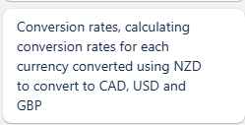
Project Management - Sprint Tracking
Task | Sprint Number | Start Date | End Date
Currency Conversion | 1 | 23/04/25 | 25/04/25
What are you working on? | What did you achieve? | What are the next steps?
I am making a currency converter program that converts between USD, GBP and CAD. The default currency being NZD. It makes sure when calculating between these currencies it will correctly convert. | I successfully added this component that provides the currency conversion rates based on what button you click starting from NZD to either USD, GBP and CAD. I also did ensure it rounded to two decimal places. | Next step is to help with error handling by displaying a message such as “Enter a number more than / equal to 1.” So if the users enter a letter or a number under 1 it will display this message. A helpful message to display when the user makes an error instead of the program crashing or providing a wrong result.
Evaluation - what worked well & what did not?
The currency conversion correctly converts from New Zealand Dollar to United State Dollar, Canadian Dollars and Great British Pounds. Accurately convert from each currency and rounds to two decimal places instead lots of digits. This currently doesn’t have good error handling, because if users enter letter it will crash and won't respond after. NExt step is to add this useful error message to prevent crashing.
Notes:
Add information about how your project is progressing - Sprint tracking

Slide 5

Project Management - Sprint Tracking
Task | Sprint Number | Start Date | End Date
Check_currency(7 digit maximum) | 2 | 12/05/25 | 14/05/25
What are you working on? | What did you achieve? | What are the next steps?
Ensuring the user can only enter 7 digits to convert. If over 7 digits the currency box will be cleared, and the user can enter digits again. Also display a message saying “Too many digits, limit is 7.” Makes sure the user doesn’t convert a unrealistic amount. | I achieved this so when the user enters 7 digits or more it displays a error message saying “Too many digits, limit is 7.” Then it clears the input box and the user can enter the correct amount of digits. | Aesthetically changing the error message by adding a red coloured background in the currency input box when digits inputted is over 7. More visually appealing. Resembling the idea of an error, helps the user to realise the mistake.
Evaluation - what worked well & what did not?
Adding a 7 digit maximum component allowed the program to look less cluttered and make it more realistic. When the 7 digit feature wasn’t added it made it so you could enter any amount so when you converted it would stretch the programs window with a lot of numbers. Being very hard to read. 7 digit currency helped with the realistic amount you can convert. As people most likely won't be converting billions. The message was a basic black text, not looking very visually appealing. As a user you would not recognise the error. My next step is adding a red background when inputting over the maximum digits, it would help the user recognise the issue.
Notes:
Add information about how your project is progressing - Sprint tracking

Slide 6
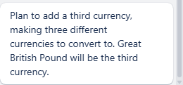
Project Management - Sprint Tracking
Task | Sprint Number | Start Date | End Date
Third currency button | 3 | 15/05/25 | 23/3/25
What are you working on? | What did you achieve? | What are the next steps?
Implementing another currency such as GBP(Great British Pound). Allowing the users to calculate now from NZD to USD, CAD and GBP. Having to update the conversion rounding. | I managed to add the third currency, now the users can choose to convert from NZD to either USD, CAD and GBP. Adding Great British Pound added more variety. Updated the conversion rounding to the calculation of the time Great British Pound is. | Changing the aesthetic appearance of all three buttons, as it off centers the two buttons below it. Having to create a new grid and center the buttons below. The buttons below being Help / Info and History / Export.
Evaluation - what worked well & what did not?
Adding a third currency button provided the currency convert program to have more variety. Adding Great British Pound being a very used currency, I thought would be useful to add. Once the third button was added, it made the Help / Info and History / Export become off centered to the left. Next step is to add this grid so I can center the bottom two buttons to look more aesthetically pleasing.
Notes:
Add information about how your project is progressing - Sprint tracking

Slide 7
Addressing Relevant Implications
Functionality is important as it shows my currency converter program to do a specific task which is converting currencies for a user. Functionality is implement through features like functions and different components within the program to work as intended to complete the task. Functionality is important as I am consistently implementing testing to my program to make sure the program is working correctly , displaying no error messages. Inputting a digit in the currency box and receiving an output of what you wanted to convert. For example using tkinter import helps implement functionality as it allowed me to create buttons, a input box for entering your currency amount. The buttons being used to select what you want New Zealand Dollars to be converted to. Giving this program a visual interface that responds to the specific task of converting a currency and outputting the conversion. This shows functionality as it lets users actively use the program. Through using Tkinter import it allows the buttons to respond to the currency they inputted in the box, making the program interactive with the buttons. This allowed me to add a United States Dollar, Canadian Dollar and Great British Pound Dollar buttons.
Notes:
Use slides with this colour background to show that you have addressed the relevant implications. To do this easily, remove this instruction and then duplicate this slide.

Slide 8
Relevant Implications Addressed
Secondly a relevant implication I applied was usability. Usability is something that helps users reach the end goal of the program easily, using minimal effort. Usability was important in my program because if users struggled to understand how to use it or keep making mistake, the currency converter program would not get accurate results. Then causing the program to fail when having a intended purpose. I addressed this implication by adding a check_currency function that checks the input is a valid number and gives an output if incorrect, like if the number is too small or has too many digits(7 or more). Then highlights the box red and displays a error message with either “Too many digits(limit of digits is 7)” or “Enter a number more than / equal to 1.” Having a red input box when a error message useful as users realise the functionality of the program and people realise red is for a error message. This improves the usability of the program as it helps the user correct mistakes quickly and understand what the program needs to work from the user. By handling these errors easily and efficiently it guides the user to correctly input what's needed for a accurate output.
Notes:
You might wish to use this slide to explain how you have addressed the relevant implications if you have not done so in previous slides.

Slide 9
Relevant Implications Addressed
Lastly, a relevant implication I applied was aesthetics. Aesthetics is how visually appealing, organized and user-friendly the program appears. Aesthetics is important because a well designed interface can make the overall program feel refined and accurate, while if the design was messy or cluttered it can confuse the users or make them less likely to use it. Aesthetics can create first impressions and overall usability. I addressed this implication using bolds, centered headings with clear fonts to make the title easy to read. Used large, vibrant coloured buttons in contrasting colours such as purple, green and gold to help each currency button stand out. Helps users navigate faster. Having padding in between buttons helps prevent it from being cluttered. Keeping the background a light grey ensures everything overpowers it giving the text and buttons easy to read but not overwhelming. My grid keeps all three conversion buttons in one row, while the “Help / Info” and “History / Export” buttons in another row beneath being centered creates a more visually appealing look as everything is symmetrical. Having a red input box when a error message useful as users realise red is for a error message. The aesthetic implication helps with design and improves users satisfaction because users can understand what to do without reading a lot of instructions. Useful because the attention of colours, alignment, padding, and font all work together to create a pleasing and effective design.
Notes:
You might wish to use this slide to explain how you have addressed the relevant implications if you have not done so in previous slides.

Slide 10
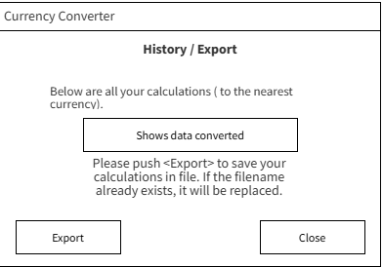
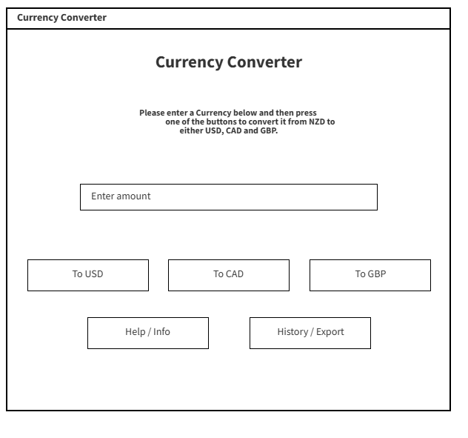
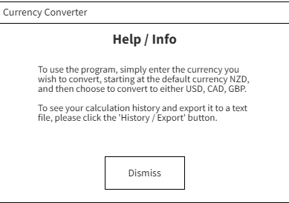
Graphical User Interface Design...
Notes:
Create wireframes for your program’s GUI. Please place them on this slide.

Slide 11
Program Structure
Display Help
-Shows help
-Disables button
Main Program
(Creates GUI Window)
Converter class
-Main UI
-Handles input and output
-Does conversion rates
- Stores history for “History / Export”
Displays History / Export
-Displays history
-Exports to file
Notes:
Create a diagram showing your program’s structure and outline the classes and functions that you plan on developing. You are welcome to edit this slide once you start developing the outcome BUT when you do that, you should show what has changed and explain why those changes were needed.

Slide 12
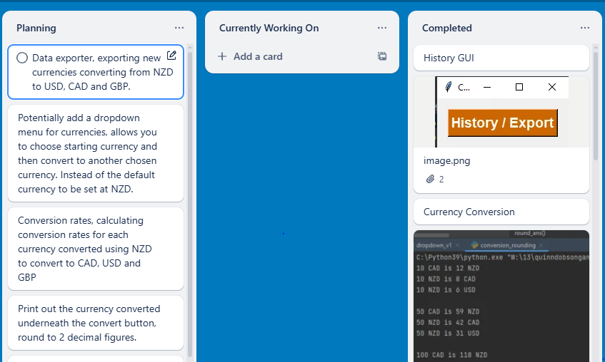
Problem Decomposition
Provide evidence showing that you have decomposed the task. This can be in the form of a trello screenshot or a list of components. If necessary, you may revisit this slide and add to it / edit it as you create your outcome. When you make changes to this slide, please do so in a different colour, date the changes and explain why they were made (this can help provide evidence for M / E grades).
Hint: Use the structure you developed earlier to work out what components you need. For each function, you should have at least one component.
Original trello
Notes:
Provide evidence showing that you have decomposed the task. This can be in the form of a trello screenshot or a list of components. If necessary, you may revisit this slide and add to it / edit it as you create your outcome. When you make changes to this slide, please do so in a different colour, date the changes and explain why they were made (this can help provide evidence for M / E grades).
Hint: Use the structure you developed earlier to work out what components you need. For each function, you should have at least one component.

Slide 13

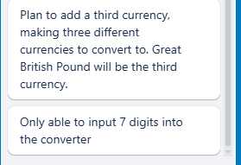
Problem Decomposition
Provide evidence showing that you have decomposed the task. This can be in the form of a trello screenshot or a list of components. If necessary, you may revisit this slide and add to it / edit it as you create your outcome. When you make changes to this slide, please do so in a different colour, date the changes and explain why they were made (this can help provide evidence for M / E grades).
Hint: Use the structure you developed earlier to work out what components you need. For each function, you should have at least one component.
Changes made 12/05/25. More additional planning on what I want my final currency converter outcome to have.
Notes:
Provide evidence showing that you have decomposed the task. This can be in the form of a trello screenshot or a list of components. If necessary, you may revisit this slide and add to it / edit it as you create your outcome. When you make changes to this slide, please do so in a different colour, date the changes and explain why they were made (this can help provide evidence for M / E grades).
Hint: Use the structure you developed earlier to work out what components you need. For each function, you should have at least one component.

Slide 14

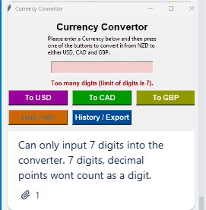
Problem Decomposition
Provide evidence showing that you have decomposed the task. This can be in the form of a trello screenshot or a list of components. If necessary, you may revisit this slide and add to it / edit it as you create your outcome. When you make changes to this slide, please do so in a different colour, date the changes and explain why they were made (this can help provide evidence for M / E grades).
Hint: Use the structure you developed earlier to work out what components you need. For each function, you should have at least one component.
Finished making changes for check_currency(7 digit maximum) at 14/05/25
Notes:
Provide evidence showing that you have decomposed the task. This can be in the form of a trello screenshot or a list of components. If necessary, you may revisit this slide and add to it / edit it as you create your outcome. When you make changes to this slide, please do so in a different colour, date the changes and explain why they were made (this can help provide evidence for M / E grades).
Hint: Use the structure you developed earlier to work out what components you need. For each function, you should have at least one component.

Slide 15

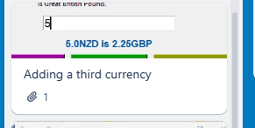
Problem Decomposition
Provide evidence showing that you have decomposed the task. This can be in the form of a trello screenshot or a list of components. If necessary, you may revisit this slide and add to it / edit it as you create your outcome. When you make changes to this slide, please do so in a different colour, date the changes and explain why they were made (this can help provide evidence for M / E grades).
Hint: Use the structure you developed earlier to work out what components you need. For each function, you should have at least one component.
Finished adding a third currency button at 23/05/25.
Notes:
Provide evidence showing that you have decomposed the task. This can be in the form of a trello screenshot or a list of components. If necessary, you may revisit this slide and add to it / edit it as you create your outcome. When you make changes to this slide, please do so in a different colour, date the changes and explain why they were made (this can help provide evidence for M / E grades).
Hint: Use the structure you developed earlier to work out what components you need. For each function, you should have at least one component.

Slide 16
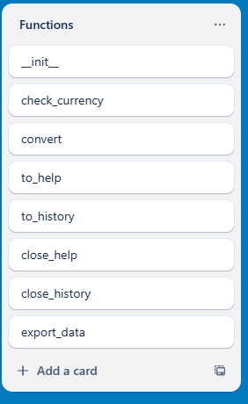
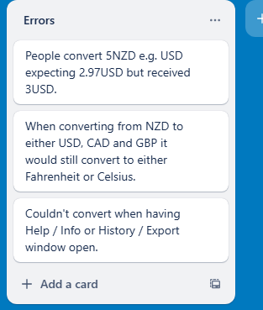
Problem Decomposition
Provide evidence showing that you have decomposed the task. This can be in the form of a trello screenshot or a list of components. If necessary, you may revisit this slide and add to it / edit it as you create your outcome. When you make changes to this slide, please do so in a different colour, date the changes and explain why they were made (this can help provide evidence for M / E grades).
Hint: Use the structure you developed earlier to work out what components you need. For each function, you should have at least one component.
Final overview of my functions and errors I came across when producing my final outcome. Changes made to trello on 21/05/25.
Notes:
Provide evidence showing that you have decomposed the task. This can be in the form of a trello screenshot or a list of components. If necessary, you may revisit this slide and add to it / edit it as you create your outcome. When you make changes to this slide, please do so in a different colour, date the changes and explain why they were made (this can help provide evidence for M / E grades).
Hint: Use the structure you developed earlier to work out what components you need. For each function, you should have at least one component.

Slide 17
Develop your Components!!
Make as many copies of the next three slides as you need. For each component you should have…
A trello screenshot / evidence of ongoing use of your project management tools
A test plan for the component that has been created BEFORE you start coding. Your plan should allow you to test all logical pathways for this component. It should also include test cases for relevant boundary and unexpected values.
Screenshot evidence showing that you have worked through the test plan you developed.
You should also provide evidence of trialling multiple components & techniques. Please make slides as needed for that evidence.

Slide 18
Component Test Plan <Conversion>
Data input | Expected output
xyz | Enter a number more than / equal to 1
0.1 | Enter a number more than / equal to 1
!@# | Enter a number more than / equal to 1
12345678 | Too many digits, limit is 7.
1234567 | = x (Converts from NZD to either USD/CAD/GBP)
1 | = x (Converts from NZD to either USD/CAD/GBP)
100 | = x (Converts from NZD to either USD/CAD/GBP)
5.5 | = x (Converts from NZD to either USD/CAD/GBP)
-100 | Enter a number more than / equal to 1
blank | Enter a number more than / equal to 1
Notes:
Create a test plan for this component BEFORE you start coding. Your plan should allow you to test all logical pathways for this component. It should also include test cases for relevant boundary and unexpected values.

Slide 19
Component Testing Evidence <>
Use this slide to provide evidence that you have tested your component in accordance with the test plan you developed earlier.
https://app.screencastify.com/v2/watch/G1bSht8mqoEBgvRupTSU
Notes:
Use this slide to provide evidence that you have tested your component in accordance with the test plan you developed earlier.

Slide 20
Complete Program...
Assemble your components into a working program. On the slides that follow, please provide a test plan and evidence that your program works as expected.
If you are going for ME, you also need to create extra slides showing how you have used your testing to improve the functionality of your program. This could mean having multiple test plans (and screenshots) showing several iterations of the assembled program.
Notes:
Use this slide to provide evidence that you have tested your component in accordance with the test plan you developed earlier.

Slide 21
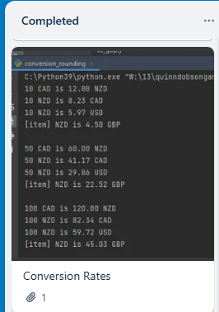
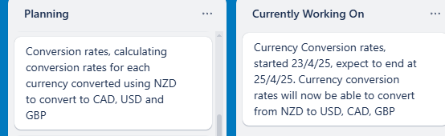
Component Planning(Conversion rounding_v2)
Notes:
Duplicate this slide and use it to show your planning for the current component. This could be in the form of a trello screenshot.

Slide 22
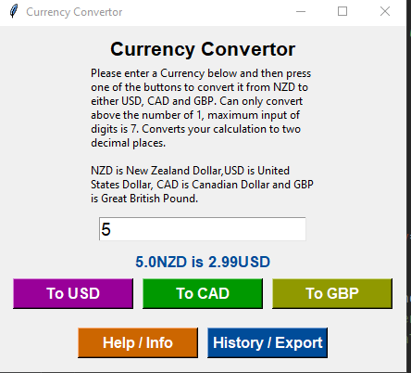
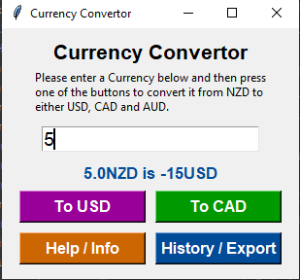
Component Trialling
I had made two versions of my conversion rounding, I had to test a range of different currencies(USD, CAD GBP) to make ensure the calculations were correct. My first conversion rounding was converting my currencies with Fahrenheit and Celsius. Outputting the wrong calculation. The second conversion rounding file made sure it was using the right calculations providing the right output.
Notes:
Use slides with this background colour to show your trialling evidence.

Slide 23

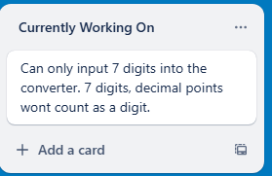


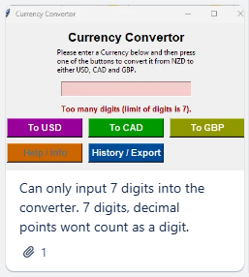
Component Planning(7 digit tester)
Notes:
Duplicate this slide and use it to show your planning for the current component. This could be in the form of a trello screenshot.

Slide 24
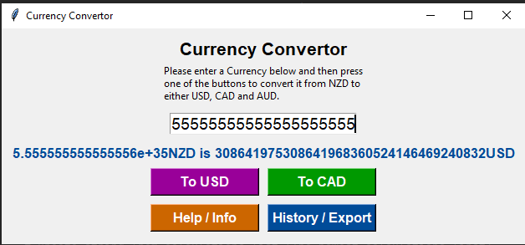
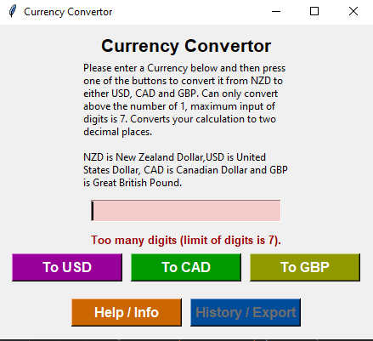

Component Trialling
Before I implemented this feature within check_currency when inputting up to lots of digits it would widen the currency converter window and write a long calculation. Long calculations are unrealistic as people wouldn’t be converting over 7 digits. Implementing the 7 digit maximum it would prevent the window from widening and showing a conversion involving “5+35”, annoying for users to realise what number they inputted.
Notes:
Use slides with this background colour to show your trialling evidence.

Slide 25


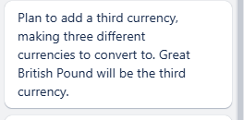
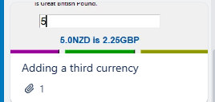
Component Planning(Third currency button)
Notes:
Duplicate this slide and use it to show your planning for the current component. This could be in the form of a trello screenshot.

Slide 26

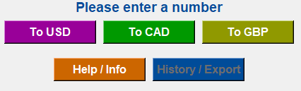
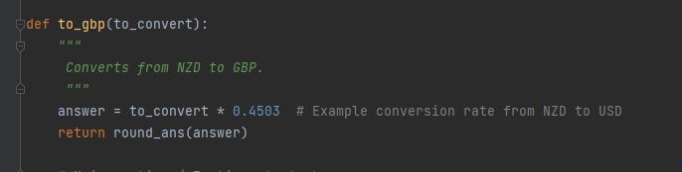
Component Trialling
When adding my third currency button “To GBP” I had produced the button, but when inputting my NZD amount into the currency input box it did not convert to GBP when clicking the “To GBP” button. I had to then link a new function within my conversion_roundingv2. This then linked
Notes:
Use slides with this background colour to show your trialling evidence.

Slide 27
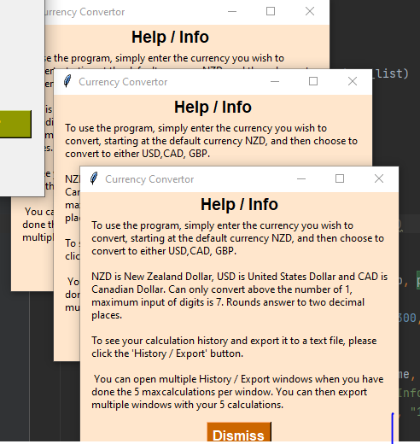
Debugging Evidence <>
During my debugging for my Help / Info GUI button was a issue. When I clicked on the Help / Info the button would not disable, meaning I could click it multiple times opening up multiple windows. The user then can keep clicking it as many times as they want. I had fixed this my editing my main_v7 code and implemented a line of code that disables the Help / Info button when clicked.
Notes:
Use this slide to provide evidence that you have tested your component in accordance with the test plan you developed earlier.

Slide 28
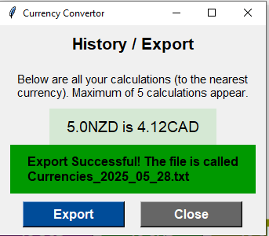
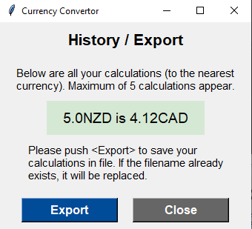
Debugging Evidence <>
During implementing the currency converter in my program one of the buttons was a History / Export button. When clicked it opens a window then when clicking export it would not export the data and create a file. Neither did window display a message “Export was successful.”
Notes:
Use this slide to provide evidence that you have tested your component in accordance with the test plan you developed earlier.

Slide 29
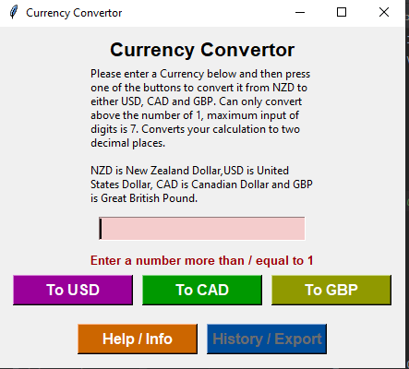
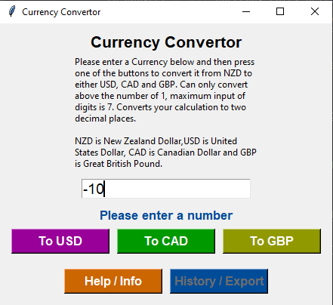
Debugging Evidence <>
When inputting a negative number e.g -10 nothing would happen. No error message displayed. In my check_currency I had to implement a feature allowing the user to only enter an amount equal or over 1.
Notes:
Use this slide to provide evidence that you have tested your component in accordance with the test plan you developed earlier.

Slide 30
Complete Program <test plan>
Normal Inputs | NZD to USD | 100 | = x (Converts from NZD to USD)
 | NZD to CAD | 2 | = x (Converts from NZD to CAD)
 | NZD to GBP | 5 | = x (Converts from NZD to GBP)
Boundary Testing | Zero Value | 0 | Enter a number more than / equal to 1
 | Small Value | 0.5 | Enter a number more than / equal to 1
 | Minimum Value | 1 | = x (Converts from NZD to either USD,CAD, GBP)
 | Check_currency(7 digit checker) | 1234567 | = x (Converts from NZD to either USD, CAD and GBP)
 | Check_currency(Over 7 digits) | 12345678 | Too many digits, limit is 7
 | Negative number | -10 | Outputs
Incorrect inputs | Letters only | abc | Enter a number more than / equal to 1
 | Symbols | @#$% | Enter a number more than / equal to 1
 | Empty input | (blank) | Enter a number more than / equal to 1
GUI and buttons | Click Help | (click) | Help window opens
 | View History after converting | (click) | Last 5 results shown in popup
 | Export conversions | (click) | File saved, "Exported to file!" message shown
Notes:
Use this slide to provide a test plan for your complete program. You may wish to create multiple slides so that you can test for expected, boundary and unexpected cases.
Remember to test ALL logical pathways so that you can ensure your program works correctly.

Slide 31
Complete Program <testing evidence>
Create as many slides as needed to provide evidence of testing that your outcome works for expected, boundary and unexpected cases. If you wish, you are welcome to submit a brief video showing your testing.
https://app.screencastify.com/v2/watch/KIikRVDU8gTMi4WLZbjl
Notes:
Use this slide to provide a test plan for your complete program. You may wish to create multiple slides so that you can test for expected, boundary and unexpected cases.
Remember to test ALL logical pathways so that you can ensure your program works correctly.

Slide 32
Complex Processes - Discussion
Discuss how you used (and combined) information gained from the planning, testing and trialling of your components to improve the quality of your program. Note that synthesising information from planning, testing and trialling of components and then discussing how this lead to a high quality outcome are needed for an E grade.
To synthesise means to “bring together” to create something new.
To synthesise information, you need to look at the testing/trialling information from different components, or different stages of development, or from different kinds of testing, and bring together this information.
You might need to compare contradictory information and work out the best solution.
You could show how different tests all led to one unified conclusion, or led to new ideas
You might need to come up with whole new ideas not originally tested
To improve the overall quality of my currency converter program, I combined information and ideas from planning, testing and trialling stages. During the planning stage I had used Trello board to help organise steps I want to accomplish throughout the program. Helping me keep track of my currency converters layout, usability and the functionality of the program. I wanted to have a clean interface and a realistic currency converter as people wouldn’t be converting numbers of 7 digits. I had implemented an idea which was to limit the amount of numbers you can enter input into the currency converter box. Planning from trello lead to a 7 digit maximum.
During the testing without a limit the currency converter window would stretch very widely when inputting huge amount of numbers. Allowed me to realise my program would round my output to a whole number. I used my conversion rounding file to fix the formatting so it would round to two decimal places. But also the having the 7 digit maximum kept a realistic program as people most likely wouldn't need to convert billions. 7 digit maximum was a good balance between the functionality of the currency converter and the usability.
For trialling I then tried this component both 7 digit and 8 digit numbers into the converter. If 8 digits was inputted it would display a error message. If 7 digits entered it would accept it. Overall keeping good functionality and providing a good interface.
Notes:
Discuss how you used (and combined) information gained from the planning, testing and trialling of your components to improve the quality of your program. Note that synthesising information from planning, testing and trialling of components and then discussing how this lead to a high quality outcome are needed for an E grade.

Slide 33
Complex Processes - Discussion
Reflect on how using the processes helped to develop the outcome through effectively testing and trialling various components to refine and enhance the design and functionality.
When you discuss how information led to a high quality outcome you could write about:
Two (or more) sources of information that disagreed with each other, and say how you decided which to trust
How your idea changed over time as new testing/trialling evidence was gained and what effect this had
How you tried different approaches and decided which was best and why
Another planning stage I used Trello board to decide how I want my final outcome to look for the currency converter. I wanted to implement a third currency, being Great British Pound.
During my trialling stage for the third currency I implemented the button, but caused the overall layout of the grid to make everything off-centered.. Through trialling then implement a new grid for the third currency button. I then would use padding to then choose where I wanted the button to be through the planning of my wireframe provided me an idea of where I wanted it to be. Testing was useful for my conversion because it was not providing a converted amount from NZD to GBP.
Testing then made me realise I had to update my conversion rounding file with a updated calculation to provide the right output. Overall by bringing together these insights with the use of Trello board, my ideas of what I wanted the final outcome to be. Testing my inputs, conversion rates, trialling enabled me to find bugs and help with functionality. Helping users receive receive a smooth and clear experience.
Notes:
Discuss how you used (and combined) information gained from the planning, testing and trialling of your components to improve the quality of your program. Note that synthesising information from planning, testing and trialling of components and then discussing how this lead to a high quality outcome are needed for an E grade.

Slide 34
Complex Processes - Discussion
Reflect on how using the processes helped to develop the outcome through effectively testing and trialling various components to refine and enhance the design and functionality.
When you discuss how information led to a high quality outcome you could write about:
Two (or more) sources of information that disagreed with each other, and say how you decided which to trust
How your idea changed over time as new testing/trialling evidence was gained and what effect this had
How you tried different approaches and decided which was best and why
My idea of the currency converter program had changed when implementing the third currency button. I assumed it was going to take a day or two to complete, but I started at 15/05/2025 and end it at 23/05/25 which was a lot later than expected. Testing consumed a majority of the time as the button wouldn't’ convert from NZD to GBP. Also adding the third button caused the grids to be off centered. Lots of trialling had been undergone to make sure the conversion_rounding file had been linked to the button correctly, centering the buttons correctly. This had taken up a lot more time as I thought implementing a button wouldn’t have any of this excess requirements. This had the been unrealistic as I thought it may take a day. This taking time from 15/05/25 to 23/05/25 had prevented me from adding a final implementation in my program. I was planning to add dropdown menu for my program so instead of the default currency being NZD you could select your starting currency from either USD, CAD or GBP. Due to the unexpected amount of time I couldn’t implement this feature. Which does partially affect the program but I still met the requirement for how I want the program to operate. The drop down was a feature I would implement if I had the time.
Notes:
Discuss how you used (and combined) information gained from the planning, testing and trialling of your components to improve the quality of your program. Note that synthesising information from planning, testing and trialling of components and then discussing how this lead to a high quality outcome are needed for an E grade.

Slide 35
Complex Processes - Feedback
Reflect on how using the processes helped to develop the outcome through effectively testing and trialling various components to refine and enhance the design and functionality.
When you discuss how information led to a high quality outcome you could write about:
Two (or more) sources of information that disagreed with each other, and say how you decided which to trust
How your idea changed over time as new testing/trialling evidence was gained and what effect this had
How you tried different approaches and decided which was best and why
Feedback was a very important part of producing a high quality outcome for my currency converter. During my development of my program I had received feedback from two people. One was my teacher and the other was a classmate. Their ideas allowed a positive impact of my final outcome providing better usability and functionality of my code.
My teacher had suggested that I should implement a component where users can only enter a maximum of 7 digits. Because if users inputted e.g. 50 digits it would stretch the program window extremely wide. The teacher also said this would keep the currency converter program have a realistic feel as users would not have the need to convert billions. Secondly he said I should make my instructions more clear within the Help / Info window as it didn’t cover what the code can do exactly. This helped an overall improvement in the usability and functionality of my code.
I had received feedback from a classmate. He said that for my three currency buttons they appeared to be visually cluttered together. I then increased the padding between each button providing more white space. Overall improving the aesthetics of my program.
By using this feedback from the teacher and a classmate it helped me create a higher quality outcome of my currency converter program. This creates better usability for the user as my instructions, appearance and functionality of the code are clearer. These helped with the final development of the program finalizing with a main_v7. I could improve my code by allowing to choose a starting currency. Something that I could have improved on in my currency converter is that it was set to a default currency at NZD and will convert to either USD, CAD and GBP. Allowing nine different total options will allow my program to have more use towards different users needing to convert different currencies.
Notes:
Reflect on how using the processes helped to develop the outcome through effectively testing and trialling various components to refine and enhance the design and functionality.

