Slide 1
91906 & 91907 Complex Programming
Please add links to your work on this slide. Then remove this instruction. Note that most of the instructions have been supplied as speaker notes for later reference :) Ensure your Github repositories, Trello board, and videos are set to public.
Trello board / Project Management: https://trello.com/b/1d5iIBNX/lyric-guessing
The project on Github: https://github.com/shiloh25/lyric_guesser
Final Project Filename: 01_Lyric_Guessing_v3
Final Testing Video: https://drive.google.com/file/d/1Qyj5t9DGCziFUZI
Notes:
Please add links to your work on this slide

Slide 2
Project Management - Agile Methodology
I have used Agile project management as my methodology for this project. Agile methodology mainly consists of a management called scrum, which is used to break down the large task into smaller increments in order to ensure progress is made. The main benefit of the agile methodology is that we see outcomes throughout the process rather than just at the end when each component is combined. This use of an iterative process such as agile methodology ensures that all of the tasks that need to be completed are completed, and I can see the results of my work before the final outcome is even complete. The scrum management starts by making a backlog of tasks that need to be completed. To do this, I have made a trello board with a list of everything that needs to be completed, it can be seen on the following slides. Scrum boards, like the trello board I have used, are used to visualise the tasks and help the programmer to stay on track to get the program completed in a timely manner. In my trello board, I used sections commonly used in scrum boards such as ‘to do’, ‘doing’, and ‘done’. These sections allow me to ensure I am making progress and could feel the sense of accomplishment and motivation to keep going when each task was moved into the ‘done’ section. I chose to use the agile methodology as I often find it beneficial for my personal understanding of projects to fully break them down before beginning, otherwise I tend to get part of the way through and realise I have to change everything because I didn’t plan ahead. The agile methodology allowed me to break down my code and use the scrum (trello) board to see visually the steps I needed to take and the order I needed to take them. When one task was complete, I could quickly move it to the ‘done’ section, and then see what my next task was and begin it. With the agile methodology and the scrum breakdown, I was able to plan my code out well with a deeper understanding of the tasks that needed to be completed. From this I was able to create a program that functions as it was intended too while seeing progress throughout the whole project and never feeling as though I did not know what the next step was.
Notes:
Provide a brief description of the project management methodology you are using and explain why you chose to use it

Slide 3
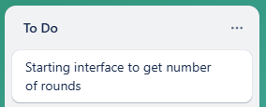
Project Management - Sprint Tracking
Task | Sprint Number | Start Date | End Date
Create starting interface to get number of rounds | 1 | 24/03 | 26/03
What are you working on? | What did you achieve? | What are the next steps?
Creating the starting interface based on the wireframe seen on a later slide. Lots of this was recycled code from the practise tasks. I also continued with planning, making wireframes and the flowchart. | The starting interface is made with the correct colours and the wireframes are complete on mockflow. The flowchart is not complete yet. | Getting the users input from the text box and check that it is valid (ie. an integer greater than 1, no negative numbers or words as input)
Evaluation - what worked well & what did not?
Having the wireframe to work off as a basis was very helpful as I had a visual representation of what my goal was. I did not get the flowchart done in this section as I ran out of time so managing this in future sections will be important.
Notes:
Add information about how your project is progressing - Sprint tracking

Slide 4

Project Management - Sprint Tracking
Task | Sprint Number | Start Date | End Date
Check rounds component | 2 | 27/03 | 28/03
What are you working on? | What did you achieve? | What are the next steps?
Getting the users input from the textbox and checking that it is a valid integer, not any other kind of input. | The program checks the input is valid correctly and displays an appropriate and helpful error message if input is invalid. | Creating the game interface which shows up when the number of rounds input is approved as valid.
Evaluation - what worked well & what did not?
This component was quite straightforward as I was able to re-use a similar component from a practise task.
Notes:
Add information about how your project is progressing - Sprint tracking

Slide 5
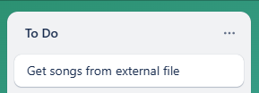

Project Management - Sprint Tracking
Task | Sprint Number | Start Date | End Date
Get songs from file and pick a random one for each round | 3 | 31/03 | 04/04
What are you working on? | What did you achieve? | What are the next steps?
Reading the spreadsheet with the songs and lyrics in it to get a list of possible songs and then pick a random song for each round. | The get songs and get possible answers components are both working with them both being able to print the expected output. | Getting the lyric with the missing lyric to show up on the interface and the possible answers to show up on the buttons in a random order.
Evaluation - what worked well & what did not?
This component worked well and using the type of spreadsheet I am means I am able to add or take away songs at any time without having to add more code or change the name of the file.
Notes:
Add information about how your project is progressing - Sprint tracking

Slide 6
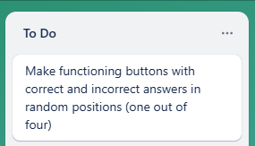
Project Management - Sprint Tracking
Task | Sprint Number | Start Date | End Date
Present lyric and possible answers on interface | 4 | 07/04 | 10/04
What are you working on? | What did you achieve? | What are the next steps?
Getting the lyric with the missing lyric to show up on the interface and the possible answers to show up on the buttons in a random order. | The lyric and the possible answers show up on the screen and buttons. However, the song name is still not showing up. Answers are in a random order | Getting which button the user selects as their answer and check if their answer is correct or not. Play the next round.
Evaluation - what worked well & what did not?
At first I was struggling to make the answers show up on a random button in the section of the code where the buttons are made. I then tried randomising the list in the get song info component which ended up working. Knowing that trying something different worked here is reassuring, I will continue to try different solutions in future components.
Notes:
Add information about how your project is progressing - Sprint tracking

Slide 7

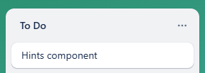
Project Management - Sprint Tracking
Task | Sprint Number | Start Date | End Date
Check if answer is correct and make the hints component | 5 | 28/04 | 02/05
What are you working on? | What did you achieve? | What are the next steps?
Getting which button the user selects as their answer and check if their answer is correct or not. Play the next round. Make hints component. | The program now checks if the user has selected the correct option and displays an appropriate message. Hints component is working and implemented. | Creating the stats component to tell the user their score, correct percentage, average score (from all score list) and high score (from all score list)
Evaluation - what worked well & what did not?
I decided to make the ‘next round’ button disabled until the user answers so they cannot skip through rounds. This was because when I went to make and test the stats component, various errors occurred when a round was skipped as it meant there was no result. This ended up working well with the ‘next round’ button being re-enabled when the user clicks a button for their answer so they can move on to the next question.
Notes:
Add information about how your project is progressing - Sprint tracking

Slide 8
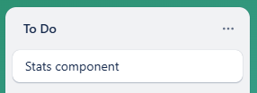
Project Management - Sprint Tracking
Task | Sprint Number | Start Date | End Date
Create stats component | 6 | 05/05 | 07/05
What are you working on? | What did you achieve? | What are the next steps?
Creating the stats component to tell the user their score, correct percentage, average score (from all score list) and high score (from all score list) | The stats component partially works. The user is given the data from the current game but the calculations from the file of previous games is not working correctly yet. | Complete the stats component so it correctly calculates the overall average and high score.
Evaluation - what worked well & what did not?
Making the stats for within the component was very straightforward as it used information already stored within the code. The stats information such as overall average score and overall high score are meant to use data in an external file to calculate information but is not calculating correctly. Further research will likely be needed to complete this component.
Notes:
Add information about how your project is progressing - Sprint tracking

Slide 9
Project Management - Sprint Tracking
Task | Sprint Number | Start Date | End Date
Complete stats component | 6 | 08/05 | 14/05
What are you working on? | What did you achieve? | What are the next steps?
Complete the stats component so it correctly calculates the overall average and high score. | The stats component works successfully after various attempts, research and trial and error. It calculates from the information from the round and from previous rounds from the file. | Testing the full program and ensuring there are no bugs in it. User testing of the whole program will be needed as well.
Evaluation - what worked well & what did not?
Research on writing to and reading from files was extremely helpful in getting this component to work. During my research I found a different way to write to files which did not overwrite the previous text as this was what was occurring before. I also reordered where the round information was written in comparison to the calculations as testing and trialling told me that the calculations were not including the round just played.
Notes:
Add information about how your project is progressing - Sprint tracking

Slide 10
Project Management - Sprint Tracking
Task | Sprint Number | Start Date | End Date
Complete final outcome | 7 | 15/05 | 19/05
What are you working on? | What did you achieve? | What are the next steps?
Complete the program as a whole and finish testing to make sure the whole program works all the way through. | The program is complete with the game working as expected. | User testing will begin now to further ensure that no small bugs remain.
Evaluation - what worked well & what did not?
Implementing the final stats component into the rest of the code worked well after a few switches of thing like variable names were made. Testing of the whole program shows that it works for expected, unexpected and boundary cases without crashing which is a positive sign as it increases the functionality and usability of the program.
Notes:
Add information about how your project is progressing - Sprint tracking

Slide 11
Project Management - Sprint Tracking
Task | Sprint Number | Start Date | End Date
Complete Documentation | 8 | 20/05 | 25/05
What are you working on? | What did you achieve? | What are the next steps?
Complete the documentation to submit with my program. | Completing the slides to show the complete process I went through with my programming and documentation. | Submit my assignment.
Evaluation - what worked well & what did not?
Feedback from my teacher, Mr Tuahine was very helpful as it strengthened my understanding of what I needed to write about, particularly in the complex discussion section of my documentation.
Notes:
Add information about how your project is progressing - Sprint tracking

Slide 12
Addressing Relevant Implications - Functionality
Functionality means to ensure that the program meets its intended purpose and works as expected. It should work for expected, boundary and unexpected cases. For example, my program needs to accept input in the check_rounds component such as expected input like 5 or 20, as well as boundary input such as 1. It should also not crash or freeze if unexpected input is entered such as -1 or ‘one’ as text, but should instead present an error message and give the user the opportunity to enter another input so they can continue with the game. It is vital that I account for every possible expected, boundary and unexpected case that the user could enter.
Functionality is important because if my program was constantly crashing or giving the user the incorrect output, the user will likely become very frustrated to the point that they may even stop trying to use the program. Programs that do not work correctly and are not functional are of limited use and would cause the maker of the game to lose users due to the impatience and frustration surrounding the program not working as it should be.
An example of how I addressed functionality in my program is using functions to check if input from the user is valid or correct. For example, I did not have my code to check if the user has clicked the right button in a function initially. However, when it came to needing to repeat the code for the next round and however many rounds after that, I was struggling. Adding this code into a function meant I was able to loop back to it for each round and therefore, ensure that the input from the user was valid each time. Through testing things like this for functionality, I have made the code more efficient and helpful for the users in the way it handles correct and incorrect answers, and returns an appropriate message to the user about their result before playing the next round. If I had not made this change to using the function, there is the possibility that this section of the program would not work correctly, resulting in errors, reduced functionality, and increased the chances of the program crashing in the face of incorrect answers or other unexpected input.
Notes:
Use slides with this colour background to show that you have addressed the relevant implications. To do this easily, remove this instruction and then duplicate this slide.

Slide 13
Addressing Relevant Implications - Sustainability and Future Proofing
The sustainability and future proofing of an outcome involves making the program easy to update and sustainable in the long term. It means it will still be functional over time and when there are additions to it. For example, if the manager of the lyric guessing game wants to update the list with new songs that have been released in a years time, or gets requests for certain songs that are not yet on the list, these additions can be made to the list without having to change the name of the file in the code or the code itself. All that has to be done is the information added into a new row in the file linked to the program.
Sustainability and future proofing are important because if the program is not easy to update, it can make the developers job very difficult in the long term as they will not want to have to change the entire code simply to add some songs. By ensuring that the program follows the implications of sustainability and future proofing, the program can be updated easily for a greater length of time.
An example of how I have addressed this implication is using a .csv file to save the information about the songs, lyrics, correct and incorrect answers. This file type saved as a microsoft excel file can be updated externally to the code. This means that additions can be made to the spreadsheet, saved, and these updates can be seen within the program without having to update the code itself. The code simply reads the additional rows and adds them to the list to randomise them. If I did not use this kind of file, the name of the file in the code as well as the code itself may have to be updated to update the list of songs, making the game inconvenient and high maintenance to update, resulting in time being wasted on updating the songs rather than improving the code or creating other programs.
Notes:
Use slides with this colour background to show that you have addressed the relevant implications. To do this easily, remove this instruction and then duplicate this slide.

Slide 14
Addressing Relevant Implications - Aesthetics
Aesthetics improves the overall appearance of an outcome to make it visually appealing for the end users. A program that is well spaced out and has nice, cohesive colouring is more aesthetically pleasing than a program that is randomly or unevenly spaced with inconsistent and random colouring.
Aesthetics matter because how the program is presented will be one of the first things that the end user notices. If they find it cluttered and confusing, they are much less likely to continue trying to use that program. It is important to make sure that the program presents a GUI with clear, easy to read spacing and colours that work well together as this makes the GUI more appealing to the user which increases the likelihood of the user happily using the program based on their first impression, and having a nice and easy experience using the program based on the aesthetics that follow.
This also relates to usability. If all of the text, buttons, headings, and labels are overlapping, poorly spaced, and difficult to read, the program would have reduced usability as the user would struggle to understand what was what. They would become very confused by the layout and stop trying to figure out the difficult to understand program. By ensuring that the aesthetics make the program easy to understand, usability is also increased as it makes the program more straightforward for the end user.
To address the implication of aesthetics in my program, I have used various frames such as label frames and button frames with padding in them to ensure that the various labels and buttons do not overlap when presented on the GUI. If I had not done this, all of the information could have become cluttered together, making it too difficult to read and overwhelming for the end users.
Another aesthetic consideration I took was people's imbedded association with different colours and their meanings. In my program, the message that comes up when you are correct is green while the message for incorrect is red. I chose these colours particularly as the colour green is often used and directly linked to being correct while red is used for incorrect. This means that the users know a moment quicker whether they have won or not as they know by the colour before the read the words. My particular choices for colours also extended to the colours of my overall GUI. This is discussed in the discussion section of the documentation. I have once again addressed aesthetics in my program by matching the colours used to the users expectations so they understand what the colours mean, do not become confused, and are satisfied by the colours chosen to represent right and wrong.
Notes:
Use slides with this colour background to show that you have addressed the relevant implications. To do this easily, remove this instruction and then duplicate this slide.

Slide 15
Addressing Relevant Implications - Usability
Usability involves how easy and straightforward it is for the end user to accomplish their task using the program. Key aspects of usability are making instructions clear and easy to understand and creating helpful error messages that effectively tell the user the issue, and suggest a solution to help them get past the issue.
Usability is important because if the user becomes confused by the program due to it being hard to understand and difficult to use, they are likely going to become frustrated at the program and give up on trying to make it work. This would result in less people playing the lyric guessing game, and the bad reputation would likely deter new users from trying out the game. Keeping the users happy and ensuring that can use the program as easily as possible is vital for my final outcome.
In my program, I have addressed usability by making the instructions at the beginning of the game very clear and making error messages helpful and easy to understand. The welcome and instructions tell the user exactly what is going to happen and what they need to do to play the game. To add to this, there is a helpful hints button for the users on the game interface which gives some helpful advice on how to get their points up if they are struggling. Testing with end users proved both of these messages very helpful and easy to understand. In terms of the error messages, the main one that is used to help users to recover from errors is the check_rounds error messages which reads “Please choose a whole number more than zero and less than 100”. This clearly tells the user what they need to enter in order to continue and play the game. Both of these kinds of helpful messages increase the usability of the program by ensuring that everything is easy to use and understand and the users are helped to recover from any issues they may face.
Notes:
Use slides with this colour background to show that you have addressed the relevant implications. To do this easily, remove this instruction and then duplicate this slide.

Slide 16
Addressing Relevant Implications - Legal Implications (Copyright)
My program uses property that I do not own. All of the artist names, song titles and lyrics are owned by those who created and trademarked them and therefore are the current holders of the copyright. Having copyright against these items means that they cannot be used commercially without the permission from the owner. Because of this, I would be unable to make money off of my program currently as I do not have permissions from these artists to use their songs and names in my program or to promote it in any way. I acknowledge this and understand that if this program were to be distributed, I would need to gain the necessary permissions first. This was backed up by information from https://www.ebsco.com which states that “Musical copyright laws refer to an international network of legal codes that provide content creators with the exclusive rights to control the distribution of their work for a set time. Musical copyrights protect both compositions and sound recordings.” This confirms that I am unable to use the songs and lyrics to make a profit without permission meaning that for now, this game cannot be distributed.
Notes:
Use slides with this colour background to show that you have addressed the relevant implications. To do this easily, remove this instruction and then duplicate this slide.

Slide 17
Addressing Relevant Implications - Ethical and Social Implications
The social implications of an outcome involves how it affects the users, the wider community and society as a whole. It also means ensuring that all of the content in the program is completely appropriate for all audiences and does not offend any group of people. For example, the lyrics I have chosen from the songs are all appropriate and do not contain any inappropriate language or comments about certain groups of people. This means that the audience is increased as the program does not exclude any users by offending them such as excluding the younger generation by making the lyrics too inappropriate.
Social implications matter because if they are not considered and addressed throughout the iterative process, the outcome could have unintentional consequences such as offending a group of people or could have a negative effect on society in some way.
I have addressed social implications firstly by ensuring that all content in the program is completely appropriate and not offensive to any group of people. I have also added a limit to the amount of rounds that you can play at a time. This limit is 100 and has been implemented in order to help the mental and physical health of the people playing as it is important to balance screen time with time spent outside and with friends and family. If I had not done these things, the program could have unintentionally offended some people and could have contributed to health issues in the end users.
Notes:
Use slides with this colour background to show that you have addressed the relevant implications. To do this easily, remove this instruction and then duplicate this slide.

Slide 18
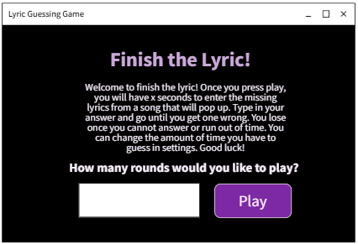
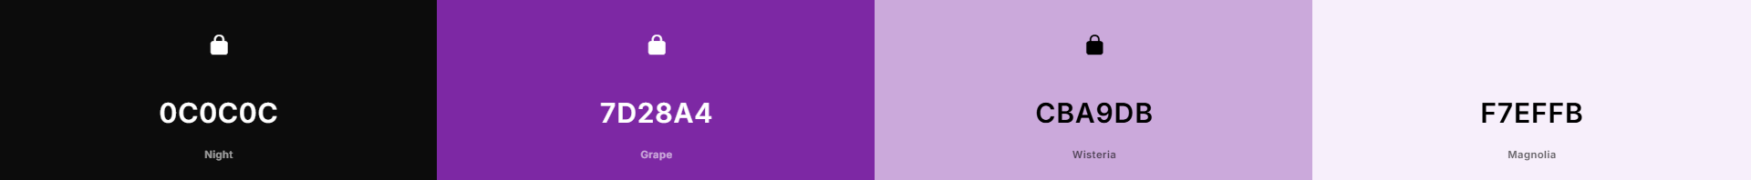
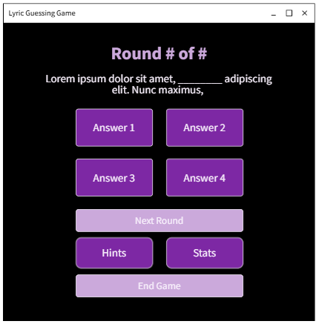
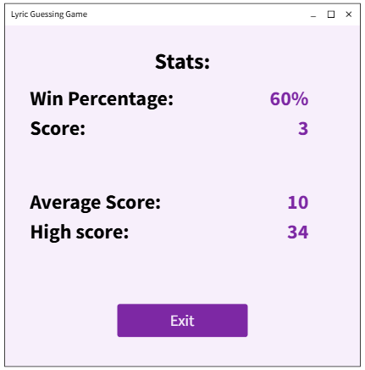
Graphical User Interface Design...
Possible Colour Options...
These screenshots show my wireframe for my lyric guessing program. The one in the top right is the opening interface to welcome the user and get the number of rounds. The bottom left is the game interface with the questions, answers and the other menu options. The bottom right screenshot shows what the stats and hints windows will look like.
Notes:
Create wireframes for your program’s GUI. Please place them on this slide.

Slide 19
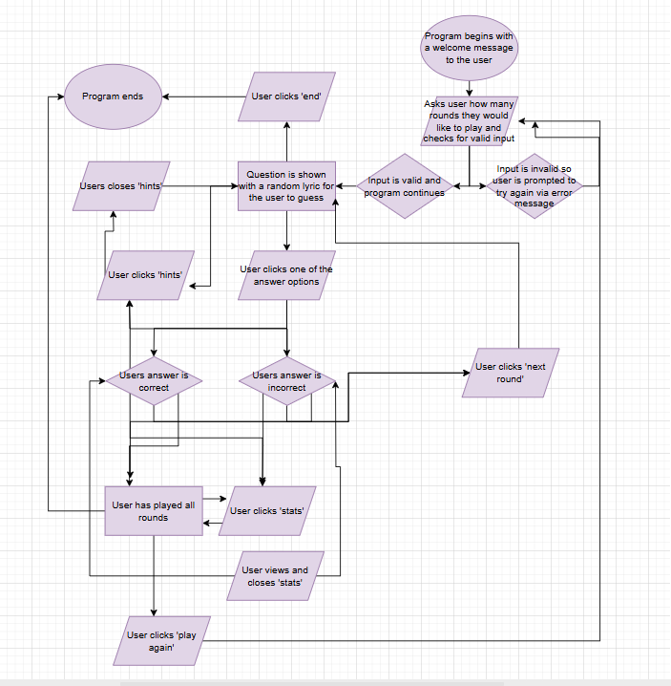
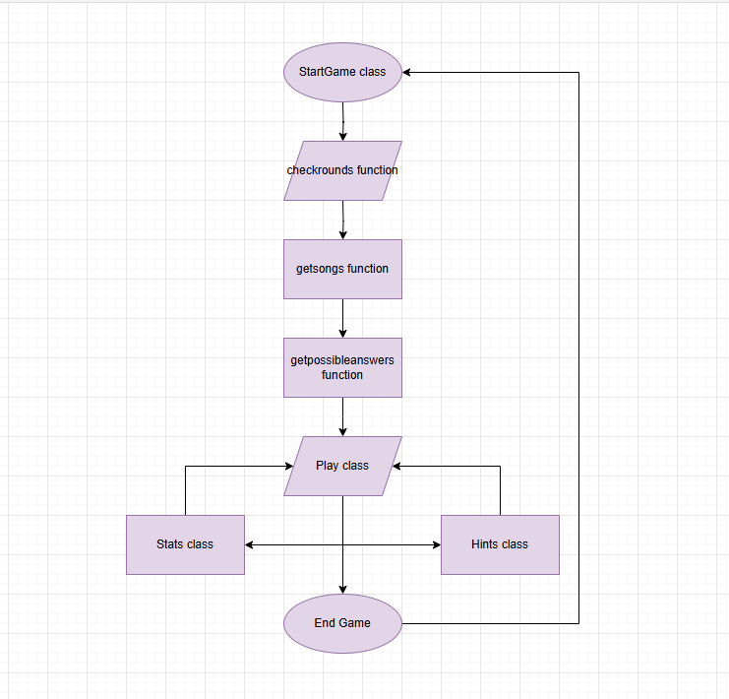
Program Structure
Outline of the program structure:
Classes and functions:
Notes:
Create a diagram showing your program’s structure and outline the classes and functions that you plan on developing. You are welcome to edit this slide once you start developing the outcome BUT when you do that, you should show what has changed and explain why those changes were needed.

Slide 20
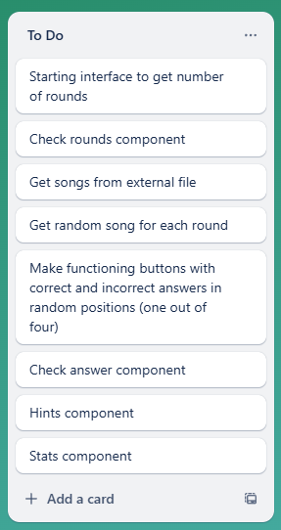
Problem Decomposition
This screenshot shows the decomposed program showing all of the components that needed to be completed. Having this as a basis for the rest of my planning will ensure that I stay on track to get the program done in time with all of the components that it needs to work correctly. This list in Trello was effectively used as a task sheet for me. I completed tasks in the order they appeared on the list and when I finished one component, I knew from one look what the next step was and did not have to waste any time wondering.
Notes:
Provide evidence showing that you have decomposed the task. This can be in the form of a trello screenshot or a list of components. If necessary, you may revisit this slide and add to it / edit it as you create your outcome. When you make changes to this slide, please do so in a different colour, date the changes and explain why they were made (this can help provide evidence for M / E grades).
Hint: Use the structure you developed earlier to work out what components you need. For each function, you should have at least one component.

Slide 21
Develop your Components!!
Make as many copies of the next three slides as you need. For each component you should have…
A trello screenshot / evidence of ongoing use of your project management tools
A test plan for the component that has been created BEFORE you start coding. Your plan should allow you to test all logical pathways for this component. It should also include test cases for relevant boundary and unexpected values.
Screenshot evidence showing that you have worked through the test plan you developed.
You should also provide evidence of trialling multiple components & techniques. Please make slides as needed for that evidence.

Slide 22
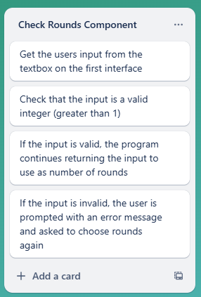
Component Planning - Check Rounds
This trello screenshot shows the check rounds component. The check rounds component gets the users input from the text box on the start game interface and checks that it is a valid integer (greater than 0). If the input is valid, the program continues using the input for number of rounds. If the input is invalid, the user is presented with an error message and asked again to choose a number of rounds within the correct numerical range.
Note: I developed my check rounds component at home and forgot to upload it to GitHub for a very long time. I uploaded it when I remembered which is why it shows up a bit later
Notes:
Duplicate this slide and use it to show your planning for the current component. This could be in the form of a trello screenshot.

Slide 23
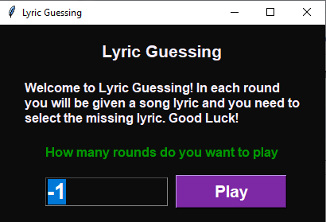
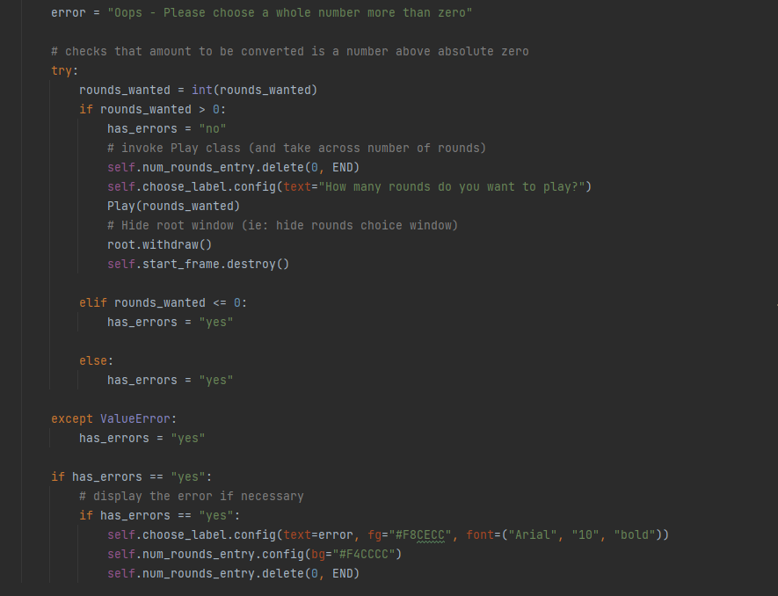
Component Test Plan - Check Rounds v1
Data input | Expected output
abc | Error message displayed, question asked again
0 | Error message displayed, question asked again
1 | Program continues with number of rounds
5.5 | Error message displayed, question asked again
20 | Program continues with number of rounds
100 | Program continues with number of rounds
-1 | Error message displayed, question asked again
As can be seen from the screenshot on the left, when I tested the output for -1, an error message was not displayed. Instead, the input box was disabled and the rounds question was asked again in green text. This is not what should have happened here which led me to double check the component. Here I found an error where the function did not handle if the user entered a negative value. The fixed code is shown on the right where there is an elif loop for if a negative number or 0 is entered into the input box. Altering the loop in the way that I have was an effective technique that allowed me to correctly check the input of the check_rounds function, as well as improved my understanding of such loops within functions for future functions.
Notes:
Create a test plan for this component BEFORE you start coding. Your plan should allow you to test all logical pathways for this component. It should also include test cases for relevant boundary and unexpected values.

Slide 24
Component Test Plan - Check Rounds v2
Data input | Expected output
abc | Error message displayed
0 | Error message displayed
1 | Program continues with number of rounds
5.5 | Error message displayed
20 | Program continues with number of rounds
100 | Program continues with number of rounds
-1 | Error message displayed
Notes:
Create a test plan for this component BEFORE you start coding. Your plan should allow you to test all logical pathways for this component. It should also include test cases for relevant boundary and unexpected values.

Slide 25
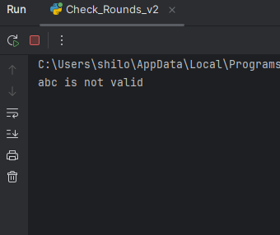
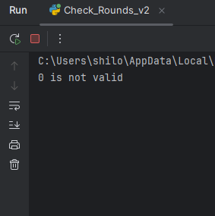
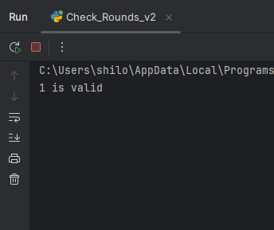
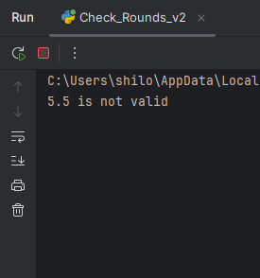
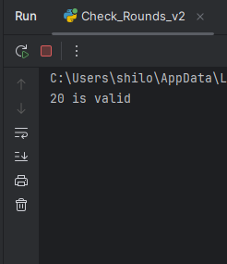
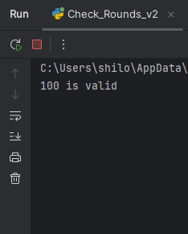
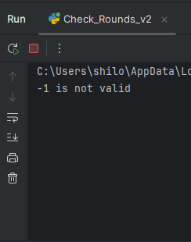
Check_Rounds Testing - Evidence Screenshots

Slide 26
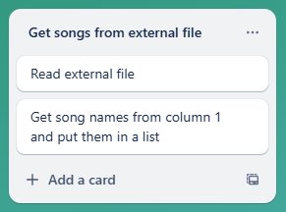
Component Planning - Get Songs
This trello screenshot shows the get songs component. The get songs component reads an external file with all of the song and lyric information in it. It then all of the song names and puts them in a list which is later used to generate a random song for each round.
Notes:
Duplicate this slide and use it to show your planning for the current component. This could be in the form of a trello screenshot.

Slide 27
Component Test Plan - Get Songs
Data input | Expected output
Randomly picks 101 in the list | ['Tate McRae - greedy', "I've been next to you all _____ and still don't know what you're about", 'night', 'summer', 'along', 'day']
Randomly picks 9 in the list | ['Beyonce - Crazy in Love', "How I'm feeling, and my _____ is the one to blame", 'pride', 'husband', 'guilt', 'job']
Randomly picks 86 in the list | ['Olivia Rodrigo - vampire', '_____ months of torture you sold as some forbidden paradise', 'six', 'five', 'four', 'eight']
Randomly picks 106 in the list | ['Renee Rapp - Snow Angel', "Can't tell a lie if you never _____", 'speak', 'talk', 'tell', 'say']
*Based on the random song that the component generated from the list
Notes:
Create a test plan for this component BEFORE you start coding. Your plan should allow you to test all logical pathways for this component. It should also include test cases for relevant boundary and unexpected values.

Slide 28
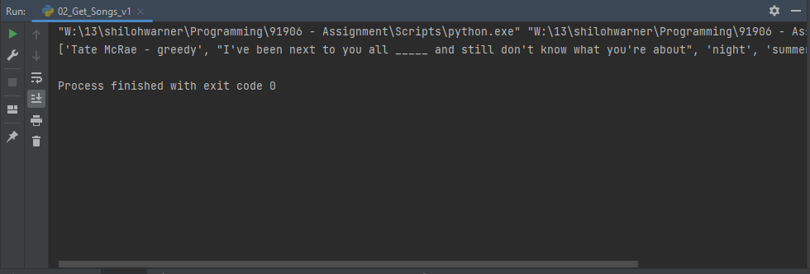
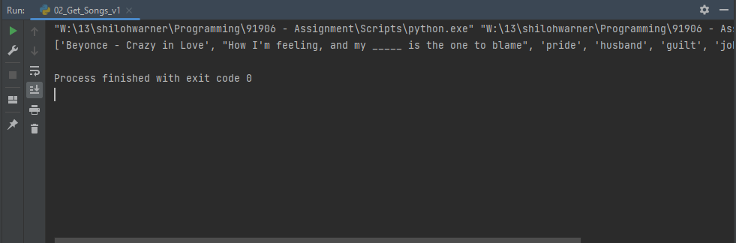
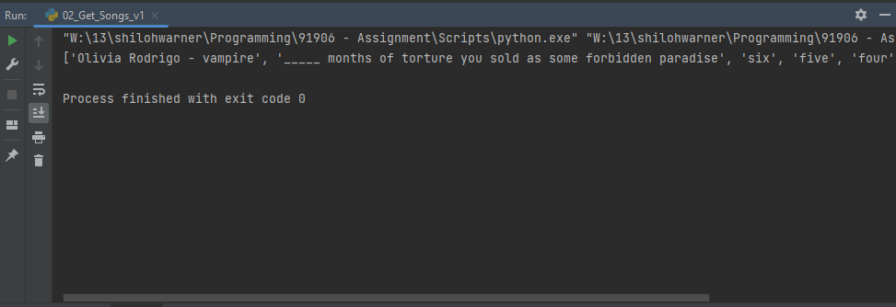
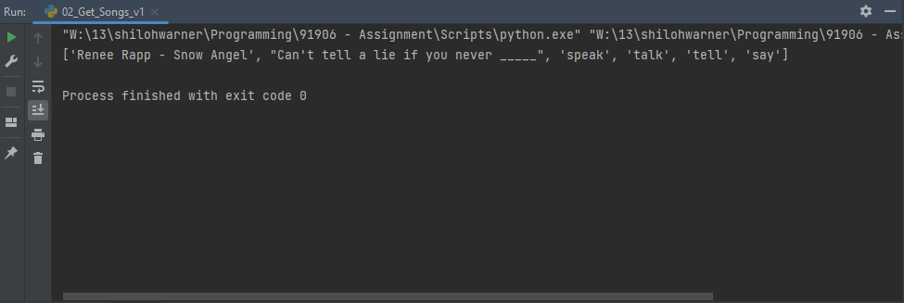
Get_Songs Testing - Evidence Screenshots

Slide 29
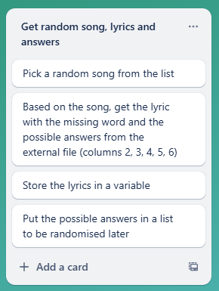
Component Planning - Get song info for round
This trello screenshot shows the get song info for round component. The get song info component picks a random song from the list in the get song component, and then uses the external file to find the corresponding information such as lyrics and possible answers which are needed to play the game. The lyric is stored in a variable and the possible answers are stored in a list to be put on a random button later.
Notes:
Duplicate this slide and use it to show your planning for the current component. This could be in the form of a trello screenshot.

Slide 30
Component Test Plan - Get song info for round
Data input | Expected output
Taylor Swift - Love Story | Taylor Swift - Love Story Escape this _____ for a little while ['town', 'city', 'place', 'house']
Kelly Clarkson - Since U Been Gone | Kelly Clarkson - Since U Been Gone I can _____ for the first time ['see', 'dance', 'breathe', 'sleep']
Lorde - Royals | Lorde - Royals Jet planes, _____, tigers on a gold leash ['beaches', 'islands', 'oceans', 'mountains']
Ariana Grande - yes, and? | Ariana Grande - yes, and? Boy, come on, put your _____ on ['lipgloss', 'lipbalm', 'chapstick', 'lipstick']
Notes:
Create a test plan for this component BEFORE you start coding. Your plan should allow you to test all logical pathways for this component. It should also include test cases for relevant boundary and unexpected values.

Slide 31
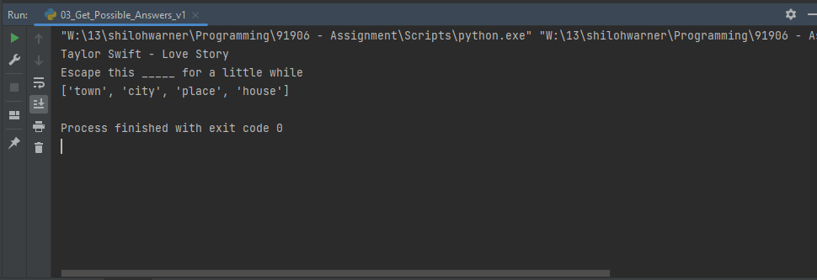
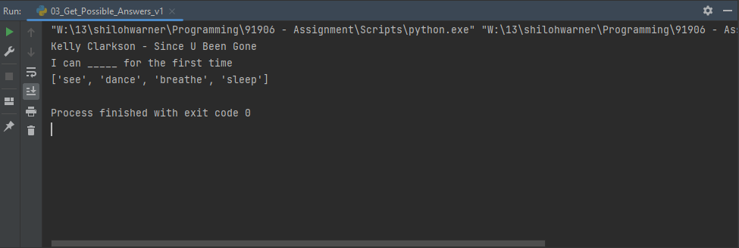
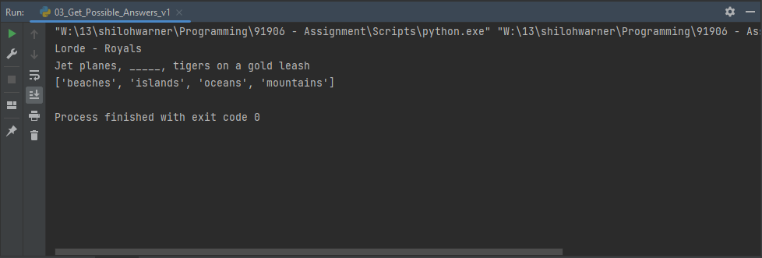
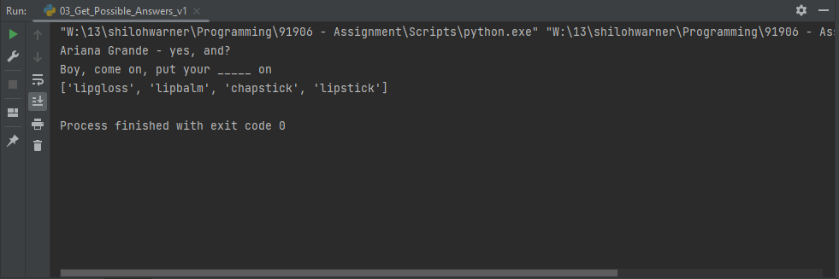
Get_Song_Info Testing - Evidence Screenshots

Slide 32
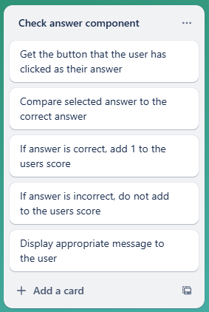
Component Planning - Check Answer
This trello screenshot shows the check answer component. The check answer component gets the button that the user has pressed and checks it against the correct answer. If the answer is correct, a point is added to the users score. If the answer is incorrect, then no points are added. The user is then informed whether they are right or wrong.
Notes:
Duplicate this slide and use it to show your planning for the current component. This could be in the form of a trello screenshot.

Slide 33
Component Test Plan - Check Answer
For ‘Dua Lipa - Don’t Start Now’
Data input | Expected output
‘Survive’ clicked | Correct Message displayed
‘Forget’ clicked | Incorrect Message displayed
‘Understand’ clicked | Incorrect Message displayed
‘Forgive’ clicked | Incorrect Message displayed
Notes:
Create a test plan for this component BEFORE you start coding. Your plan should allow you to test all logical pathways for this component. It should also include test cases for relevant boundary and unexpected values.

Slide 34
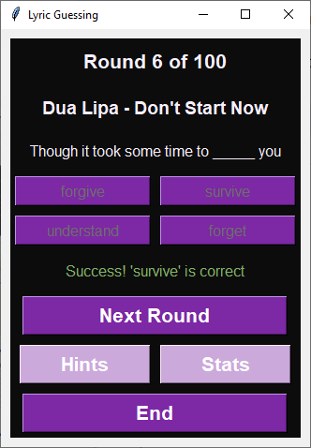
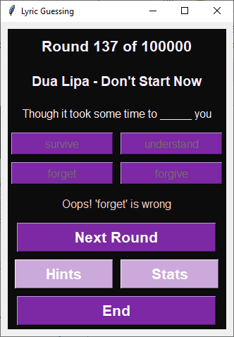
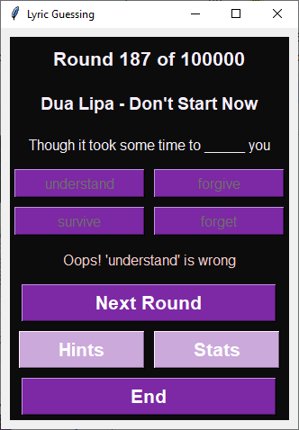
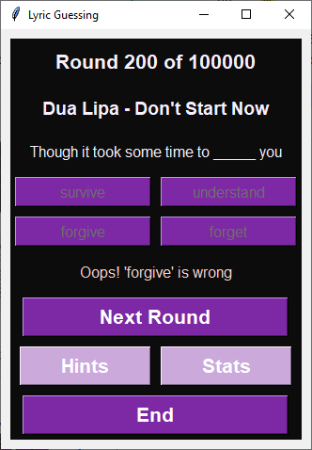
Check_Answer Testing - Evidence Screenshots

Slide 35
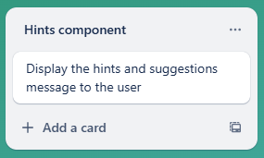
Component Planning - Hints Component
This trello screenshot shows the hints component. The hints component is used to display a menu with some advice on how to get more points and guess the correct answer and can be very helpful if the user is struggling to get the answers right. This component is invoked when the ‘hints’ button is clicked on the game interface. It can be clicked at any time.
Notes:
Duplicate this slide and use it to show your planning for the current component. This could be in the form of a trello screenshot.

Slide 36
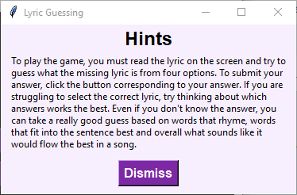
Component Test Plan - Hints Component
This component was quite simple to test as it was simply ensuring that the hints window shows up when the button is clicked, and that the window closes when the dismiss button in the help window is clicked so that the user can continue the game with the knowledge from the hints. Because of this, there was no test plan for this component in the form of a table. The screenshot shown here shows that the component is working as intended and the users can get the hints from the help menu when they click the hints button.
Notes:
Create a test plan for this component BEFORE you start coding. Your plan should allow you to test all logical pathways for this component. It should also include test cases for relevant boundary and unexpected values.

Slide 37
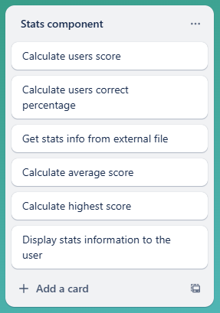
Component Planning - Stats Component
This trello screenshot shows the stats component. The stats component is used to calculate the users game and overall statistics before presenting this information to them. To calculate the overall statistics, it reads from an external file which contains information on the previous games and the scores. This component is invoked through the ‘stats’ button being pressed and it can only be pressed after at least one round has been played (otherwise there will be errors as there will be no game information)
Notes:
Duplicate this slide and use it to show your planning for the current component. This could be in the form of a trello screenshot.

Slide 38
Component Test Plan - Stats Component
Data input | Expected output
File contains 1, 3, 5, 7 | Average Score: 4 High Score: 7
File contains 2, 4, 6, 8 | Average Score: 5 High Score: 8
File contains 10, 7, 4, 13 | Average Score: 8 High Score: 13
File contains 50, 76, 109, 32 | Average Score: 67 High Score: 109
File contains 1, 2, 3, 4 | Average Score: 2 High Score: 4
File contains 10, 9, 8, 7 | Average Score: 8 High Score: 10
Notes:
Create a test plan for this component BEFORE you start coding. Your plan should allow you to test all logical pathways for this component. It should also include test cases for relevant boundary and unexpected values.

Slide 39
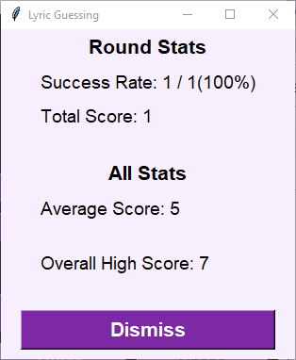
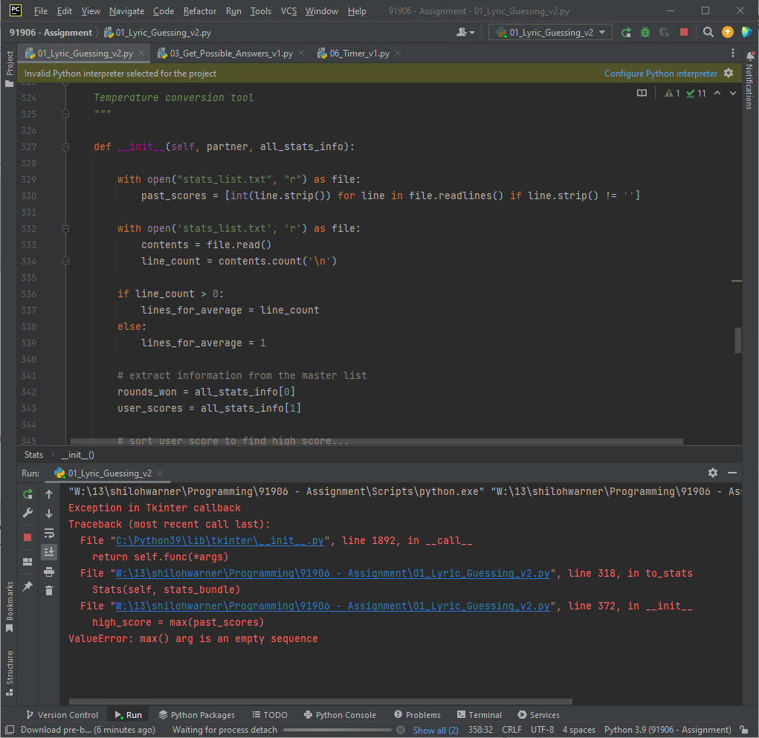
This version of the stats component was calculating the average score wrong as its answer was 5 for 1, 3, 5, 7 rather than 4 which it should be. I realised that it was not including the information from the round just played and was only reading the information that was in the file prior to the game starting.
As I was trying to fix this error, I discovered another error that is, if the file is empty, the line of code which finds the maximum does not work as max() cannot return an answer if there is nothing in the file to read. With various trials to make this code work, such as adding a default score so it could never default to nothing, I eventually realised that the easiest solution was to reorder the code chunks so that the file is read after it is updated and before calculations happen. I also changed the way I was writing to the file which was changing from writing mode, ‘w’, to append mode, ‘a’. ‘W” was overwriting what was in the file while ‘a’ is used to add to what was already in the file.

Slide 40
Component Test Plan - Stats Component v4
Data input | Expected output
File contains 1, 3, 5, 7 | Average Score: 4 High Score: 7
File contains 2, 4, 6, 8 | Average Score: 5 High Score: 8
File contains 10, 7, 4, 13 | Average Score: 7 High Score: 13
File contains 2, 50, 36, 109 | Average Score: 49 High Score: 109
File contains 1, 2, 3, 4 | Average Score: 2 High Score: 4
File contains 10, 9, 8, 7 | Average Score: 8 High Score: 10
Notes:
Create a test plan for this component BEFORE you start coding. Your plan should allow you to test all logical pathways for this component. It should also include test cases for relevant boundary and unexpected values.

Slide 41
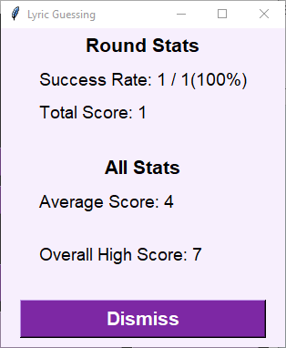
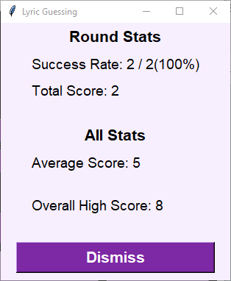
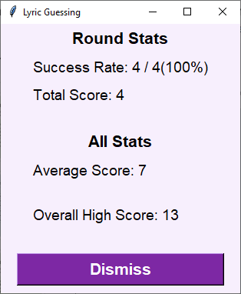
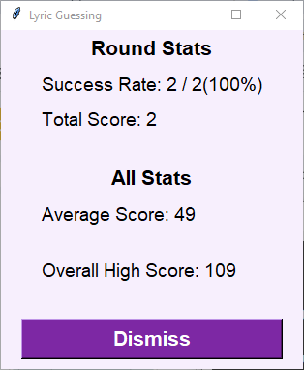

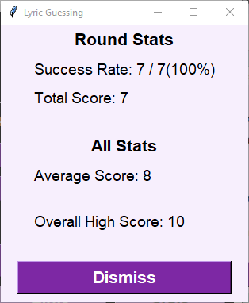
Stats Testing - Evidence Screenshots
Notes:
Create a test plan for this component BEFORE you start coding. Your plan should allow you to test all logical pathways for this component. It should also include test cases for relevant boundary and unexpected values.

Slide 42
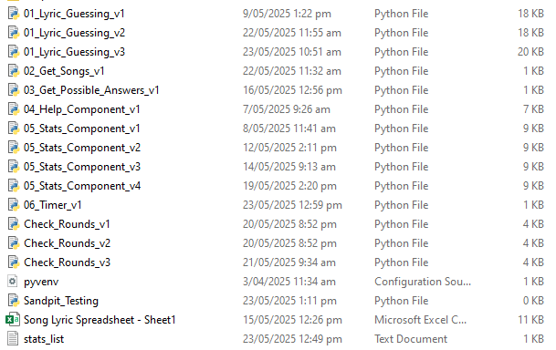
Debugging Evidence - Version Control
The screenshot below shows evidence of my version control. As can be seen, I have broken down my program into various components as I was developing it as well as making multiple versions of some components in order to try new things or fix major issues while keeping the progress I had already made.
Without a version control for my project, progress would have been much slower as I would have lost my old code in attempt to make beneficial changes meaning, if these changes did not work out, I would have lost all of my progress and had to restart. Making new versions when significant changes were implemented also allowed my to debug my program more effectively as with each new version, different bugs were removed as they were found through the trialling. Having multiple versions of some components also allowed me to find the best and most efficient way to use my code before implementing then into the end program. Overall the version control was vital in tracking the progress I had made and being aware of the bugs I had already fixed in previous versions, and the bugs that were yet to be fixed and were therefore my next steps. Tracking these developments were vital in ensuring that minimal bugs ended up in my final program.
Notes:
Use this slide to provide evidence that you have tested your component in accordance with the test plan you developed earlier. Use this slide to provide evidence that you have identified any bugs that prevent certain functionality and how you fixed them.

Slide 43
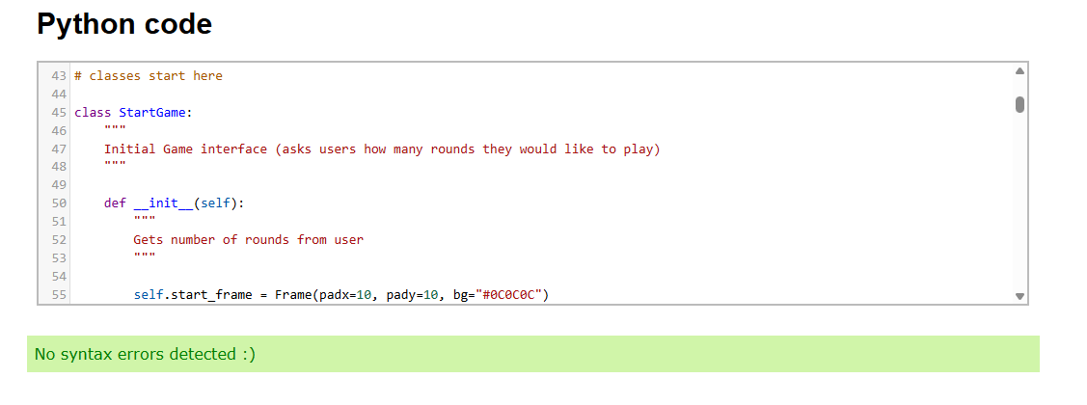
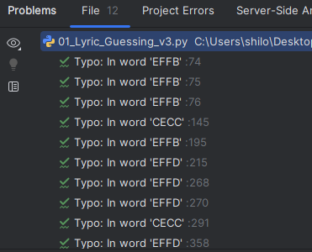
Debugging Evidence - Error Detection
Using python checkers was another important factor of ensuring there were no small bugs in my code. Firstly, PyCharm has a built in error detection system which tells you when there are errors in your code. These could be of various kinds of errors from code being out of scope when used to unexpected data types. This is very effective in helping to find errors in the code before they cause issues in the outcome when the user tries to play. As can be seen in the top screenshot, there are no errors detected in my code. The only thing detected is 12 typos in words but as the screenshot on the right shows, these are in the colour hex codes so therefore, not an issue. Having no errors detected in my code by PyCharm improves the functionality of my code as it reduces the chances that any errors in the code will result in bugs getting into the final outcome. To further ensure that no bugs would end up in my final outcome and cause functionality errors, I decided to put my code into a python syntax checker from https://extendsclass.com and as the screenshot on the left shows, there were no syntax errors detected in my code. This means that my code meets all of the conventions of the python coding language. This is important as small errors even as small as syntax errors can cause major issues to present themselves in the final outcome, reducing the functionality and making it more difficult for the users to operate the program. Both of these kinds of error detection showing no
errors in the code is very positive as any small errors could cause the program to crash when faced with unexpected or unpredictable user activities. Double checking that the code is error free increases the reliability and functionality of the program and makes it more usable for the end users by reducing the chances of any small bugs getting into the outcome.
Notes:
Use this slide to provide evidence that you have tested your component in accordance with the test plan you developed earlier. Use this slide to provide evidence that you have identified any bugs that prevent certain functionality and how you fixed them.

Slide 44


User Testing Evidence
During my user testing, my friend Sam found an error where if you click ‘end’ straight away, you get taken back to the pick rounds screen but cannot enter a number because the textbox is disabled. In order to re-enable the textbox, you have to click play, resulting in an error message and the textbox resetting. When trying to fix this error, I did some research through which I figured out that when ‘End’ is clicked, a whole new window is created and opened which is why this new window was not following the same code as the first get rounds window. To fix this error, I added the highlighted line of code in the screenshot which destroys the additional window created, allowing it to default to the get rounds window that works as it is meant to.
Notes:
Use this slide to provide evidence that you have tested your component in accordance with the test plan you developed earlier.

Slide 45


User Testing Evidence
To fix this error, I added a default colour of the purple tinted white to the frame as this labels text colour. This label in particular did not have a text colour assigned to it previously which meant it was starting at the system default colour, white, before carrying the result texts colour into the next round, making it green if the user was correct and red if the user was incorrect. Fixing this error was vital to the aesthetics of the program as the random green and red ‘=’ on the next round screen could have been very confusing for the users, distracting them from enjoying the game fully.
Amaya found a colouring error where the decorative ‘=’ signs copy the previous rounds result colour.
Notes:
Use this slide to provide evidence that you have tested your component in accordance with the test plan you developed earlier.

Slide 46

User Testing Evidence
Tye suggested making the font of the hint text bigger as it was quite small which could make it difficult for some users to read it such as people who require glasses. When looking into the code here, I realised that I had not set a font size which meant that the text was going to a default size, much smaller than what is ideal. To fix this, I added a line of code into the text configuration which set a text size of 12. This increased the size of the message in the hints window and made it much more readable, meaning that even those who need glasses to help their sight will be able to read the hints message easily. This increases the accessibility of the program as it means that more people can play the game without struggling to read the messages. To re-test this component to ensure that it is now easier to read, I had my dad read them both to me without his glasses and he could read the changed text and said it was very easy to read in comparison to the original.
Notes:
Use this slide to provide evidence that you have tested your component in accordance with the test plan you developed earlier.

Slide 47

User Testing Evidence
To do this, I added another condition to the if loop in the check rounds component,
0 < rounds_wanted <= 100, instead of just
0 < rounds_wanted. I also added another elif condition which was if rounds_wanted > 100 then has_errors is activated. This means that the user is limited to 100 rounds. While this does not prevent them from playing more rounds, as they can click ‘play again’, I encourages users to take a break between games and play a maximum of 100 rounds at a time. This makes the program more ethical as it recommends that the user balance how much they are playing and being online with taking breaks. This is especially important for the younger users who might be playing the game as they have less self control and awareness of how much time they have spent playing as adults would.
Mum suggested adding an upper limit to the check rounds component to encourage people to limit how long they are playing for
Notes:
Use this slide to provide evidence that you have tested your component in accordance with the test plan you developed earlier.

Slide 48
Component Test Plan - Check Rounds v3
Data input | Expected output
0 | Error message displayed
1 | Program continues with number of rounds
100 | Program continues with number of rounds
101 | Error message displayed
500 | Error message displayed
one | Error message displayed
<blank> | Error message displayed

Slide 49







Stats Testing - Evidence Screenshots
Notes:
Create a test plan for this component BEFORE you start coding. Your plan should allow you to test all logical pathways for this component. It should also include test cases for relevant boundary and unexpected values.

Slide 50


Further Insight from User Testing
While making this adaption to this code and writing about it, I realised there was a further improvement which could be made in this if loop. Because I was very focused on the conditions of the if loop, I have created two elif (else if) loops for if the input is less than or equal to zero and if the input is greater than 100. This is unnecessary as the loop already has an else condition in which has_errors is set to ‘yes’ and it reverts to this if the first condition of greater than zero and less than 101 is not met. This therefore meant that I could remove both of these conditions to further reduce the size of the code

Slide 51




Complete Program...
Using testing to improve functionality in v1 vs v2
In the first version of my constructed program, the play again aspect was not working. I found through user testing that when ‘End’ is clicked early, the check rounds window does not work correctly. I also found through trialling the check rounds component that when you enter a negative number, the same thing occurs with the starting window not working correctly. The text box to enter a number of rounds is disabled so no input can be entered. This makes the program not functional and unusable. This occurred because in the first version of my code, I was attempting to make a new window rather than reusing the old check rounds window. From this, I decided to make a version two of my based component to fix this error throughout the code. I decided to try a different strategy in the second version of the program and reuse my initial window. This not only made the code functional and operate as it is meant to but also means that my code is more efficient, being reused when it can be for the same purpose instead of using more code to make another window. In terms of how the code runs, the speed of the response from the computer will be made quicker by the smaller sized program due to having fewer lines which further improves the functionality for the user. A program that responds quickly and runs at a reasonable pace is much more likely to keep users rather than one that is slow due to the size of the program. Trying the different technique to make the play again response improved the functionality of my code in various ways.
close_play in v1
check_rounds in v1
check_rounds in v2
close_play in v2
Notes:
Use this slide to provide evidence that you have tested your component in accordance with the test plan you developed earlier.

Slide 52




Complete Program...
Using testing to improve functionality in v2 vs v3
In the second version of my fully constructed program, there were a few minor bugs that were found during user testing as well as the main functionality error found in trialling which was in the stats component where the average was being calculated wrong, and the high score calculation was causing the program to crash when the file was empty. Both of these factors needed to be fixed in the next version of the based component. In version three, I altered a few things. Firstly, I changed the order in which the events occured in the stats component. In the second version, I had made the mistake of reading the file before the new round information was added to the file which meant that it was not included in the reading. To fix this was quite simple, I changed the order of the code so that the new information was written to the file before the file is read. The next change I made was the way in which I was calling the file to write to it. In the original version, I called the file with ‘w’ and when this was used to write to file, it was overwriting the other information in the file resulting in the round results being the only thing in the file and the past round information being deleted. To fix this issue, I did some research which told me to instead call the file with ‘a’ meaning that when writing to the file, the information will be appended, or added to the list, rather than overwriting. This combined with the disorder of the code was what was causing the average to be calculated incorrectly and the max() line to return an error for being empty. Iterative testing resulted in me finding a better solution to writing to the file and overall calculating the stats information which improves the overall functionality of my program, making it more usable and functional for the user.
Stats in v2
Stats in v3
Notes:
Use this slide to provide evidence that you have tested your component in accordance with the test plan you developed earlier.

Slide 53
Complete Program - Test Plan
Data Input | Expected Output
Check Rounds: 0 | Error message displayed, question asked again
Check Rounds: 101 | Error message displayed, question asked again
Check Rounds: one | Error message displayed, question asked again
Check Rounds: -1 | Error message displayed, question asked again
Check Rounds: 100 | Input accepted, program continues
Hints: User clicks hints | Hints menu is displayed
Hints: User clicks dismiss | Hints menu is hidden, game menu is shown
Stats: User tries to click the stats button | Stats button cannot be clicked before a round has been played
Game: User clicks end | Taken back to the welcome/rounds window
Notes:
Use this slide to provide a test plan for your complete program. You may wish to create multiple slides so that you can test for expected, boundary and unexpected cases.
Remember to test ALL logical pathways so that you can ensure your program works correctly.

Slide 54
Complete Program - Test Plan
Data Input | Expected Output
Check Rounds: 4 | Input accepted, program continues
Game: User clicks the correct answer | Result message displayed and score updated
Game: User clicks next round | Next round is shown
Game: User clicks the incorrect answer | Result message displayed and score updated
Game: User clicks next round | Next round is shown
Game: User clicks the incorrect answer | Result message displayed and score updated
Game: User clicks next round | Next round is shown
Game: User clicks the incorrect answer | Result message displayed and score updated
Game: User clicks next round | Next round is shown
Notes:
Use this slide to provide a test plan for your complete program. You may wish to create multiple slides so that you can test for expected, boundary and unexpected cases.
Remember to test ALL logical pathways so that you can ensure your program works correctly.

Slide 55
Complete Program - Test Plan
Data Input | Expected Output
Game: All of the rounds have been played | Window shows ending message
Stats: User clicks stats | Stats window is shown
Stats: User clicks dismiss | Stats window is hidden
Game: User clicks end | Taken back to the welcome/rounds window
Check Rounds: 1 | Input accepted, program continued
Game: User clicks the correct answer | Result message displayed and score updated
Game: All of the rounds have been played | Window shows ending message
Notes:
Use this slide to provide a test plan for your complete program. You may wish to create multiple slides so that you can test for expected, boundary and unexpected cases.
Remember to test ALL logical pathways so that you can ensure your program works correctly.

Slide 56

Complete Program - Testing Evidence based on Test Plan
Notes:
Use this slide to provide a test plan for your complete program. You may wish to create multiple slides so that you can test for expected, boundary and unexpected cases.
Remember to test ALL logical pathways so that you can ensure your program works correctly.

Slide 57
Complex Processes Discussion - Planning
Planning was a vital aspect in ensuring that I could develop a high quality outcome. Ever since I had just decided on the idea for my program, I understood that there would be various components that would need to be developed in order to get the program working correctly and that I would need to manage my time well in order to get these components complete. Using a trello board to deconstruct my components was very effective as I was able to clearly see every step that needed to be completed in order to get the final program up and running. This meant I was able to plan out my time and manage my progress through the ‘to do’, ‘doing’ and ‘done’ sections of the board to ensure that I was making progress and that I was on track to complete the project on time. During this project, I did face a challenge with timing which is discussed further on a later slide. Planning also helped me to fully break down and understand the specific order that components needed to be completed in. For example, I could not have developed and tested the get_song_info component without first making the get_songs component as I cannot get information from a list of songs that the program does not have yet. The planning measures I took ensured that the program was completed in the correct order and therefore reduced the amount of time wasted on trying to make a component early, getting stuck, and having to backtrack through other components to find what I really needed to be working on. This improves the functionality of the end program and reduces the chances of small errors ending up in the outcome as I never leave what I am working on before completion to make something else. If I had jumped between components I likely would have forgotten about some things that needed altering or fixing, resulting in more uncaught errors sneaking through into the final outcome and causing greater issues. Overall, the use of this planning was extremely effective and vital to the success of the project as it allowed me to manage my time as best as I could, understand every step that needed to be completed and in what order to ensure that the final outcome was completed in its entirety, and increase the functionality by reducing the amount of small bugs slipping through from jumping between components constantly due to being at the wrong point in the programs development. If I were to go through this process again, the main thing I would change in my planning is allowing more buffer time for unexpected setbacks in the code, and unexpected days being away and unable to work on the project. As discussed on a later slide, I was unable to complete a different game mode in time due to unexpected setbacks in the stats component, so in future I would allow more spare time during my planning to have more wriggle room for unpredictable time constraints like this one.
Notes:
Reflect on how using the processes helped to develop the outcome through effectively testing and trialling various components to refine and enhance the design and functionality.

Slide 58
Complex Processes Discussion - Testing and Trialling
Throughout the development of each of my components, I thoroughly tested for every possible input from the user and every possible outcome in order to ensure that the program did not crash in the face of unexpected occurrences, and was able to recover itself and help the users to recover if it was an input error. To do this, I developed test plans for each component which contained expected, unexpected and boundary inputs to make sure that the programs output was reasonable, accurate, and helpful. For example, when I tested my stats component, I realised that it was calculating the average scores incorrectly, getting 5 when it should have calculated 4. This led me to begin some research to find a solution to the issue. While looking at some example write to file code on a website, I realised a small difference in how they were calling the file to write to. I was using ‘w’ while they were using ‘a’. I had used ‘w’ as this is what I have used for past projects and it was simply what I had defaulted to, I had not even considered that there might be a better or different way to write to a file. With a little more research, I discovered that ‘w’ is the call to write to file when you want to overwrite what was previously there while ‘a’ is used to append to a file and add to it without removing the previous information stored in it. With a quick check of my txt file I realised this was correct and the previous game data had been removed. As the whole purpose of my stats file is to store information from the previous games, I decided to trial writing to file with ‘a’ instead of ‘w’. I tested this new version of the stats component again and it worked effectively, calculating the users average score correctly. From this successful testing, I decided to use the newer version of the stats component instead of my original version. This shows the importance of thoroughly testing all of the components. Had I not tested the stats component well, this error could have ended up in the final program which would mean that the users would have been being told incorrect stat numbers. Small bugs like this could get through at any stage of the component development if they are not tested well enough, by testing well I have reduced the chances of these small bugs getting through to the end code and causing greater issues. This therefore increases the functionality and usability of the outcome as it means that it is functioning correctly and as it should be, and more users can happily play the game without the annoyance of the stats component being incorrect.
Notes:
Reflect on how using the processes helped to develop the outcome through effectively testing and trialling various components to refine and enhance the design and functionality.

Slide 59


Complex Processes Discussion - Testing and Trialling
The importance of trialling different methods was shown again when I attempted to implement the get_songs component in with the other classes and components. In the python file for the separated get_songs component, the code works but is not in a function, it is simply part of the main routine. When I tried to implement this back into my game to get everything to work together, I was struggling to access the code as I was not able to call it whenever I needed to. With this issue in mind, I decided to trial making the get_songs component into a function, allowing me to call it when it was needed later on in the code and have it return information so it is easily accessible to other parts of the code. Having the get_songs component in a function worked out and was much more effective than having this code sitting in the main routine and therefore is the option that was used in my final outcome. This shows the importance of trialling different options and testing for which one was more effective for each component. Without trialling and testing a different option, I would have struggled to get my code to work as the information that get_songs retrieves would have been out of scope of some of the code where it is needed. Trialling and testing improved the functionality of my program by allowing me to find the best and most effective way to use and call my code.
Notes:
Reflect on how using the processes helped to develop the outcome through effectively testing and trialling various components to refine and enhance the design and functionality.

Slide 60
Complex Processes Discussion - User Testing and Feedback
User testing and feedback was another factor in the development process that greatly influenced the quality of my final program. User testing and feedback is extremely important as user testing can often led to errors being found in the unpredictable way users operate outcomes that can be difficult for developers to discover on their own, and feedback tells you both directly and indirectly what the end user wants which is vital as if the outcome is not what the end users are looking for then they simply won’t use it. During the user testing of my outcome with my friend Sam, she did just this and tested something I hadn't considered testing myself, the user pressing ‘end’ straight away without playing any of the game. This resulted in the user being taken back to the check rounds screen, but the input box was disabled so you could not type into it meaning you could not play again. From this, I investigated the issue and did some further research to find that a line of code I was using was causing a completely new window to be presented instead of just reusing the previous check rounds window, and the duplicate was causing the textbox to be disabled. Thanks to the user testing, I was able to identify and fix this error so that it did not end up in my final outcome where it would have caused issues for the end user when they wanted to play again. This also shows the importance of user testing in the sense of making sure every possible path that the users can take is covered. I myself would never have thought to test what happens when you end without properly starting the game but thanks to the user testing, I was able to identify the bug and fix it resulting in a final outcome with increased functionality and usability.
Another example of how feedback was used to improve the quality of my outcome was when I first began making the spreadsheet of songs to begin developing the get_songs and get_song_info components. To begin with, I only entered songs that I knew of and enjoyed, as I was only pulling them from my mind. When it came to asking my friends and family about the first versions of the code, every single user I tested with asked if they could recommend some songs to add or add some to the spreadsheet. While the feedback here was not explicitly telling me I needed to broaden the range of songs, it was very clearly understood that the users would enjoy the game more if they found some of their favourites in there. From this user testing and feedback, I decided that instead of picking the songs myself, I would get a range of the biggest songs from the early 2000’s to today. This increases the chances that more people will enjoy the game as they are more likely to become excited by coming across a song they know. From this, I also ensured that whatever method I used to store the songs and the code to get the songs was easy to update so that I could take requests on what songs should be added to the game so more people can enjoy it for longer. This led to some research which suggested using a csv file, which proved in testing to be very effective as I do not have to change any code, I can simply add to the spreadsheet and save it and the program will automatically get the new songs and include them as well. This clearly shows how user testing and feedback improved the quality and usability of my outcome as more users will be happy with the selection of songs that are there and if they are not, more can easily be added. Without this user testing and feedback, my program would have been very narrow and only targeted people who have a similar music taste to me. Feedback from the end users broadened my audience and made my program more enjoyable to play for all.
Notes:
Reflect on how using the processes helped to develop the outcome through effectively testing and trialling various components to refine and enhance the design and functionality.

Slide 61
Complex Processes Discussion - User Testing and Feedback
One of the first steps in my planning after breaking down my program was to make a wireframe and therefore, decide on a colour scheme. I narrowed my options down to the two colour palettes seen in the screenshot on an above slide. I then did some user testing by asking a few people which colours they would prefer for a lyric guessing game to determine what most end users would prefer. In my first test with Amaya, I was told that the blue was the favourite option. Later that day when asking my Mum, I found that she preferred the purple. These differing results from testing led me to do some further research into what colours would be best for my programs GUI. Research showed that blue is often associated with tranquility and even sadness while purple is often more associated with creativity and fun. From this research, I was leaning towards purple for my game as the game is all about fun rather than tranquility. My Mum also later explained to me that she tends to associate blue in games with things like crosswords, which is not reflective of my lyric guessing game which is why she had recommended the purple. Thinking about this even further, I realised that using the blue colour scheme with a known association to calmness, tranquility and crossword puzzles could subconsciously cause some of the younger audience to not be as excited or willing to play the game. I combined information gathered from testing and further research to decide to make my colour scheme purple as to make the game associated with fun and to not limit the audience by using the blue colour scheme. This shows how important testing and research were to my outcome. Had I trusted the judgement of the first person I tested with, I could have unintentionally reduced the number of people using the game simply due to the colour associations they may have with what they were seeing. Overall the testing and research helped me to improve the aesthetics of the game, by making the colours match the theme, and the accessibility of the game, by reducing the unconscious bias of younger users.
Notes:
Discuss how you used (and combined) information gained from the planning, testing and trialling of your components to improve the quality of your program. Note that synthesising information from planning, testing and trialling of components and then discussing how this lead to a high quality outcome are needed for an E grade.

Slide 62
Complex Processes Discussion
As can be seen in the screenshot to the right, I have a component in my version control which was not used in my final outcome, a timer. As part of my original idea, I was going to add a second game mode to the lyric guessing game where instead of entering a number of rounds, the user enters how many seconds they would like on a timer and they then get that many seconds to guess the missing lyric. The timer resets for the next round if they get it right and the game ends if the user is wrong or time runs out. As can also be seen in this screenshot, the stats component has 4 versions as I faced a lot more trouble than expected when trying to get this component working. Due to having to spend more time on the stats component, I did not have time to complete the other game mode for the lyric guessing game. Looking back on the process I took throughout creating this program, I could have tried to plan my time a little bit better by having a longer term plan for when each component would be complete however even if I did do this, I would not have predicted the stats component taking as long as it did. It is impossible to know exactly how long each step in the complex process of making the program is going to take meaning that despite my best efforts, I may never have been able to complete this part of the program due to the time restraints of the assessment. If I were to continue to develop this program with more time on my hands, I would implement this timed gamemode using a similar methodology as I did with my successful game mode as it was proven to work well, you simply cannot predict the time that will be taken up by unexpected roadblocks. The main way I would prevent this from happening again in future projects is allowing more buffer time. I would plan out my projected allowing more spare time before the deadline to account for any difficulties that take up more time and take away time from other components. Adding more buffer time with be something I will implement into the planning of my next project in order to increase the chances that I can complete the whole idea before the assessment deadline.
Notes:
Reflect on how using the processes helped to develop the outcome through effectively testing and trialling various components to refine and enhance the design and functionality.

