Slide 1
91892 Databases
Women Olympic Athletes Database
Working outcome: https://php.mmc.school.nz/201COS/isaacearp/91892_isaacearp/Women%20Olympic%20Athletes%20Database%20-%20Finished%20Website/
For this assessment my goal is to create an website outcome that successfully and efficiently presents data from an external database. It should have special functions such as a quick search for olympians, item search dropdowns for specific aspects of the olympians and the ability for a user to add their own data into my database through the website. The data I used was sourced from the website: https://www.kaggle.com/heesoo37/120-years-of-olympic-history-athletes-and-results
Notes:
Please add links to your work on this slide

Slide 2
Sorting Data Selection
This is a glimpse of the spreadsheet that I used to apply to the main table of my PHPMyAdmin database. Connected to each _ID label is another tab in the spreadsheet that links said ID to a int or varchar value. This sheet is to be cleaned of all values that have a corresponding ID column next to them, as they were only put there to use an excel command to link them all to their specific tables.

Slide 3
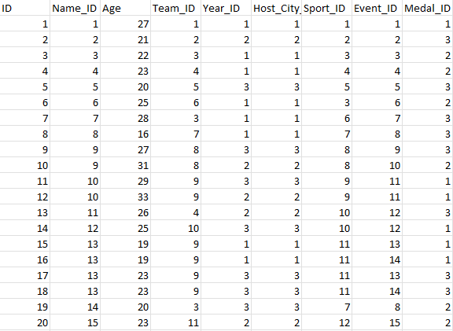
Sorting Data Selection (continued)
This screenshot shows all of my main table data in third normal form, which is a method of organizing data that simplifies data and decreases risk for duplications or possible anomalies. To achieve this form I removed of the value columns that had corresponding ID columns next to them, as they have all been added into external tables that will be connected to the main table with use of SQL queries within the website.

Slide 4
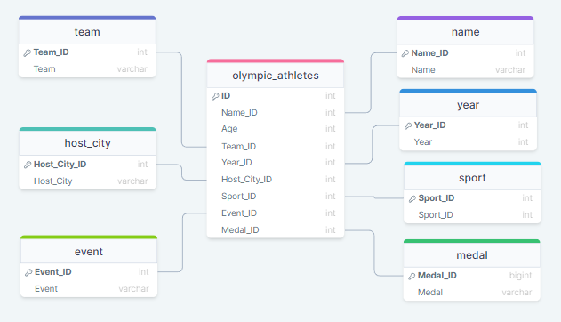
Database Design (First Iteration)
The main table named olympic athletes has all integer values in the columns. Each of the ID values have been linked to other tables that contain both the ID values and the variable character values. This allowed me to connected the ID of an item to its variable character through multiple tables.
Notes:
Place your database design on this slide

Slide 5
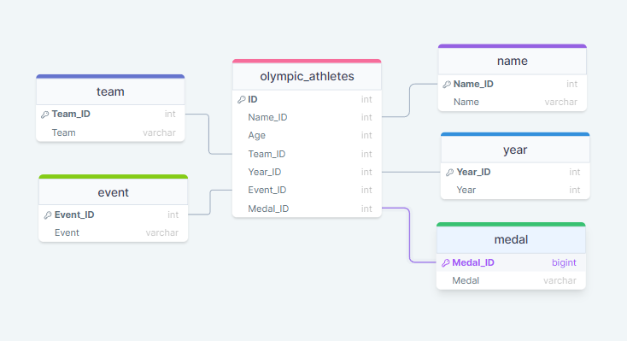
Database Design Refinement
I cleaned out my database by removing the values of sport and host city. This is because sport was listed in the corresponding event every time and the host city had the same ID as the year. Therefore I optimized the website to have less tables but the same amount of data.

Slide 6
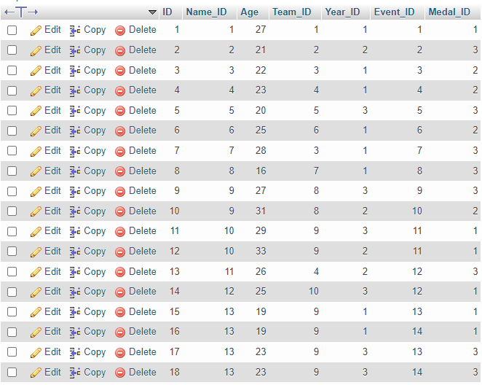
PHPMyAdmin Database (Main Tables)
Main Table:
This is most refined version of my PHPMyAdmin database. All of the refinements made from the first iterations have been listed in the previous Database Design Refinement slides. This is the main table out of five others which contain the linking information to collate the data onto the website.

Slide 7
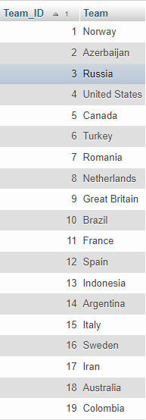
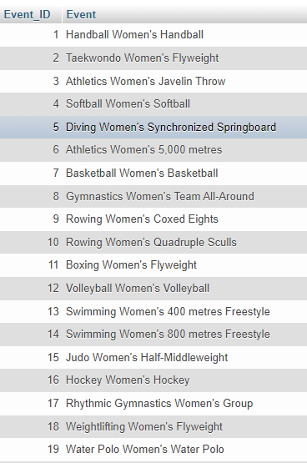
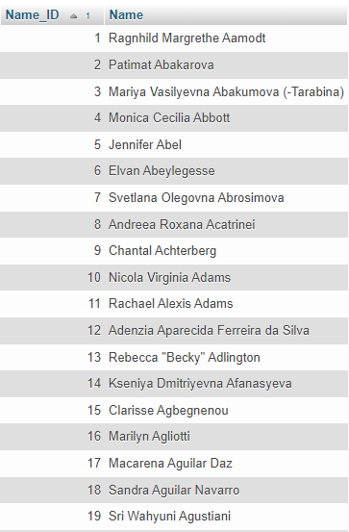
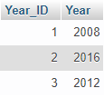
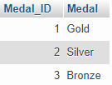
PHPMyAdmin Database (ID Tables)
These PHPMyAdmin tables show the ID tables that connect to the _ID values in the main table. Using these tables in the database, I can connect the _ID values from the main table to a int or varchar value that I can display on the website.

Slide 8
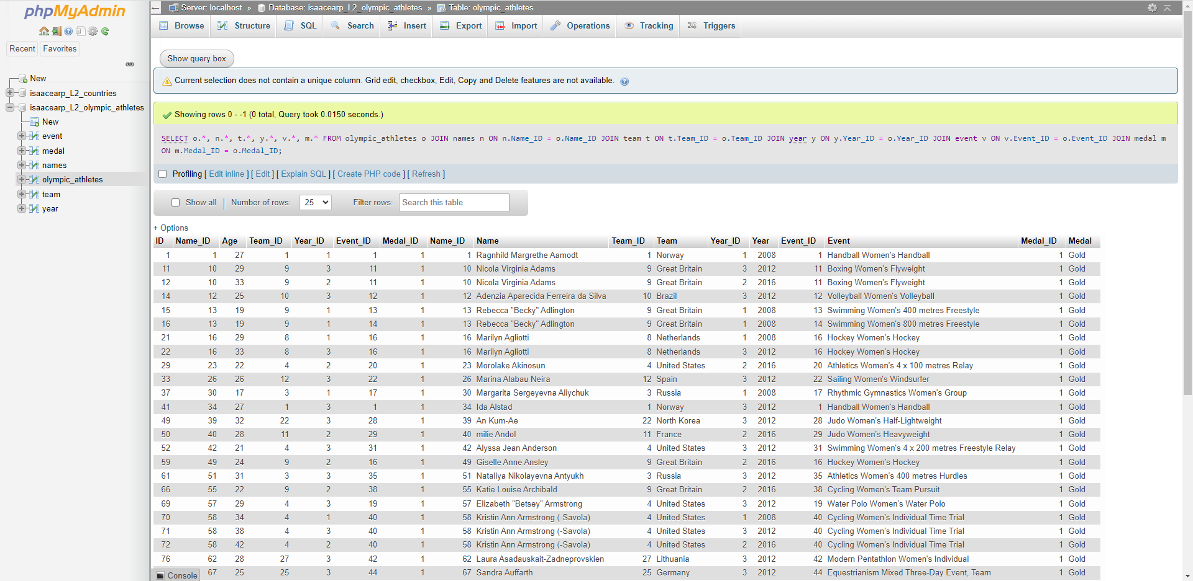
SQL Testing
To validate my SQL queries, I first put them into the PHPMyAdmin SQL entry to make sure they yielded the results I wanted. For example, the sql input below gave me the correct data from my table and in the format I wanted. It connected the _ID columns on the main table with their corresponding value on the individual tables:

Slide 9
SQL Testing Continued
Another SQL entry that I had to test was the search functions on my website that required a LIKE% % input from my database. To retrieve this query, I went into the table that I wished to find the query, opened the search menu, selected LIKE%...% and searched for an item. This returned me a working search query that I could input into my website and would pull up the right results:
Here is a video that demonstrates more clearly how I did this:
https://drive.google.com/file/d/1VERMshwwvvXQiZRH3bnZtuItQO3254-U/view?usp=sharing
Below on the left shows the SQL query that I found from PHPMyAdmin and on the right shows the edited and simplified version that I put into my website:

Slide 10
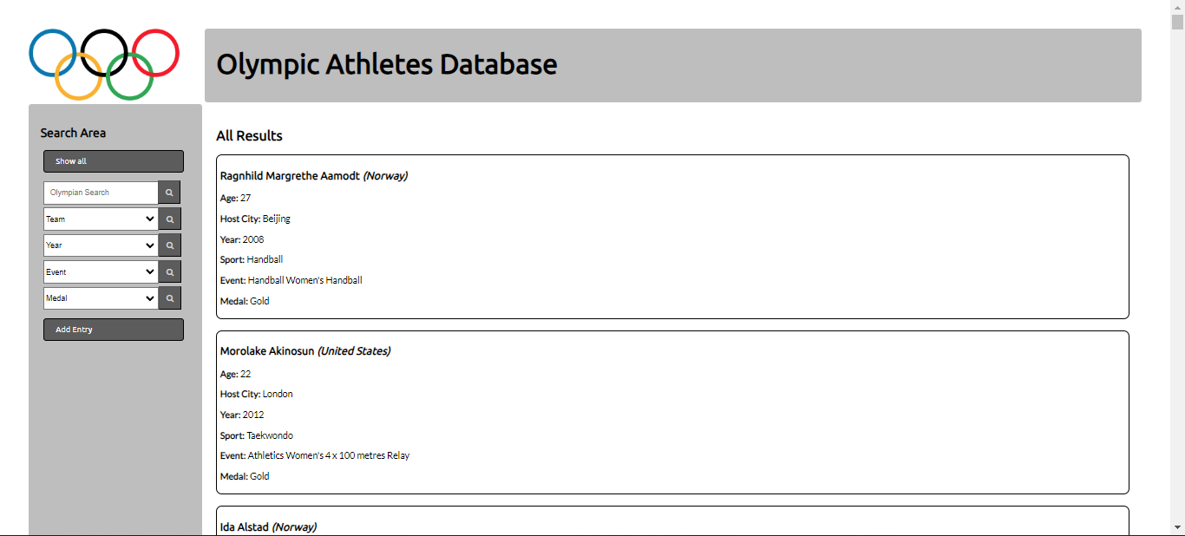
Results (First Iteration)
This screenshot shows the first iteration of my show all page. This shows all of the data pieces being presented in results divs in order of their Primary ID. This iteration includes all original data pieces that I intended to enter.
Notes:
Place a screenshot showing that entries in your database can be seen via your website (eg: provide a screenshot of a basic ‘show all’ page)

Slide 11
User Testing
To test my first iteration of results, I asked my dad to review the show all page and give me feedback as to some of the things I can improve towards creating a better outcome. While showing him my website I got the following feedback:
“I find the bold colours of the boxes hurts my eyes a little bit and makes the black text a little bit harder to read.”
He also wondered why I had a sport listed in the box and then the sport being repeated in the events listing.
Notes:
Place a screenshot showing that entries in your database can be seen via your website (eg: provide a screenshot of a basic ‘show all’ page)

Slide 12
Possible Results Refinements
There are a couple ways in which I can refine my results to provide the user with a better and more usable outcome. Using both my own ideas and my dads I can implement the following:
For a start, I plan organise the data further both within the database itself and its presentation on the website. To get rid of any unnecessary data points that can be displayed using already existing data, I removed my host city table and host city column from the main olympic_athletes table. I removed the host city data because the Host_City_ID was identical to the Year_ID, which meant that I could present the host city data using just the Year_ID. As for the sports data, every sport that was presented in the sport table was already mentioned in the events table, therefore I found it redundant and a waste of space.
To further refine my data and its presentation I also want to consider the aesthetics and usability of my data. To make it more pleasing to the eye, I plan add some colour into the results boxes that correspond to the Medal colour present in the results box. Additionally, I also plan to remove the independent Year label in my results div and combine it with the year div, as they are related.

Slide 13
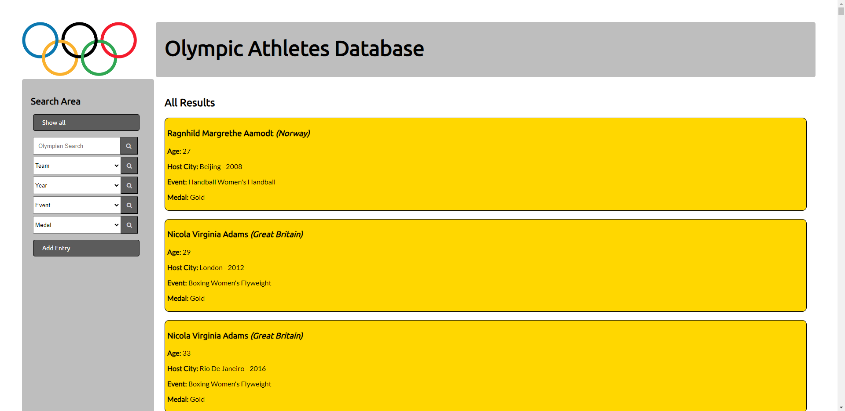
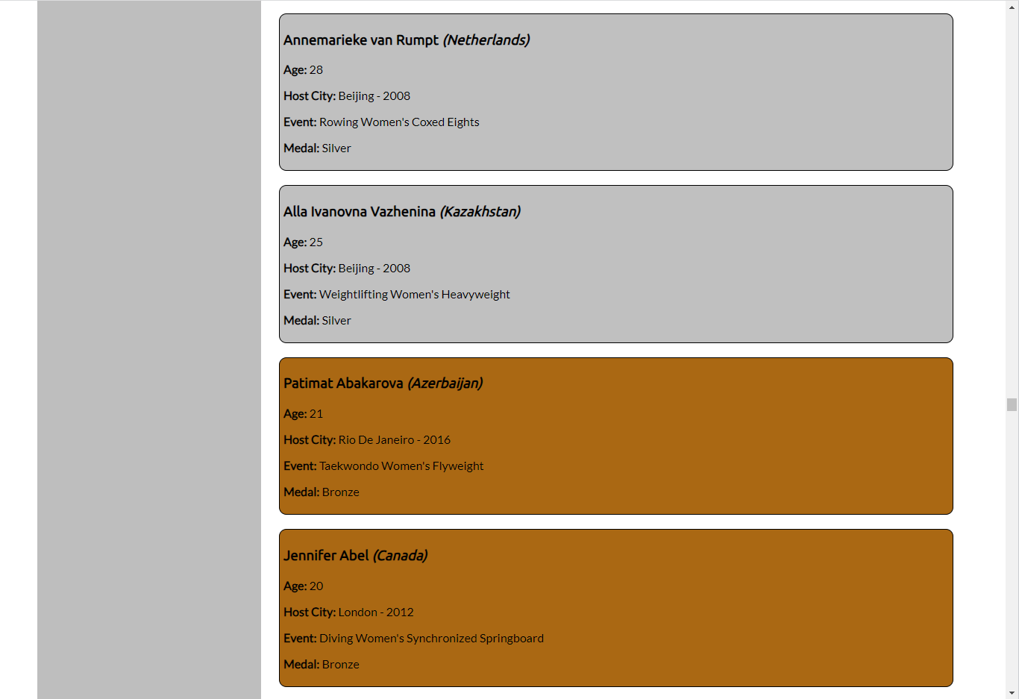
Results Refinements
To refine my show all page, I first allocated each results div to the corresponding colour of their medal. I felt this would enhance the aesthetics and usability of the website, as it more prominently shows the olympian’s medal colour. I also got rid of host city and sport, as the host city had the same ID number as the year, so I could connect it just using the year ID. Every event listed had the sport preceding it, therefore I found the sport table redundant. From here, I plan to use lighter colours for the results divs, as the dark and bold colours can make the divs both unreadable and not pleasing to the eye.
Notes:
Outline how you can refine / improve your results (for M / E). Then include extra slides showing that you have implemented the refinements.

Slide 14
Results Refinements Continued
These screenshots show the lighter colour of the divs, however from here I also plan to make the Medal colours more prominent by adding a border of the corresponding medal colour as a darker tone. This should ensure the viewer knows that the medal colour correlates to the div.

Slide 15
Results Refinements Continued
These screenshots show the final divs, which have a lightish background colour corresponding to their medal colour, and a border confirming it with a more prominent and darker tone of the medal colour. I feel this is an appropriate final out come for the results, as it has taken into account usability and aesthetics to provide the user with an effective and aesthetically pleasing outcome.

Slide 16
Results Implications
Aesthetics: I was able to address the implications regarding the aesthetics of my results function by adding some relevant colour changes to the divs. Instead of having a white background with a black border, I changed the divs to have a light tone of their medal colour with a darker tone as the border. I felt that this would have both aesthetic and usable applications, but primarily aesthetic.
Usability: To address this implication I decided to refine my data selection to get rid of any unnecessary data points such as the host city which could be presented using the Year_ID, as they are identical. Additionally, I removed sport as it was already represented in the event label and was therefore redundant. This made the data less repetitive and easier to understand and analyze for the user.

Slide 17
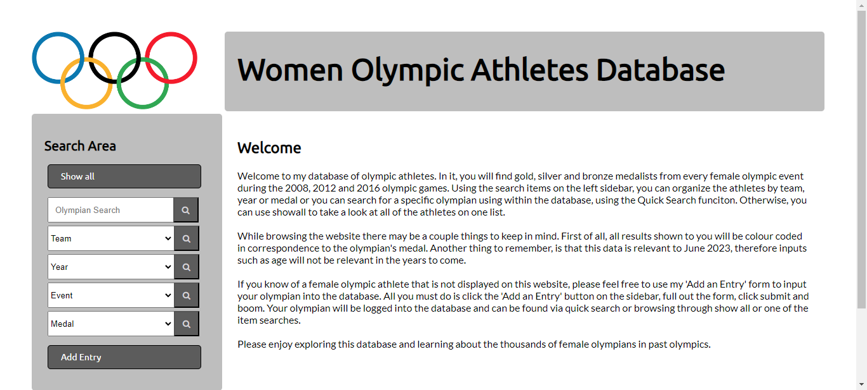
Copywriting on Home page
To try and make my website more accessible to those with trouble seeing or focussing, I decided to spread out my copywriting on my homepage so as not to trouble those people. These are before and after screenshots.
Before:
After:

Slide 18
Basic Search Test Plan (and Evidence)
As a function of my website, I would like to a simple text input for the user to search the database for a specific olympian. I plan to do this by using the search function on my PHPMyAdmin database to return me a working SQL query that I can plug into my website. When plugging it into my website, I will use a simple $quick_find variable that will input the search query into the SQL query at the appropriate point. From there, all of the relevant results divs should be presented to the user, relevant divs being those that contained the user’s search somewhere in the olympian’s name.
For my basic quick search input to be deemed functional, a search input should return all result items that contain the search input anywhere within the name of the olympian. Here are videos of both my planning method and test to confirm its validity:
https://drive.google.com/file/d/1VERMshwwvvXQiZRH3bnZtuItQO3254-U/view?usp=sharing
https://drive.google.com/file/d/1pikCK_7PeU8ZOxXsbPdzEAjkGa8yy6Wz/view?usp=sharing (ignore the duplicate years, it was promptly fixed)
Notes:
Provide test plans that will allow you to confirm that your basic search works. These should be followed with screenshot / video proof of a working search feature. Use as many slides as necessary for this.

Slide 19
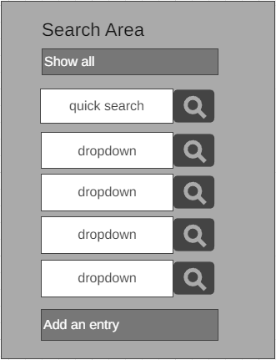
Advanced Search Test Plan (and Evidence)
As an advance extension of my basic search plan, I am going to add a few dropdown menus that the users can use to search the database for specific teams, years, events and medals. The wireframe left depicts how I wish for the sidebar to look after adding in the dropdown search functions. Each box labelled dropdown will contain all of the options for a specific item, including the four I mentioned before. For example, a year dropdown box should contain options of 2008, 2012 and 2016. From there, once an item is selected an the submit button is clicked, the user should be taken to the search page corresponding to the item and shown all of the results that contain that item. For example if the user search for gold under the medal dropdown they should find all olympians who received gold medals.
Notes:
If you have planned & created an advanced search facility, insert slides showing your planning / wireframes and testing for this feature. Your test plans should allow you to confirm that your advanced search works. These should be followed with screenshot / video proof of a working search feature. Use as many slides as necessary for this.

Slide 20
Advanced Search Test Plan Continued
To retrieve the SQL queries for the search queries, I plan to again use the search feature on the PHPMyAdmin database. The search feature will allow me to pull out the string of code I need for the website to use an SQL query and find a LIKE% % of the search input in the data. Using the SQL query I find in PHPMyAdmin, I can replace my search query with a variable that represents the user’s search query, with my $quick_search variable.
Here is a video demonstrating how I retrieved the queries, using the event table:
https://drive.google.com/file/d/1wg4ve98SxXBWIwoke743KJDmfqaq_4dt/view?usp=sharing
Here is a video confirming that all of the dropdown searches yield the relevant results:
https://drive.google.com/file/d/1dWrKIpER7ILi-THiEwKI_4QAJPzr2Gnd/view?usp=sharing
Notes:
If you have planned & created an advanced search facility, insert slides showing your planning / wireframes and testing for this feature. Your test plans should allow you to confirm that your advanced search works. These should be followed with screenshot / video proof of a working search feature. Use as many slides as necessary for this.

Slide 21
Add An Entry - Planning
Olympian Name (required)
This is the planned format of my first entry of my Add An Entry form. I made all of the inputs text boxes and each was required. I found issues with it however such as the ability to input values that don’t coalign with the desired input, such as the ability to put in a text value for the age and the ability to enter a team that doesn’t exist. For this reason I plan to make a large majority of the inputs dropdowns with my own selection that I know to hold only appropriate inputs. I also plan to get rid host city and sport from the add an entry
Age (required)
Team (required)
Text Boxes
Year (required)
Host City (required)
Sport (required)
Event (required)
Medal (required)
Notes:
Use this slide to show what your ‘add’ entry form might look like. If you have a hand-drawn sketch, either give it to your teacher or scan / photograph it and put the resulting image on this slide.

Slide 22
Add An Entry - Refinement
Text Boxes
Olympian Name (required)
This is the refined version of my Add An Entry form. In this updated version, I first of all got rid of host city and sport similarly to my show all page. (Year corresponds to Host City and Sport is listed in the events). Additionally, I changed the Age box to an integer only box so users can only input numbers. This optimized my Add Entry system.
Int only input
Age (required)
Team (required)
Year (required)
Dropdown
Event (required)
Medal (required)
Notes:
Use this slide to show what your ‘add’ entry form might look like. If you have a hand-drawn sketch, either give it to your teacher or scan / photograph it and put the resulting image on this slide.

Slide 23
Entry Form (basic validation)
To validate my entry form I have to ensure that users can only put valid entries into the inputs provided. To do this, I will start by ensuring that each of the input boxes given are required to have an input within them before the user is able to submit their entry.
Additionally, I will change the input type so that they pertain to whatever data type is needed. A text entry suits the name input, as the name being inputted will likely not already be in the database, therefore a new data value should be submitted. For the age input, I will give it an integer only input, so that the user can only type numbers in it. I also plan to ensure that the user will not be able to input numbers lower than 12 or higher than 100, as below 12 year olds or above 100 year olds are not plausible competitors in the olympics. Finally, for the team, year, event and medal inputs, I will use dropdowns, as all of these values have fixed options to them and should not be changed. Applying all of these inputs should do well in preventing invalid inputs from users, disrupting the data.
Notes:
Provide evidence of basic data validation on this slide. If you have quite a bit of basic validation, use multiple slides / provide video evidence. If you are going to use php validation later on, you might choose to remove this slide or show one or two examples and then explain why you prefer an alternate approach.

Slide 24
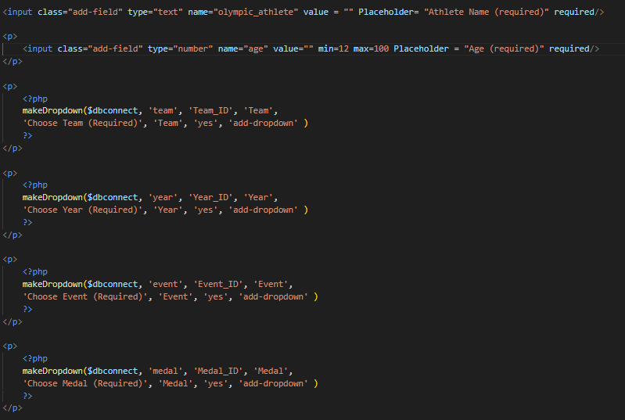
Entry Form (basic validation) Continued
This screenshot shows some of the ways that I was able to validate the entry form. The keywords that took action towards validating the entry form are underlined in red. The ‘required’ that’s underlined is a property of the text and number input that makes it a required input. The ‘min=12 max=100’ is used to only allow numbers in the range of 12-100. The ‘makeDropdown’ code turns the input into a dropdown, limiting the dropdowns to only valid inputs. Finally, the ‘yes’, is the method of making an input required for a dropdown input.
Notes:
Provide evidence of basic data validation on this slide. If you have quite a bit of basic validation, use multiple slides / provide video evidence. If you are going to use php validation later on, you might choose to remove this slide or show one or two examples and then explain why you prefer an alternate approach.

Slide 25
Add Entry Success
After completing the entry form, I need to confirm that users can successfully add data points into the database through my website. For an entry to be considered successful, there are a few indicators that will help me. For one, when an entry is successfully entered into the database, a result div will show up with the information that the user just entered. This is one of the ways that I and the user can tell if their entry was successful. Another check that both I and the user can perform is by searching for the name of the olympian that was just entered using the quick search function. If a results div with accurate information is displayed, the user will know their entry was successful. A final way that only I can confirm that the entry was successful is by checking the PHPMyAdmin database tables. If there are new entries in both the olympic_athletes and names tables and they correspond to the entry, I can confirm that the entry was successfully entered.
Here is a screen recording for proof that I can successfully add an entry:
https://drive.google.com/file/d/1z8vOV_a_BGldYbciaa8Znj6fuI6ryn8z/view?usp=sharing
Notes:
Show that users can successfully add items to the database via the web page. If you started with a basic ‘success’ page and then created an improved version, you should show BOTH versions (ie: provide evidence of iterative improvement).

Slide 26
Add Entry Implications
Usability and Functionality: While creating the Add Entry form I had to ensure that I addressed the relevant usability and functionality implications. To address these, I took into consideration the amount of information that the user had to enter. If there was too many input boxes, the user may dislike having to put in a lot of information and may find it easier to insert less information. Additionally to improve functionality, I helped the users avoid errors by applying certain requirements or features to inputs to validate them. For example, for every input, I made it a required entry in order for the entry to go through. This made it so that the user couldn’t submit an incomplete entry. Another way I validated the inputs was by creating the age input as just an integer input with a minimum and maximum entry. These features, combined with some other validation techniques, allowed me to improve the usability and functionality of my Add entry form.

Slide 27
PHP Validation
As a method of PHP validation I used a common sql function: Mysqli_real_esacpe_string. The purpose of this function is to ensure that no malicious code is inputted into my website, leading to possible disruption of the website. For example, an input containing <script></script> would result in a null search entry and remove any chance of the script making any changes to the website.
Here is a video that proves the functionality of the aforementioned function:
https://drive.google.com/file/d/1CF92yykMDgXFLk6_4mBXVC-jEtWzBGgY/view?usp=sharing
The heading at the top confirms that the search query was turned into a null search query and not processed by the website.
Here is another video which shows how the search function would usually return a search query:
https://drive.google.com/file/d/1CF92yykMDgXFLk6_4mBXVC-jEtWzBGgY/view?usp=sharing
Notes:
If you have used PHP to validate user input, please provide evidence of this. Your evidence should include test plans and then screenshot. Testing that is systematic and comprehensive help justify higher grades.
Your evidence can be in the form of screenshots or video evidence. Note that annotating your screenshots can make it easy for your teacher to mark your work.
If you are going for M / E, please provide evidence of testing relevant boundary and unexpected cases.

Slide 28
Relevant Implications: Usability
Usability is the ease with which a user can interact with and navigate through my website and its data. This is an important implication to consider, as it determines whether the user will want to engage with the website and be able to successfully use all of the functions. To have adequately address this implication, I needed to have created an outcome that was efficient and easy to use. There were quite a few things I did to improve the usability of this website, for example, during the refinement of my results, I thought it may help the user if they were able to easily tell which medal a particular athlete got. To do this I changed the colour of the results box to correlate to the colour of the medal that the athlete was awarded. I felt that this way the user could easily absorb the information without having to read too much information. Another way I addressed the usability was by making sure that the entry form didn’t have too many input boxes, as I knew that the more input boxes that my entry form had, the more likely the user was to make errors and lose interest in the website. Taking into account the examples I listed above and other improvements I made I would say that I successfully address the relevant implications surrounding usability. Overall, I would consider my website a very easy to use and efficient outcome.
Notes:
You might wish to use this slide to explain how you have addressed the relevant implications if you have not done so in previous slides.

Slide 29
Relevant Implications: Functionality
Functionality is an important implication to consider. Functionality pertains to how well your website functions and whether or not it fulfills its purpose. To try and address this relevant implication, I made various changes through my website and database. For one, I validated all of the add entry inputs and php search input. To validate all of the add entry inputs, I took precautions such as making all of the inputs required to submit the entry form, giving age an integer only input and giving team, year, event and medal dropdown inputs, as they only had limited valid options. As for the search queries, a simple string was able to nullify any attempts of malicious attacks using <script></script> inputs and proof was shown of this functionality feature. This string used was $mysqli_real_escape_string. All of the edits to the add entry form helped to ensure that no invalid information was submitted, that could either disrupt the database or display unrealistic results. The anti script string was also useful in retaining functionality of the website, as there was now no risk of it being disrupted by a user. One more way that I improved functionality of my website was by testing my sql statements in PHPMyAdmin before plugging them into the website. This did well in ensuring that the SQL queries would be functional and yield the desired results. Overall, these changes to my website and database were beneficial to the functionality of it and lead to what I would consider a functional outcome.
Notes:
You might wish to use this slide to explain how you have addressed the relevant implications if you have not done so in previous slides.

Slide 30
Relevant Implications: Aesthetics
Aesthetics of a website is important to consider. The relevant implication of aesthetics refers to whether the design, colour scheme, font etc. looks appealing to the user. To address this relevant implication, I thought it were important to create a colour scheme that was both relevant to the information on my outcome and appealing to the user. To do this, I used a gold, silver, bronze colour scheme for my results boxes, each colour corresponding to the medal that an athlete was awarded. This was accompanied by a thick border around the box, to give the sort of feel that the box itself was like a medal. I feel this small touch up does well to liven up the website a little bit, while also being a helpful tool for the user to show clearly what medal an athlete won. Another improvement I made upon aesthetics was lightening up the colours of the results div. To make sure that the viewer could both read the content inside each results box and that the results box was appealing to look at, I lightened the background colour of each of them, to make them easier on the eyes. I feel that this does well to slightly tone down any bright or ugly colouring and present a more aesthetic, mellow feeling. By improving the outcome in the ways listed above I feel I have adequately considered and improved upon the relevant implications regarding aesthetics. Overall I would say that my website has an aesthetically pleasing layout and colour scheme that the user would find pleasant.
Notes:
You might wish to use this slide to explain how you have addressed the relevant implications if you have not done so in previous slides.

Slide 31
Relevant Implications: Accessibility
Accessibility is the element of how well my website pertains to those with disabilities and/or impairments that may limit their ability to engage with my out come. This was important to address, as I wanted all potential users to have no trouble accessing my website and engaging with it without much trouble. First of all, to combat this issue, I made sure to consider those with vision impairments or dyslexia who may want to access my website. To help them easily navigate my website, I made sure that the font was big enough and contrasted enough with the background to be readable. I did this by by asking my visually impaired dad whether or not he could read the text on my website with its current font size and background colour. He told me he felt the background colour of the results boxes were too dark and that I should make them lighter. After doing so he told me that he had no trouble reading the font in regards to the font size and therefore I made no changes in the regard. Additionally, for the most part, I tried to keep the copywriting on the website to a minimum and keep the paragraphs in small sizes to try and prevent ] those with trouble focusing or visual impairments from getting disinterested or struggling to read to information. Overall, I feel these changes improved the accessibility element of my outcome and has provided me with an outcome accessible to most.
Notes:
You might wish to use this slide to explain how you have addressed the relevant implications if you have not done so in previous slides.

Slide 32
Conclusion
Overall I feel I have achieved my goal with this website, which was to use it as a medium to present my database of female olympic athletes. I used an iterative process, whilst considering several relevant implications and usability testing to create an outcome that could sufficiently present my data. I have taken into account usability, functionality, aesthetics and accessibility and improved upon them between iterations. My planning, testing and validation allowed me to easily create this outcome and show my processes that took my to my end point. In conclusion, this was a successful outcome that provided its purpose effectively.

