Slide 1
91892 Databases - Jamie Spicer
Please add links to your work on this slide. Then remove this instruction. Note that most of the instructions have been supplied as speaker notes for later reference :)
Working outcome: <https://php.mmc.school.nz/201COS/jamiespicer/91892_jamiespicer/jamiespicer_database_site/ >
Notes:
Please add links to your work on this slide

Slide 2
Topic
For my topic I decided to go for an olympics themed database, as it is a subject I am interested in and would provide data that would work in my database
The data I will be using for my database is sourced from the 201COS potential datasets and is the “Olympic Athletes” database.
I sorted the data in excel spreadsheets into separate tables with assigned IDs.

Slide 3
Implications relevant to the dataset selection:
One implication relevant to the dataset selection was the ethical considerations. An ethical dataset should not offend anyone, cause any backlash, promote something dangerous or illegal and it should not be inappropriate. I addressed this implication by choosing the Olympics dataset. The olympics dataset is not promoting anything illegal, dangerous or inappropriate therefore it is able to address this implication well. By addressing the ethical considerations it makes the dataset safe for people of all ages to be able to use my database. Overall I think the Olympics dataset was a safe choice relating to this implication.

Slide 4
Implications relevant to the dataset selection:
Another implication that is relevant to the dataset selection is intellectual property obligations. This implication relates to issues such as stolen data, copyright and other intellectual property related issues that could be sprung from a bad dataset. To address this this issue I selected the Olympics dataset. The reason I know this dataset was a good option to address this implication that could lead to potential issues if not sorted, was because the olympics dataset was in the potential datasets resource folder we were supplied with for this assessment. Due to the olympics dataset being from this folder the dataset will have been approved for use by students as a fully legal and free to use dataset that will cause no negative outcomes.

Slide 5
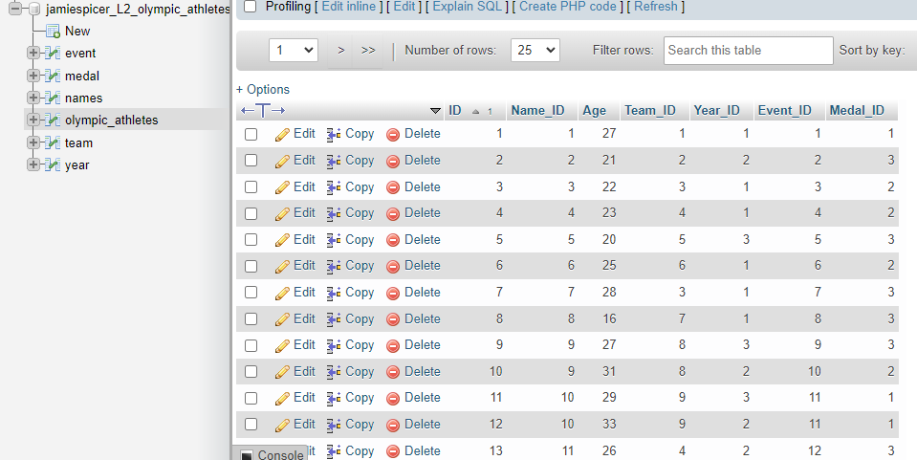
My database tables:
Here is the olympic_athletes main table with the list of other tables pictured beside it.

Slide 6
My database tables:
My database consists of seven tables that store the data on them. The “event” table stores the list of events an athlete may be apart of along with its ID, the “medal” table stores the medals an athlete may have won and an ID representing it, the names table which stores the athletes names and name ID, The olympic athletes “master table” which links everything together from the smaller tables, the teams table which stores the teams an athlete may be from and its ID and finally the year table which holds the years the olympics were on and the IDs for each year.

Slide 7
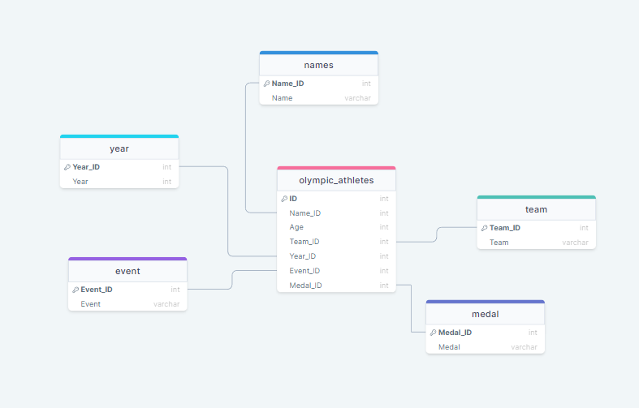
My database tables:

Slide 8
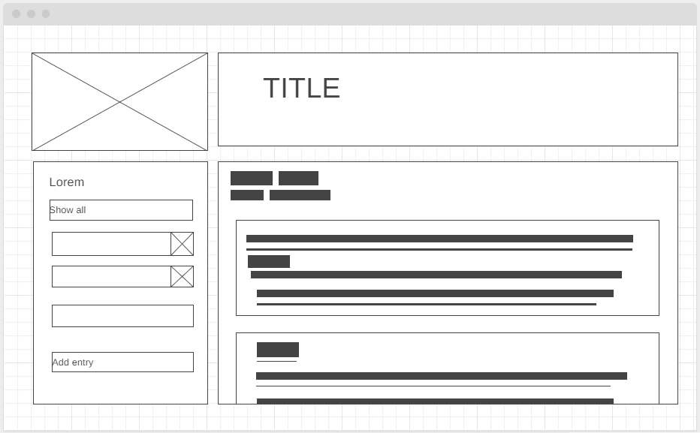
Database website Design:
Here’s a simple database design I made a wireframe on. The main points I considered were user friendliness through simplicity, aesthetic appeal along with the important functionality. I think this basic design includes all of those key points.
Notes:
Place your database design on this slide

Slide 9
Relevant implication to Database Design:
Usability: I believe my straightforward and simplistic layout is also able to provide the ease of use, addressing the usability implication. The layout, including a sidebar which has all the functions a user makes the site very easy to navigate along with being easy to learn. Overall I think this layout keeps the site very easy to use and has a predictable layout, decreasing the users confusion.
Aesthetics: I addressed the implication of aesthetics through the layout of my databases design. The square edges of the panels and boxes provide a modern twist to a simplistic yet functional website. The square edges make it clear where each section ends, keeping the site tidy and easy on the eyes to look at. The image in the top left keeps the site interesting and aesthetically pleasing to look at while not interfering with the rest of the website aesthetics.

Slide 10

Colouring
To match the theme of “olympic athletes” I will try to use a color scheme which resonates with that database choice while being aesthetically pleasing.
I think it would be fitting to the theme to select a colour palette that matches the olympic logo pictured on the left.
Potentially I could use this for the websites top left image. It is sourced from pixabay so it is a non copyright image.

Slide 11
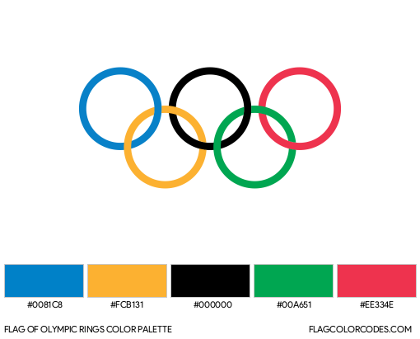
Potential colour palettes:
A combination of these colours would be fitting to the olympic databases website
I think I will use the main colours, red, green and blue for the background colouring and use black as the font colour.

Slide 12
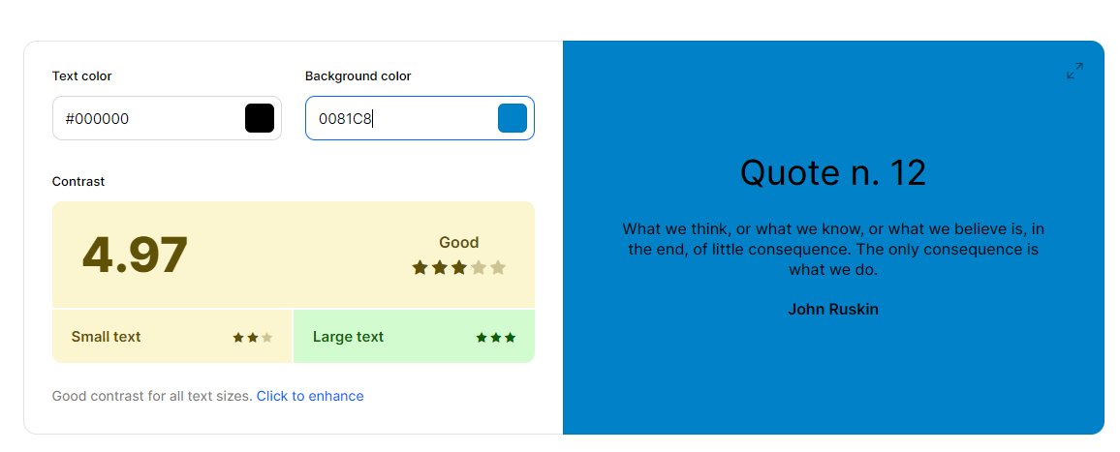
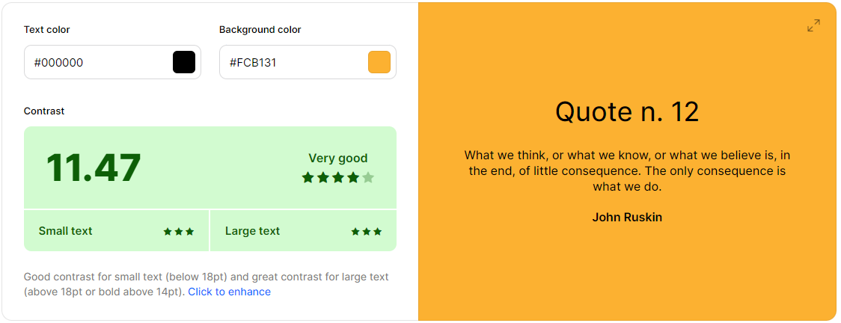
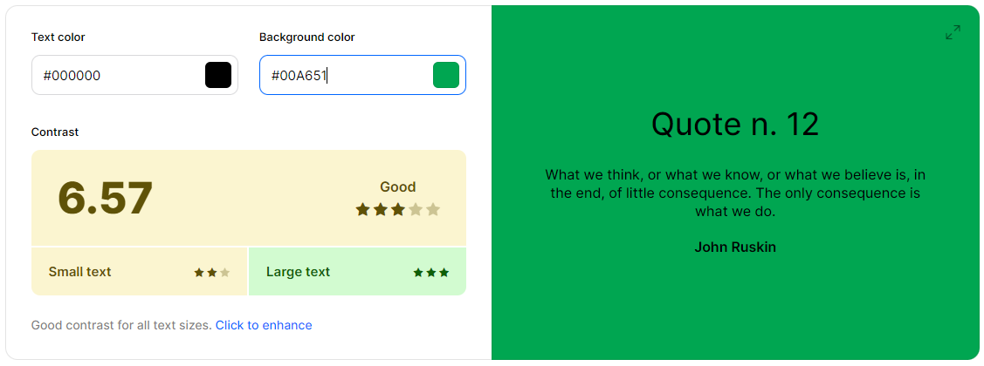
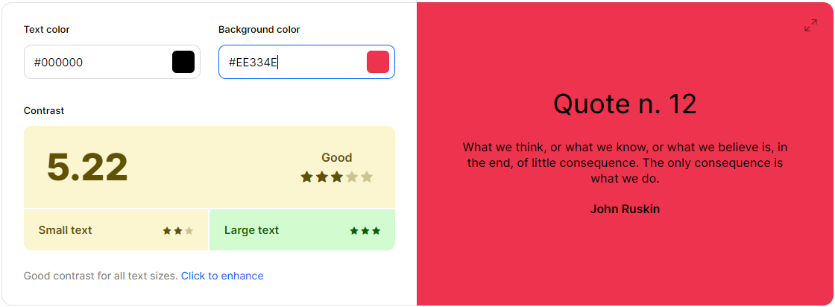
Font/background colouring:
Just testing the colour contrast of the exact colours of the rings included in the olympics logo I found the contrast to be decently ok, averaging a rating of ⅗ stars according to the website: https://coolors.co/contrast-checker/000000-ee334e

Slide 13
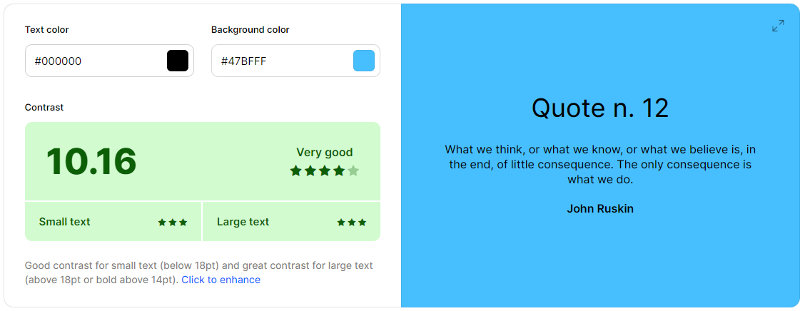
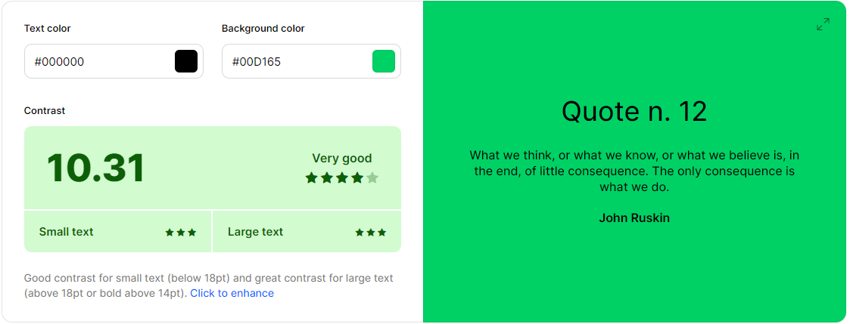
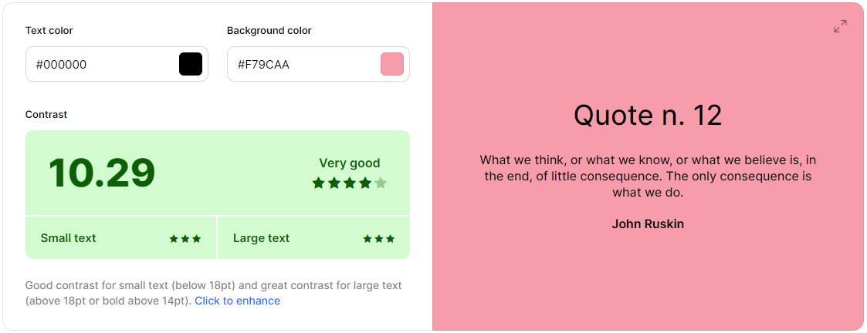
Font/background colouring:
To increase this rating to increase the contrast ratio it was pretty easy, all I needed to do was to make the colours lighter. I will implement these colours later when I have a first iteration to start styling the database.
(the yellow background already had a good contrast ratio so no changes were made to it)

Slide 14
Font/background colouring:
After lightening the colours for use as backgrounds to increase contrast for better user friendliness, I decided to select blue and green as the main colours to use for the background colour(along with white). This was because the blue and the green provided enough contrast to allow the black text to be seen easily while still being aesthetically pleasing to look at and fitting to the olympic theme.
I decided that the lightened red was not very nice of a colour to look at so I would not use it as a background colour. I will consider using the darker original red and the yellow that didn’t need to be changed as accent colours, potentially for borders, headers and other small details to increase the aesthetic appeal of the website while fitting the olympic theme.

Slide 15
Relevant implications(colour choice):
Accessibility: I addressed the implication of accessibility appropriately through the colour choice. The implication of accessibility relates the ease of reading thanks to contrast and other factors which relate to the colour choice. This implication was addressed by selecting colours with high contrast for the font and the background colour. This ensures the website is easier to read for users who may have a vision impairment or another disability, thus increasing user friendliness through my colour choices.
Aesthetics: I addressed the relevant implication of the aesthetics of my database through selecting colours that went well with the theme of the site while not being hideous to look at. I did this by choosing two colours which are known to compliment each other, blue and green, as the main colours for my database website. It is also relevant that these colours are featured in the olympics logo, fitting the theme of my database

Slide 16
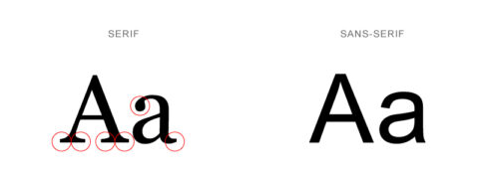
Font choice:
For ease of reading, it is important to choose a font which makes it easy for the end user to read.
I knew before even considering the font choice that I will choose a sans-serif font for the sake of easy reading along with a cleaner finish aesthetically and less complex lettering to help with accessibility:

Slide 17
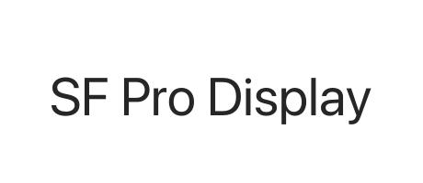
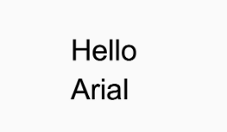
Font choice
After searching online for a tidy and modern sans-serif font I settled on two final choices:
SF Pro, The font used by apple, a sans serif font with a modern design. It’s a simplistic font with basic lettering which are easy to read.
Arial, Another sans serif font which is among one of the most commonly used fonts across the internet. This font is familiar for many with its basic and modern design

Slide 18
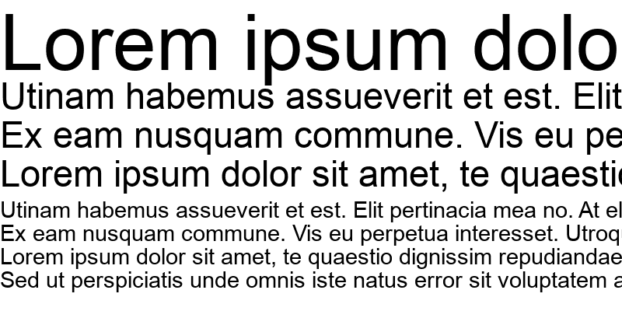
Font choice
After a couple of considerations I decided to select Arial as the font to use for my databases site. I think it was a better choice because it is used widely across more platforms than SF Pro is used on. I think it's simple design along with familiarity will add to the overall familiarity of my website while increasing the accessibility by being an easy font to read for the end users.
Example of arial font in use, showing how easy it is to read at different sizes

Slide 19
Relevant implications(font choice):
Accessibility: Through my font choice selection of Arial I was able to address the relevant implication of accessibility appropriately. To increase accessibility a font needs to be, simple, easy to read and have simplistic letterforms. I selected Arial to address this as it is a very straightforward font, it being a sans serif font it doesn’t have flares on the end of the letters that may overcomplicate the letter, helping with ease of reading thus increasing accessibility for those who may have a vision impairment or another disability.
Aesthetics: A font needs to be modern, tidy and meet the theme of the site in order to address the aesthetics implication in terms of the font choice. By selecting Arial, a basic, contemporary font I was able to achieve this. Arial being a sans serif font adds a modern flare to my database site. It fits the theme of olympics not taking away from the idea or adding to the idea therefore I believe it is a suitable choice of font to address this implication

Slide 20
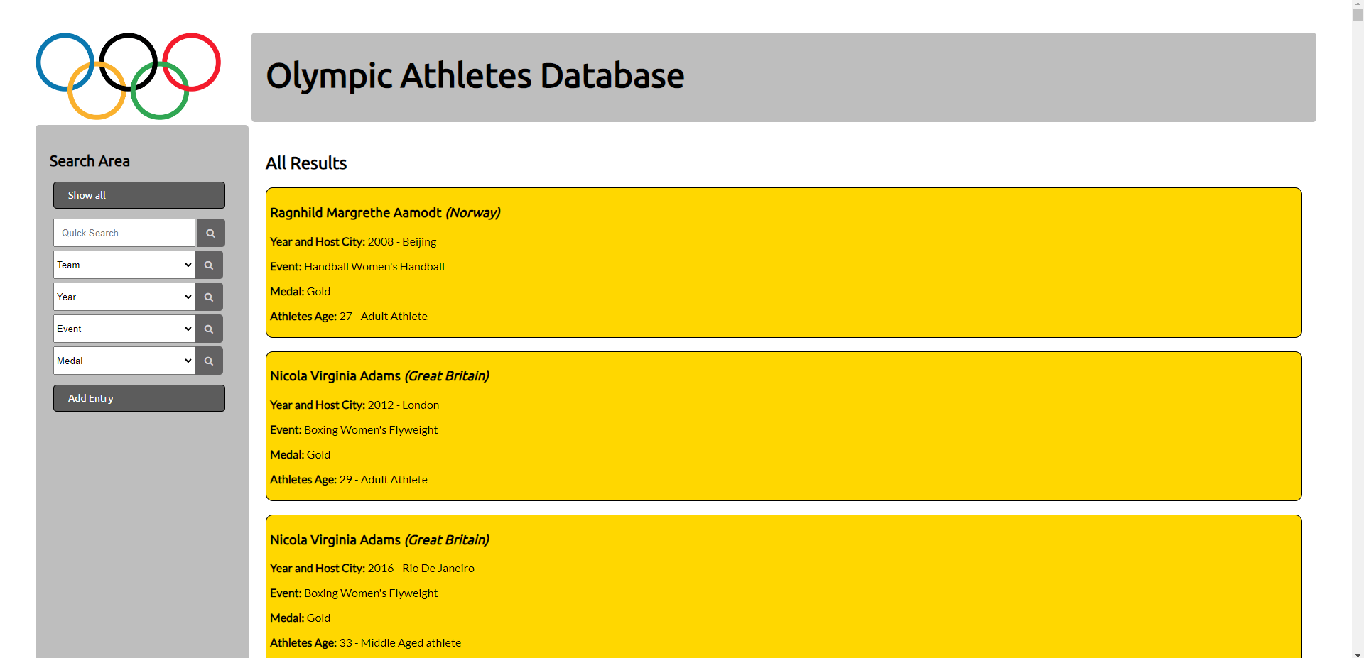
Results (First Iteration)
Here is the initial iteration of my database. It maintains functionality but feels a bit ugly and is slightly difficult to read.
Notes:
Place a screenshot showing that entries in your database can be seen via your website (eg: provide a screenshot of a basic ‘show all’ page)

Slide 21
Query testing:
I tested the queries from my sql on the php database input. All the queries were free of error, returning the desired and correct values when testing inside of the input function on php my admin with the sql I wrote

Slide 22
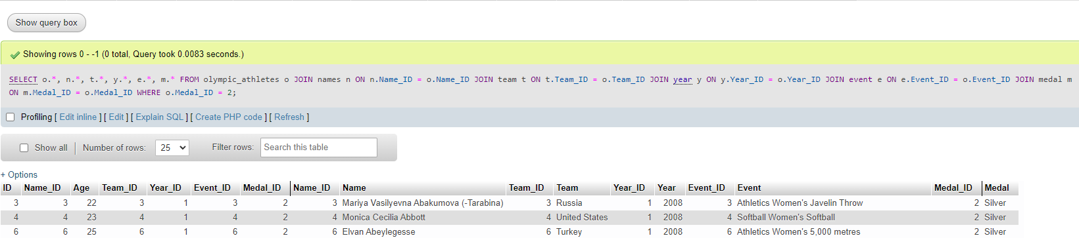
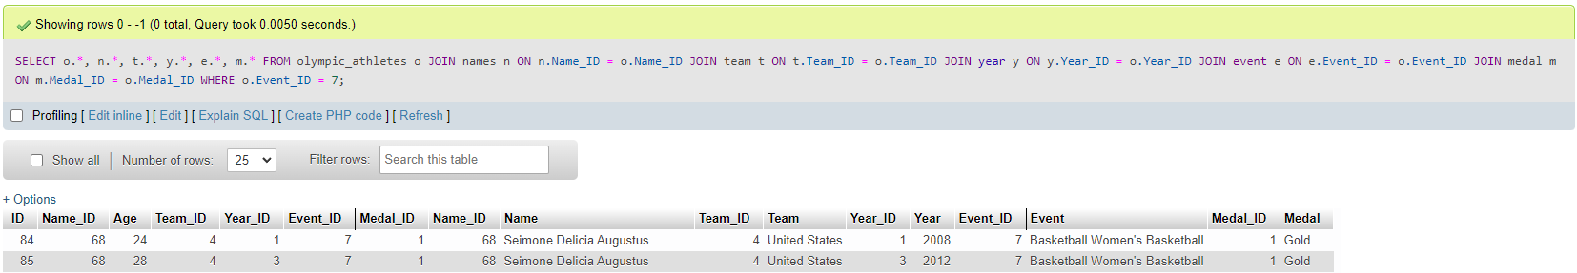
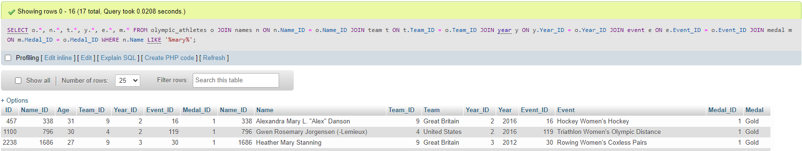
Successful Query testing

Slide 23
Results Refinements
Notes:
Outline how you can refine / improve your results (for M / E). Then include extra slides showing that you have implemented the refinements.

Slide 24
User Testing:
I allowed my parents to test my site, allowing them to input fictional olympic athletes to test my websites functionality and user experience. After a few minutes my parents were able to learn how to carry out all functions on my website on their own. I asked them if they were able to read the information featured on the website. My Dad who has a slight vision impairment, requiring him to wear glasses during any time he was reading suggested that the colours representing the medals should be lightened up to increase contrast to help make the site easier to read.

Slide 25
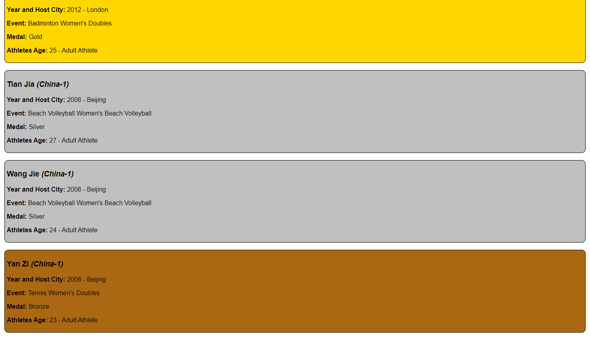
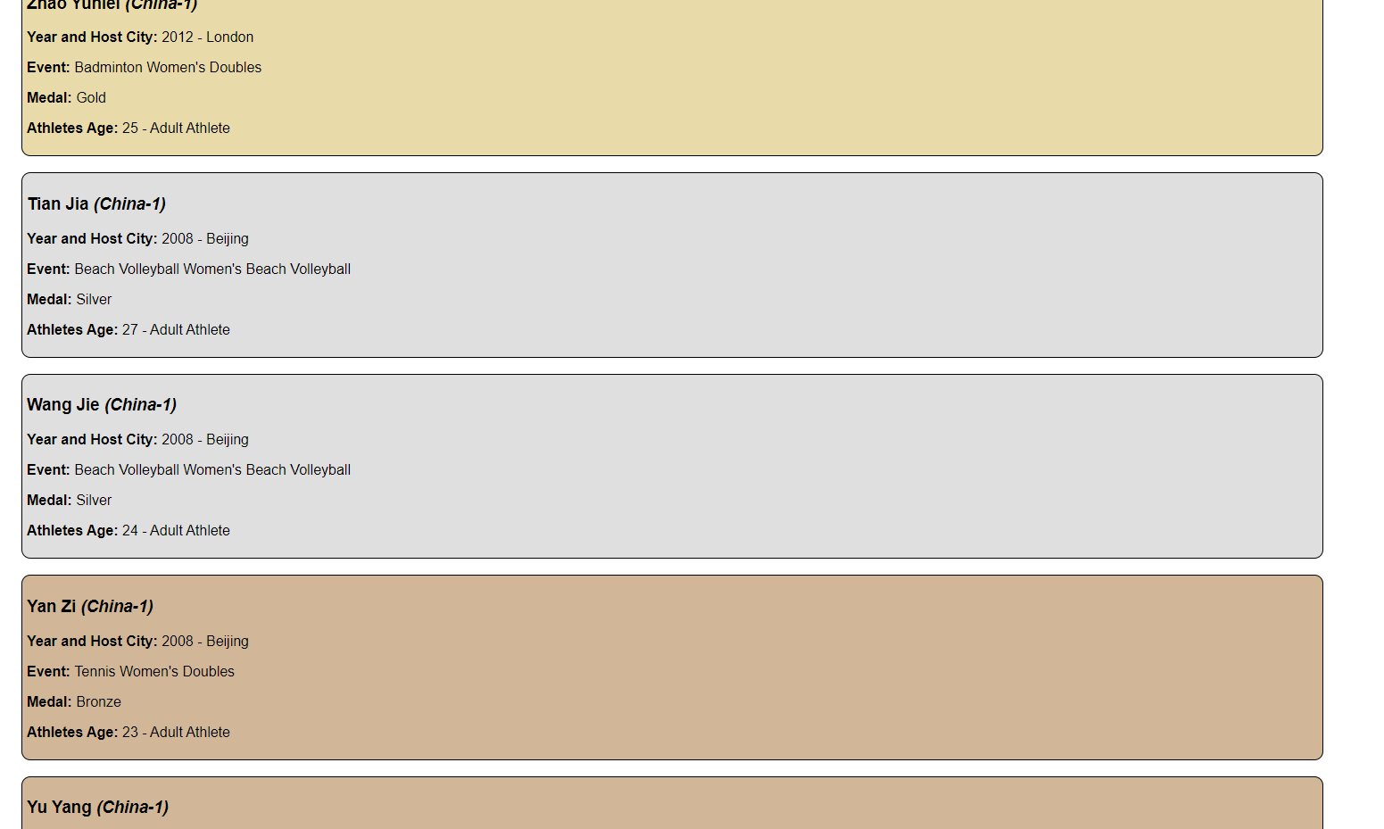
Change from user feedback:
I decreased the brightness of the medal representing colours. This made it easier to read thanks to the increase of the contrast. This increases the accessibility of my website.

Slide 26
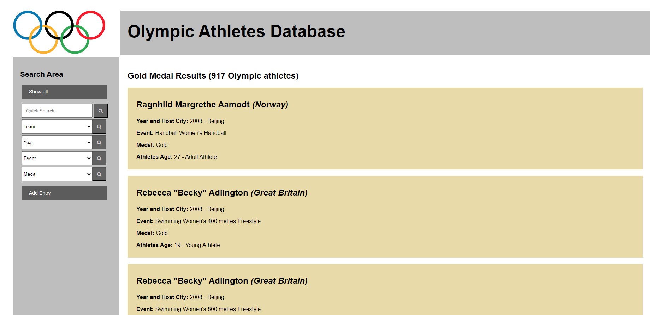
Border radius
To achieve a more modern feel to the site I deleted the border radii on the boxes on the site.
Before vs after. I feel the changing of this helped to give the website a more contemporary look adding to the aesthetic appeal of the website overall.

Slide 27


Font change:
I had not been using the Arial that I had originally stated to use as a font:
This was a simple fix by changing the font in the css:

Slide 28
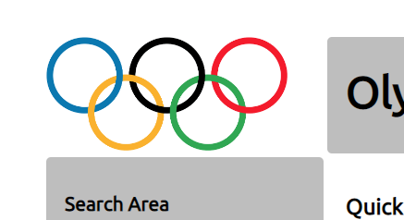
Image in the top left corner:
I used a free image from pixabay to ensure there will be no copyright rules are broken. I used a JPG to lower the size of the image to speed up the process of loading in the website.

Slide 29
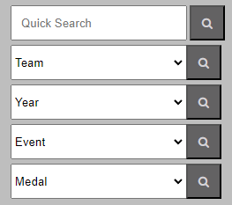
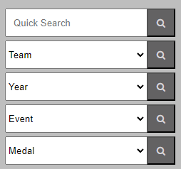
Sidebar fix
The sidebar quick search button was not fully aligned with the search bar. This makes the site look more untidy. This was a simple fix which Improved the look of my website greatly. All I did was give it its own class separate to the other buttons and make its margin smaller which aligned it correctly.
Before After

Slide 30


Colouring changes:
I implemented the green I got from the colour pallete that I increased the contrast on with black text that I created at the start:
I decided that this doesn’t actually look as good as I initially thought it would so I decided to change it to this green instead.

Slide 31
Colouring changes:
I think even though going to the slightly darker green would have a tiny impact on the contrast it still is worth it since it is only on the header which is large text and already extremely easy to read. I think the way it makes up aesthetically for the website makes it worth it to make that change.
To see if it did actually had a major impact on the accessibility of my website, I asked my dad who has some difficulty with reading text, to see if he was able to read the large header with the lighter green and then with the slightly darker green. I asked if he saw a major difference between the two shades and he said there really was not a noticeable difference that impacted him so I decided to go with the darker green. I think doing this was suitable as the aesthetics definitely were improved from this choice and from user feedback I also found there was not a significant difference in accessibility according to the tester.

Slide 32
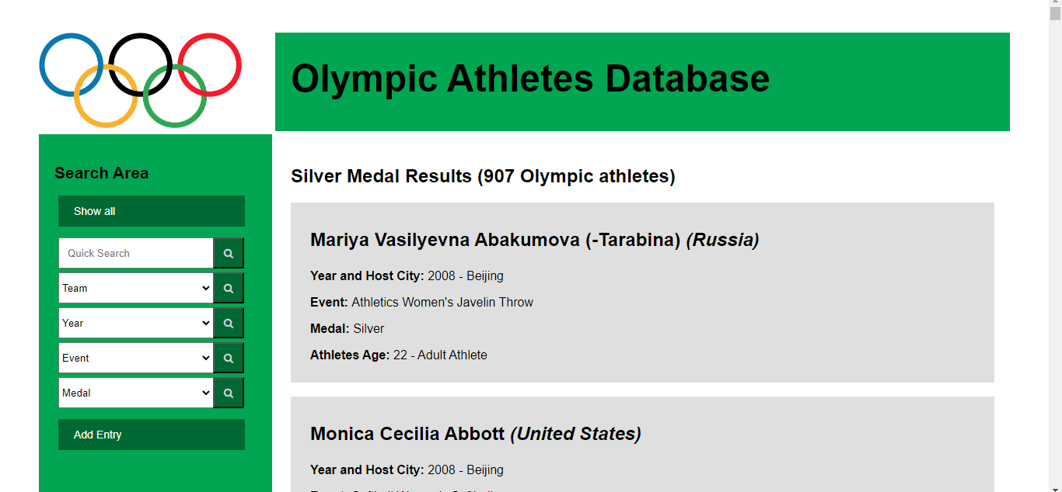
Colouring changes:

Slide 33
Colouring changes:
I decided not to implement the remainder of the colours I had originally decided to opt for in the olympics colour pallet. I made this decision based on the fact that I didn’t feel that adding another colour to the mix would add to the aesthetics of this site, but would rather take away from it making the sight overall more ugly.
Also to match the green I used a slightly darker shade on the buttons to make them stand out but not be too “out there” to take away from the sleek and modern design of the databases website. I think this was a necessary touch to making the green background on the sidebar and the header look properly integrated with the website.

Slide 34
Basic/Advanced Search Test Plan (and Evidence):
I plan to have a text input panel where the user can search by olympian by typing directly into the input bar. I also plan to have assorted dropdown menus beneath the text input. I think I will opt to have a Team dropdown followed by a Year dropdown with a Events dropdown and at the bottom a Medals dropdown. These dropdowns will allow the user to select the item featured on the tables represented by the selected item and search by that. Beside each search dropdown and input will be a magnifying glass, a universal symbol for searching to help with usability and accessibility.
To confirm the basic search works with the text input and the advanced search works correctly with the dropdown menus, I will test to see if each search part carries out its supposed function by entering an input and searching.
Notes:
Provide test plans that will allow you to confirm that your basic search works. These should be followed with screenshot / video proof of a working search feature. Use as many slides as necessary for this.

Slide 35
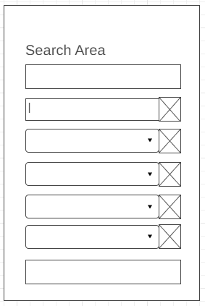
Basic/Advanced Search wireframe:
Here is the search system featuring the dropdowns along with the text input feature. I think this simple layout will be great as it is very straightforward helping with usability and accessibility while also being complex enough to allow the user to search a variety of fields to find specific information.

Slide 36
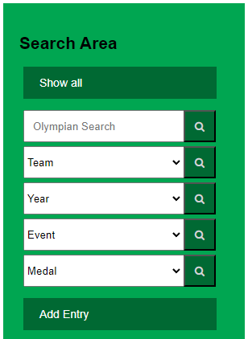
Basic/Advanced Search added to site:
I think that the search part of the sidebar turned out very nice to look at, being a perfect balance of usability and aesthetics.
This is enough options to help the user search a variety of fields allowing them to navigate through the information with ease

Slide 37

Basic/Advanced Search testing:
Link to video of testing the search: https://youtu.be/DYTwtNU--MA
All functions I had stated I was going to add in my search system were added and are all functional proving success.
Also to add to the usability I included a function that tells the user to add something to the field when they submit nothing. This adds to the overall user experience.

Slide 38
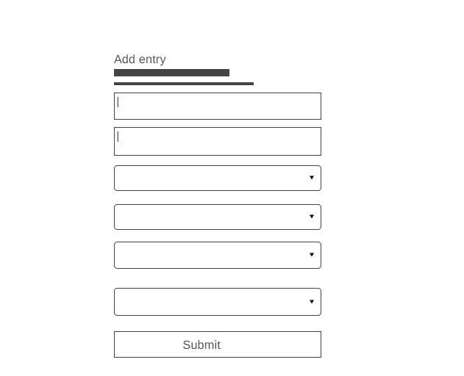
Add An Entry - Planning
Here's a simple wireframe displaying what my input form is likely going to look like on my website. It features text/number inputs along with dropdown menus where required.
Notes:
Use this slide to show what your ‘add’ entry form might look like. If you have a hand-drawn sketch, either give it to your teacher or scan / photograph it and put the resulting image on this slide.

Slide 39
Entry Form (basic validation)
I included ensured the user was unable to submit an empty input to the search bar and the input form. This ensured no empty data would be added to the table and the user would be alerted of any empty required fields, increasing the overall usability and user friendliness of the website.
Video of me testing this validation functionality: https://youtu.be/tSLmWQV3CuQ
Picture of code showing the limits of the age boundaries of 0-100 and part of the code that adds required field pictured below:
Upper and lower limits
This part makes this field required
Notes:
Provide evidence of basic data validation on this slide. If you have quite a bit of basic validation, use multiple slides / provide video evidence. If you are going to use php validation later on, you might choose to remove this slide or show one or two examples and then explain why you prefer an alternate approach.

Slide 40
Add Entry Success
To see if my advanced entry form worked and added data to the table I used a row of the test column to test adding into the database. I needed to see if it was able to be inputted and stored on the table along with being able to be found when searching after adding it.
Here is a video of me successfully adding test data to my database and it being able to be found during searching: https://www.youtube.com/watch?v=Ljg2wgU4iXE
The test data entry was successful, proving functionality of my entry form and it being able to found after being added showing further success.
Notes:
Show that users can successfully add items to the database via the web page. If you started with a basic ‘success’ page and then created an improved version, you should show BOTH versions (ie: provide evidence of iterative improvement).

Slide 41
Add Entry relevant implications:
One implication relevant to my add entry is the usability. Usability takes into consideration how easy the program is to use, how easy it is to use and how easy it is to learn. To address this I made my add entry form very easy to learn, having a list of required fields for the user to go through and fill. To also help with usability I included coding to make the fields give a notification that says “Required, please fill in this field” to help users know where to look when they accidentally miss a field.
Another implication relevant to the entry form is the functionality. A functional program carries out each function it was intended to do with ease. I ensured this implication was addressed by using the the test data to see if the add entry form worked, which it did, proving the entry form functional.

Slide 42
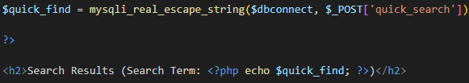
PHP Validation
Also to help validate user inputs I used the built in sql function Mysqli_real_escape_string to ensure no malicious scripts could be put into any of the inputs/searches. It also validated that the input to the search along with input for to make sure it was appropriate to the site and to fix issues regarding characters:
Link to video of me testing the Mysqli_real_escape_string functionality by putting in a script, it detecting it and not allowing it to enter the search bar: https://youtu.be/UEZrLFWbrjA
Pictured below is an example of one use of the Mysqli_real_escape_string function which I used for validating the users input into the search bar:

Slide 43
Relevant implications: Aesthetics
Aesthetics is a very important implication to consider with the development of any user interface that may be created whether that is a website, an input form or any other form of media. Aesthetics mainly refers to the overall styling of the website along with the correlation between the styling and the theme of the website. Aesthetics can be used to portray the message or add a mood to the website or perhaps even a deeper meaning.
During the development of my database I always kept aesthetics in mind as something important to consider. I addressed this implication through a variety of measures. One measure I carried out was selecting a sans serif font, Arial, as the overall websites font. Thanks to the simplicity of this font it really added to the feel of the databases website while being easy on the eyes, providing a clean and contemporary finish. Another measure I used to address this implication was the

Slide 44
Relevant implications: Aesthetics continued….
use of green background to the header and sidebar. The use of this green was more welcoming than the original cold grey, improving the overall mood and feel of the site while not being overly prevalent in the design. The green also fitted with the olympics theme of the site, fitting with grass, a plant that goes hand in hand with sporting events. The green improved the overall aesthetic appeal of the database. A final thing I did to address this implication was by adding small details to add to the site overall. For example aligning the misaligned search button by changing its margin, lining it up with the rest of the buttons, really added to the overall finish of the site making it look more professional and tidy. Another was the addition of the olympics logo in the top left corner which matched the theme of the site well. Overall I would say this implication was addressed in a manner that improved the overall final outcome of the database and its website.

Slide 45
Relevant Implications: Accessibility
Accessibility is a vital part to consider when developing a user interface or any other type of program. Accessibility helps those who may struggle with a disability that could impact their ease of use on the program, most commonly considered being visual impairments. Accessibility all comes down to the font size, the colouring and even can be affected by the overall layout of the site.
I addressed the important implication of accessibility through a few different approaches. One way I addressed this implication was through the use of the sans serif font Arial. Not only is this font aesthetically pleasing but it also is sans serif which means the lettering is extremely basic making it easier to read, which could lead to improved readability for those with visual impairments, thus increasing the overall accessibility of my databases website. Another way I addressed the accessibility of the site was through the colour selection of the

Slide 46
Relevant Implications: Accessibility Continued…
colour palette of the site. I selected high contrast colourways such as black text on a white background for example. When conflicted between a colour choice of either selecting the darker option that had slightly less contrast or sticking with the uglier lighter and higher contrast option, I asked a visually impaired person for their feedback on both colours which allowed me to make a decision based on their opinion. Overall I would say I am satisfied with how I addressed the implication of accessibility as I went through a number of measures to ensure the database and its website was kept accessible.

Slide 47
Relevant implications: Usability
It is extremely important to consider the implication of usability during the development of a website. Usability relates to the overall functionality of the website along with how easy it is to learn and navigate. It also can relate to how complex the program is. Accessibility really comes down to the overall layout of the website along with the headings and subheadings which help the viewer to learn the site. It also relates to the links which help the user navigate the website.
I addressed the implication of usability through a couple of different ways. One way I addressed the usability was through the inclusion of a sidebar on the left of the screen at all times. This sidebar was always there, no matter which page the user is on or whatever they are trying to input. This makes the program more predictable and easy to navigate thus increasing the overall usability. Another thing I did to help with the usability was the inclusion of titles and labeling of

Slide 48
Relevant implications: Usability continued…
buttons throughout the program. This helps the user to know exactly what they are going to do with the buttons, increasing the ease of use. This makes the program easier to gain an understanding of as it pretty much explains a lot of the functions through this. A final thing I did to increase the usability was through the inclusion of a variety of dropdown menus and the text input bar. The inclusion of many dropdowns allows the user to search through a variety of terms allowing them to find the desired value a lot easier. Overall I would definitely say that I addressed this implication in a way that added to the overall usability of the database website along with improving the overall user experience.

Slide 49
Conclusion
I can conclude that I created a fully functional website with an intuitive design which lets the end user search for specific data pieces and add data to the database. Overall I would say the website considers a number of factors such as accessibility, usability, functionality, aesthetics and legal implications. I would like to say the end result was a balanced database website and database balancing functionality and looks. There are no grammatical or typographical errors too which adds to the sites quality as a whole. I think the overall project was successful in creating a database to represent the olympics athlete database I selected appropriately.

